Slide 1
Year 2 – Spring Block 5 – Length and Height – Measure Length (m)
About This Resource:
This PowerPoint has been designed to support your teaching of this small step. It includes a starter activity and an example of each question from the Varied Fluency and Reasoning and Problem Solving resources also provided in this pack. You can choose to work through all examples provided or a selection of them depending on the needs of your class.
National Curriculum Objectives:
Mathematics Year 2: (2M2) Choose and use appropriate standard units to estimate and measure length/height in any direction (m/cm); mass (kg/g); temperature (°C); capacity (litres/ml) to the nearest appropriate unit using rulers, scales, thermometers and measuring vessels
More Year 2 Length and Height resources.
Did you like this resource? Don’t forget to review it on our website.
© Classroom Secrets Limited 2019

Slide 2
Year 2 – Spring Block 5 – Length and Height
Step 2: Measure Length (m)
© Classroom Secrets Limited 2019

Slide 3
Introduction
Would you use a centimetre ruler to measure your classroom?
Can you think of a bigger unit of measurement for length that would be better?
How many centimetres (cm) are there in 1 metre (m)?
© Classroom Secrets Limited 2019

Slide 4
Introduction
Would you use a centimetre ruler to measure your classroom?
No, this unit of measurement is too small to measure a room.
Can you think of a bigger unit of measurement for length that would be better?
metres - m
How many centimetres (cm) are there in 1 metre (m)?
100cm = 1m
© Classroom Secrets Limited 2019

Slide 5
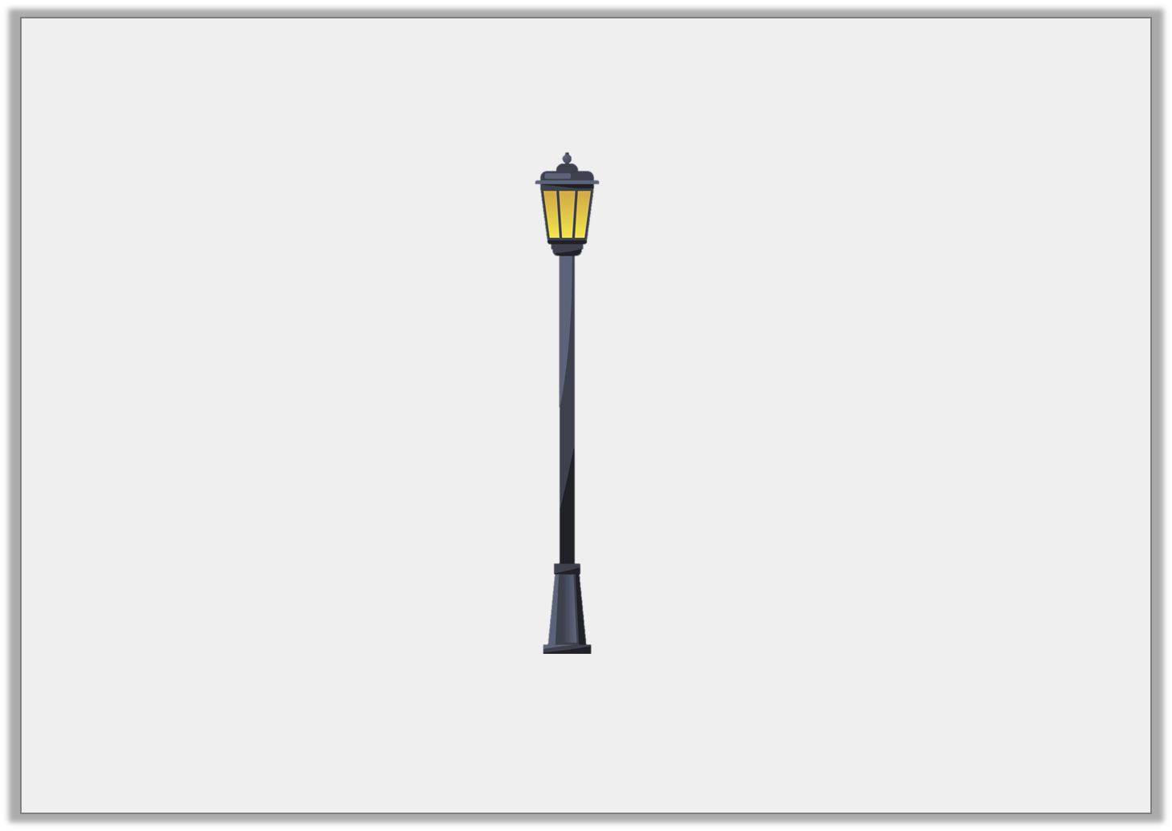
Varied Fluency 1
True or false? This lamppost is less than 1m tall.
2m and 91cm
not to scale
© Classroom Secrets Limited 2019

Slide 6
Varied Fluency 1
True or false? This lamppost is less than 1m tall.
2m and 91cm
False, it is 1m and 91cm taller than 1m.
not to scale
© Classroom Secrets Limited 2019

Slide 7
Varied Fluency 2
Choose the correct word to complete the statement.
The school hall is than 1 metre and 28 centimetres.
longer
shorter
© Classroom Secrets Limited 2019

Slide 8
Varied Fluency 2
Choose the correct word to complete the statement.
The school hall is than 1 metre and 28 centimetres.
longer
longer
shorter
© Classroom Secrets Limited 2019

Slide 9
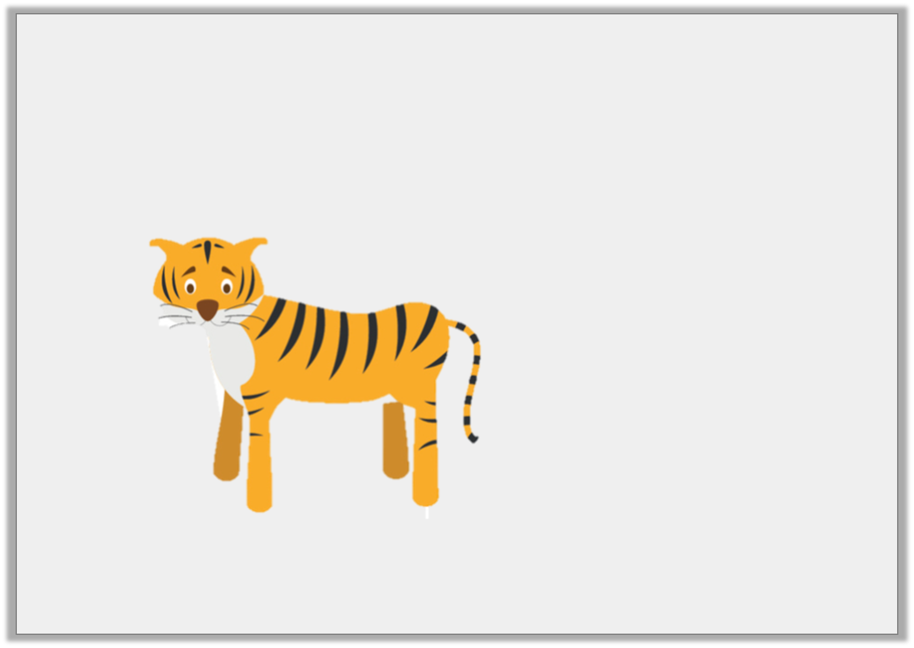
Varied Fluency 3
Circle the measurement that is the best estimate for the height of a tiger.
39cm
5m 14cm
1m 21cm
not to scale
© Classroom Secrets Limited 2019

Slide 10
Varied Fluency 3
Circle the measurement that is the best estimate for the height of a tiger.
39cm
5m 14cm
1m 21cm
not to scale
© Classroom Secrets Limited 2019

Slide 11
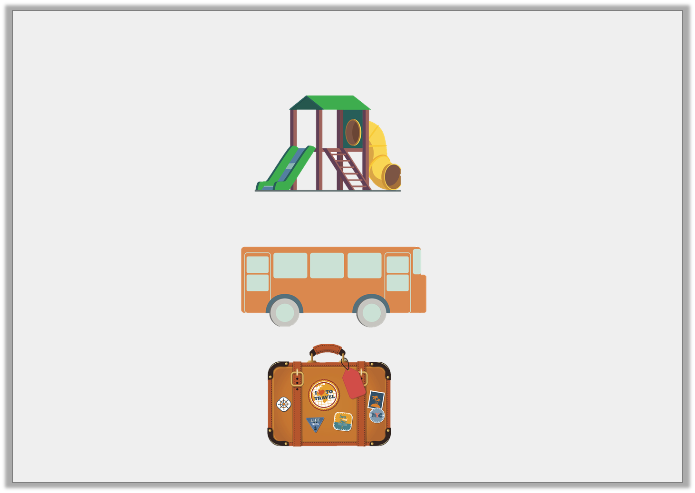
Varied Fluency 4
Match the object to the estimated length.
play house
coach
suitcase
11m
67cm
2m 51cm
not to scale
© Classroom Secrets Limited 2019

Slide 12
Varied Fluency 4
Match the object to the estimated length.
play house
coach
suitcase
11m
67cm
2m 51cm
not to scale
© Classroom Secrets Limited 2019

Slide 13
Problem Solving 1
Use the digit cards to estimate a suitable length for these objects.
truck | 9 | m | and |  |  |  | cm
car |  | m | and |  |  | 0 | cm
3
8
1
5
© Classroom Secrets Limited 2019

Slide 14
Problem Solving 1
Use the digit cards to estimate a suitable length for these objects.
Various possible answers
truck | 9 | m | and | 8 |  | 5 | cm
car | 3 | m | and | 1 |  | 0 | cm
3
8
1
5
© Classroom Secrets Limited 2019

Slide 15
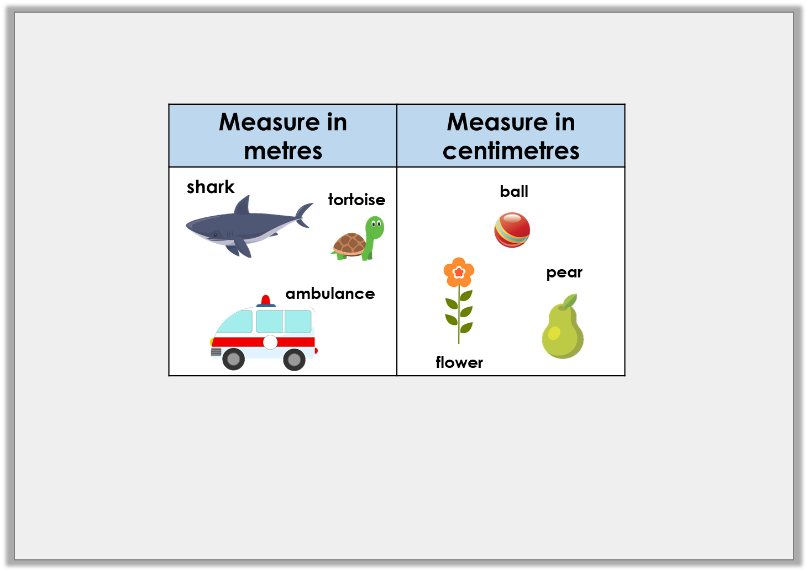
Reasoning 1
Chloe has been sorting objects into the chart below.
Has she sorted them correctly? Explain your answer.
© Classroom Secrets Limited 2019

Slide 16
Reasoning 1
Chloe has been sorting objects into the chart below.
Has she sorted them correctly? Explain your answer.
No, she has not sorted them correctly because...
© Classroom Secrets Limited 2019

Slide 17
Reasoning 1
Chloe has been sorting objects into the chart below.
Has she sorted them correctly? Explain your answer.
No, she has not sorted them correctly because the tortoise should be measured in cm.
© Classroom Secrets Limited 2019

Slide 18
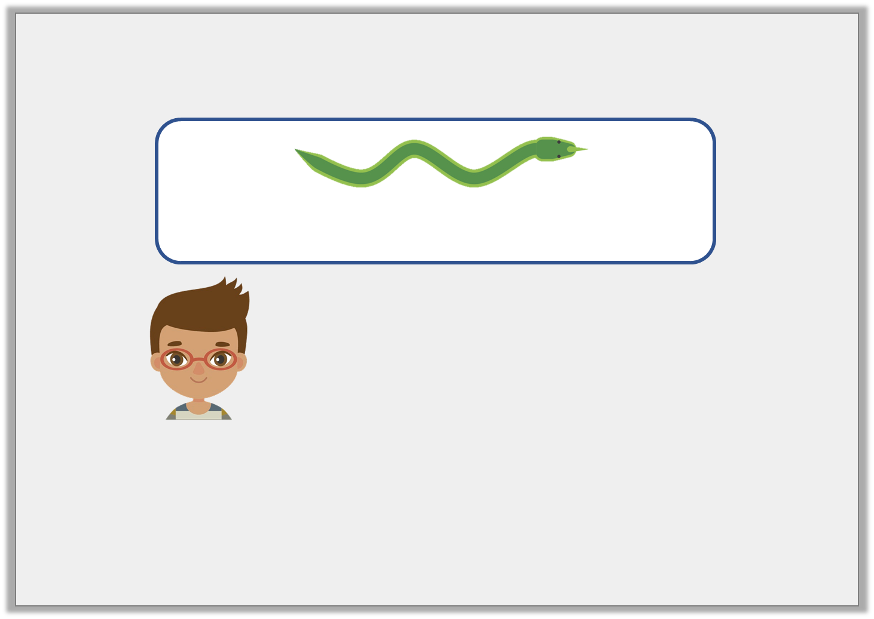
Reasoning 2
Harry is measuring objects. He says,
Is he correct? Explain your answer.
0cm | 50cm | 1m | 1m 50cm
I think the snake is 1m and 55cm.
© Classroom Secrets Limited 2019

Slide 19
Reasoning 2
Harry is measuring objects. He says,
Is he correct? Explain your answer.
No, he is not correct because…
0cm | 50cm | 1m | 1m 50cm
I think the snake is 1m and 55cm.
© Classroom Secrets Limited 2019

Slide 20
Reasoning 2
Harry is measuring objects. He says,
Is he correct? Explain your answer.
No, he is not correct because the snake’s tail should be in line with the 0.
0cm | 50cm | 1m | 1m 50cm
I think the snake is 1m and 55cm.
© Classroom Secrets Limited 2019

