Slide 1
Year 2 – Spring Block 5 – Measurement – Measure Length (cm)
About This Resource:
This PowerPoint has been designed to support your teaching of this small step. It includes a starter activity and an example of each question from the Varied Fluency and Reasoning and Problem Solving resources also provided in this pack. You can choose to work through all examples provided or a selection of them depending on the needs of your class.
National Curriculum Objectives:
Mathematics Year 2: (2M2) Choose and use appropriate standard units to estimate and measure length/height in any direction (m/cm); mass (kg/g); temperature (°C); capacity (litres/ml) to the nearest appropriate unit using rulers, scales, thermometers and measuring vessels
More Year 2 Length and Height resources.
Did you like this resource? Don’t forget to review it on our website.
© Classroom Secrets Limited 2019

Slide 2
Year 2 – Spring Block 5 – Measurement
Step 1: Measure Length
(cm)
© Classroom Secrets Limited 2019

Slide 3
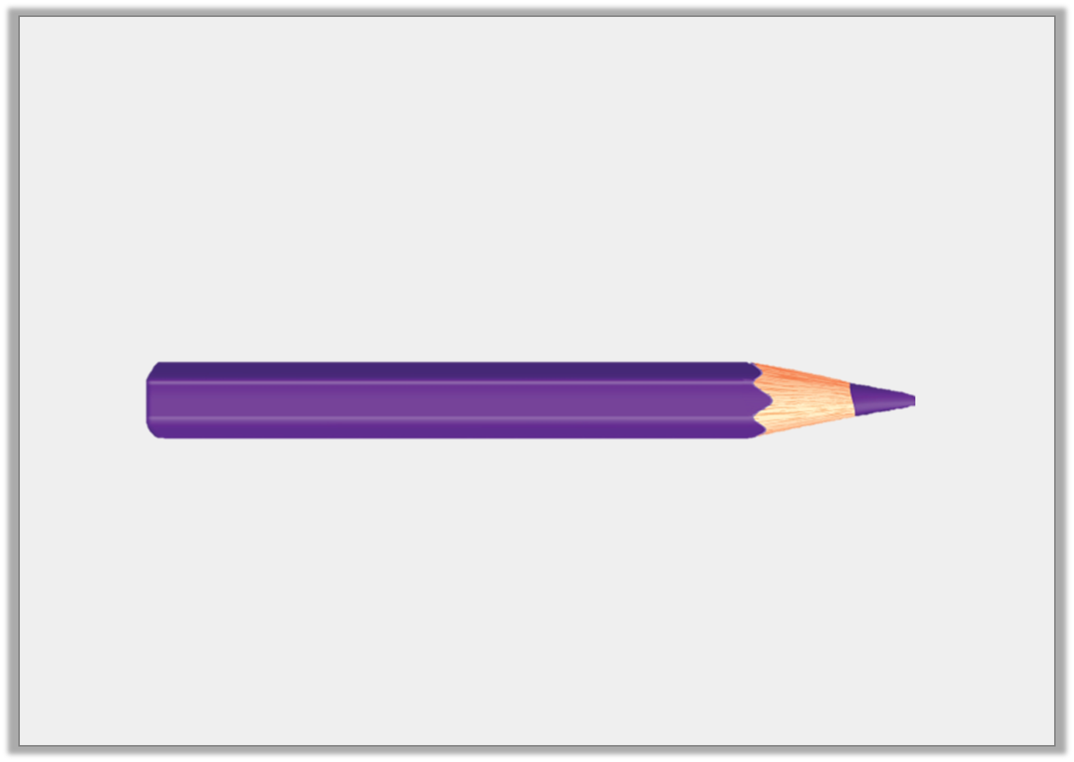
Introduction
What would you use to measure a pencil?
© Classroom Secrets Limited 2019

Slide 4
Introduction
What would you use to measure a pencil?
A ruler or a tape measure.
© Classroom Secrets Limited 2019

Slide 5
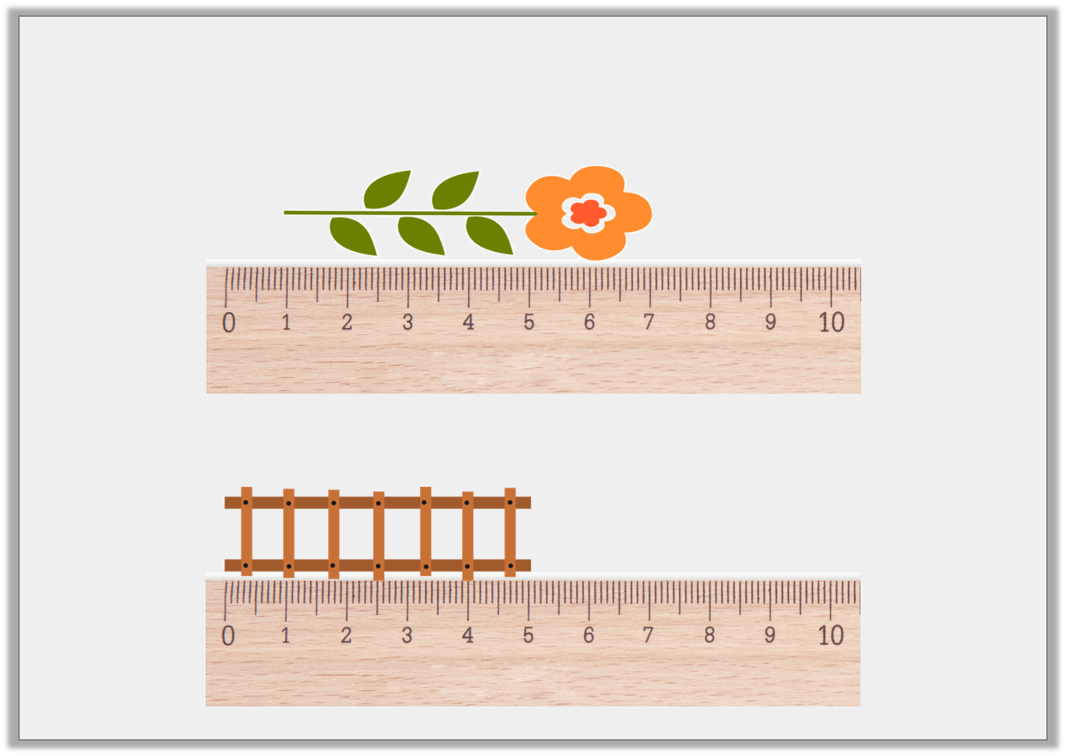
Varied Fluency 1
How long are these objects in centimetres?
A.
B.
© Classroom Secrets Limited 2019

Slide 6
Varied Fluency 1
How long are these objects in centimetres?
A.
6cm
B.
5cm
© Classroom Secrets Limited 2019

Slide 7
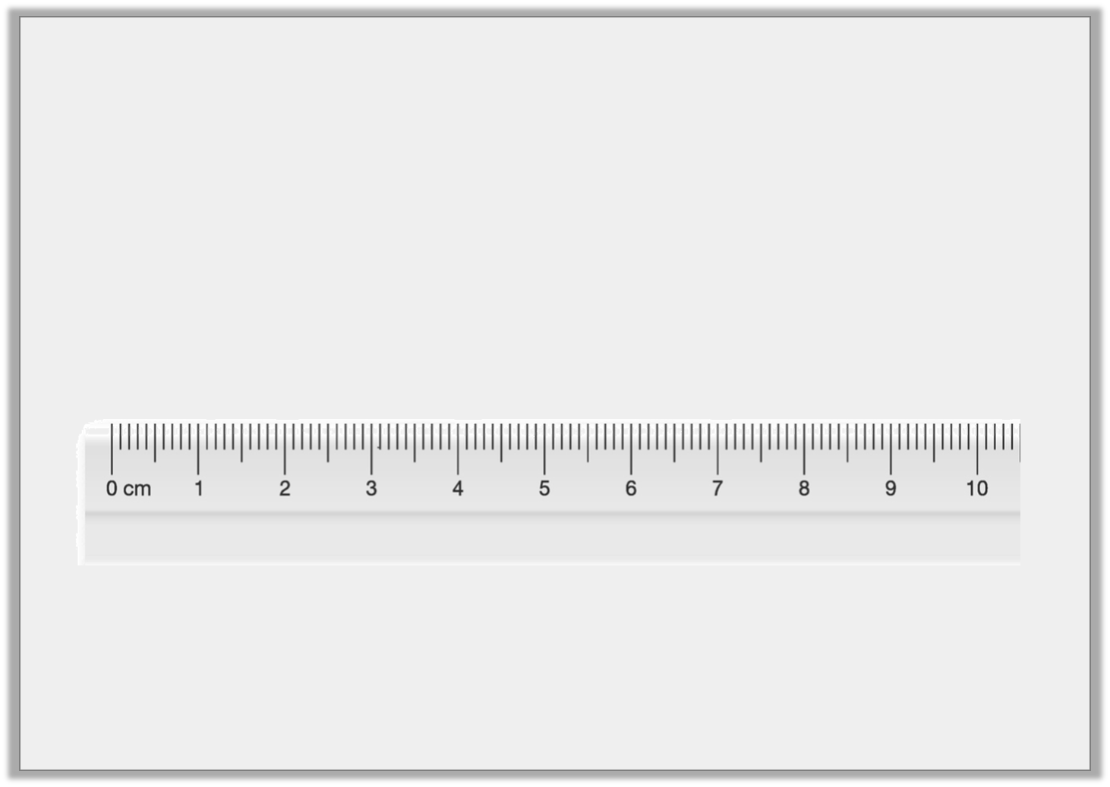
Varied Fluency 2
Matthew draws a 2cm line. He starts at the arrow.
What number will he finish at?
© Classroom Secrets Limited 2019

Slide 8
Varied Fluency 2
Matthew draws a 2cm line. He starts at the arrow.
What number will he finish at?
6cm
© Classroom Secrets Limited 2019

Slide 9
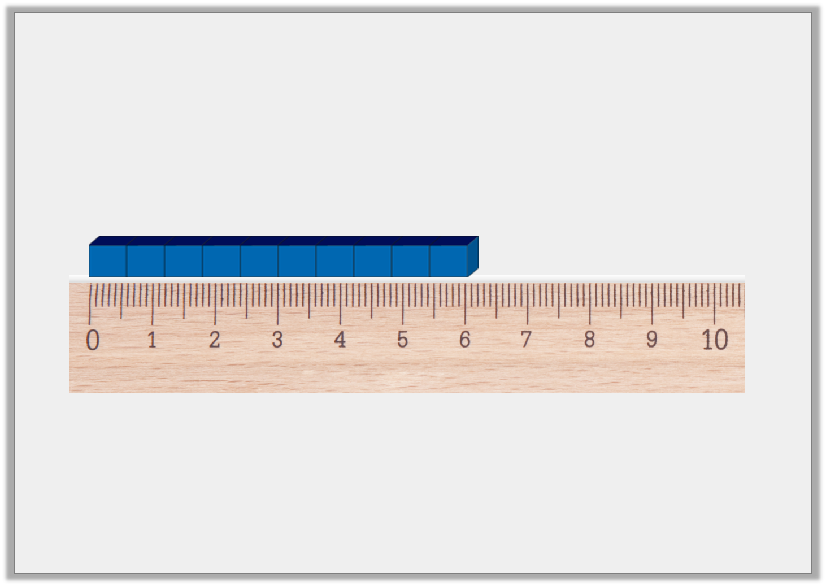
Varied Fluency 3
True or false?
This Base Ten is 8cm long.
© Classroom Secrets Limited 2019

Slide 10
Varied Fluency 3
True or false?
This Base Ten is 8cm long.
False. It is 6cm long.
© Classroom Secrets Limited 2019

Slide 11
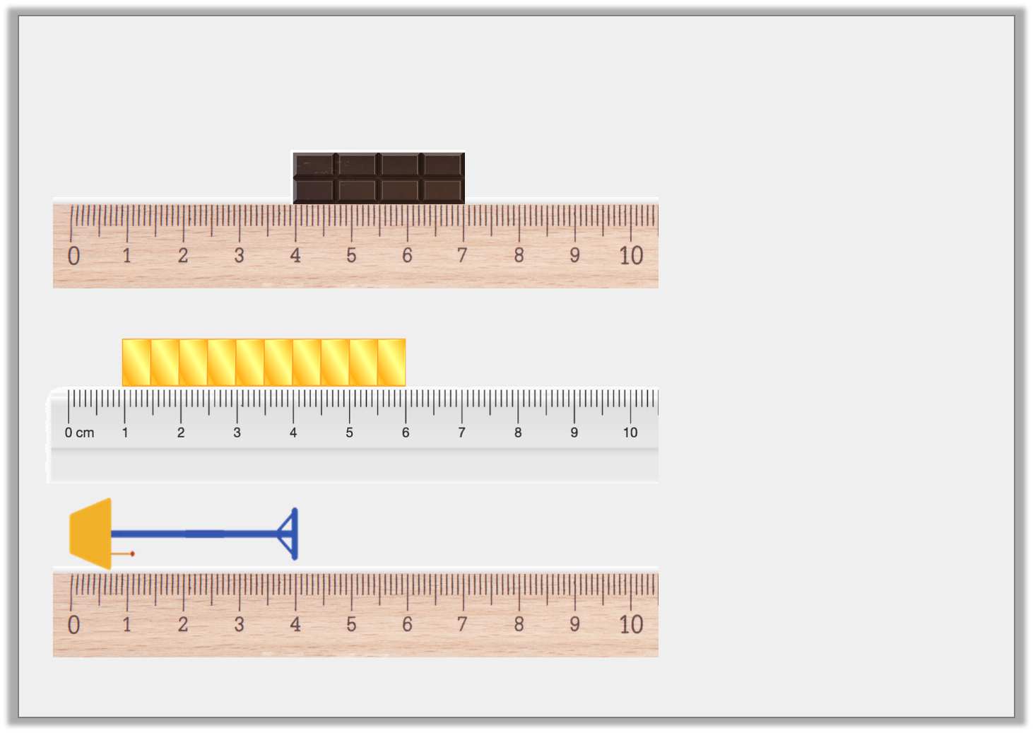
Varied Fluency 4
Match the measurement to the object.
5cm
4cm
3cm
© Classroom Secrets Limited 2019

Slide 12
Varied Fluency 4
Match the measurement to the object.
5cm
4cm
3cm
5cm
4cm
3cm
© Classroom Secrets Limited 2019

Slide 13
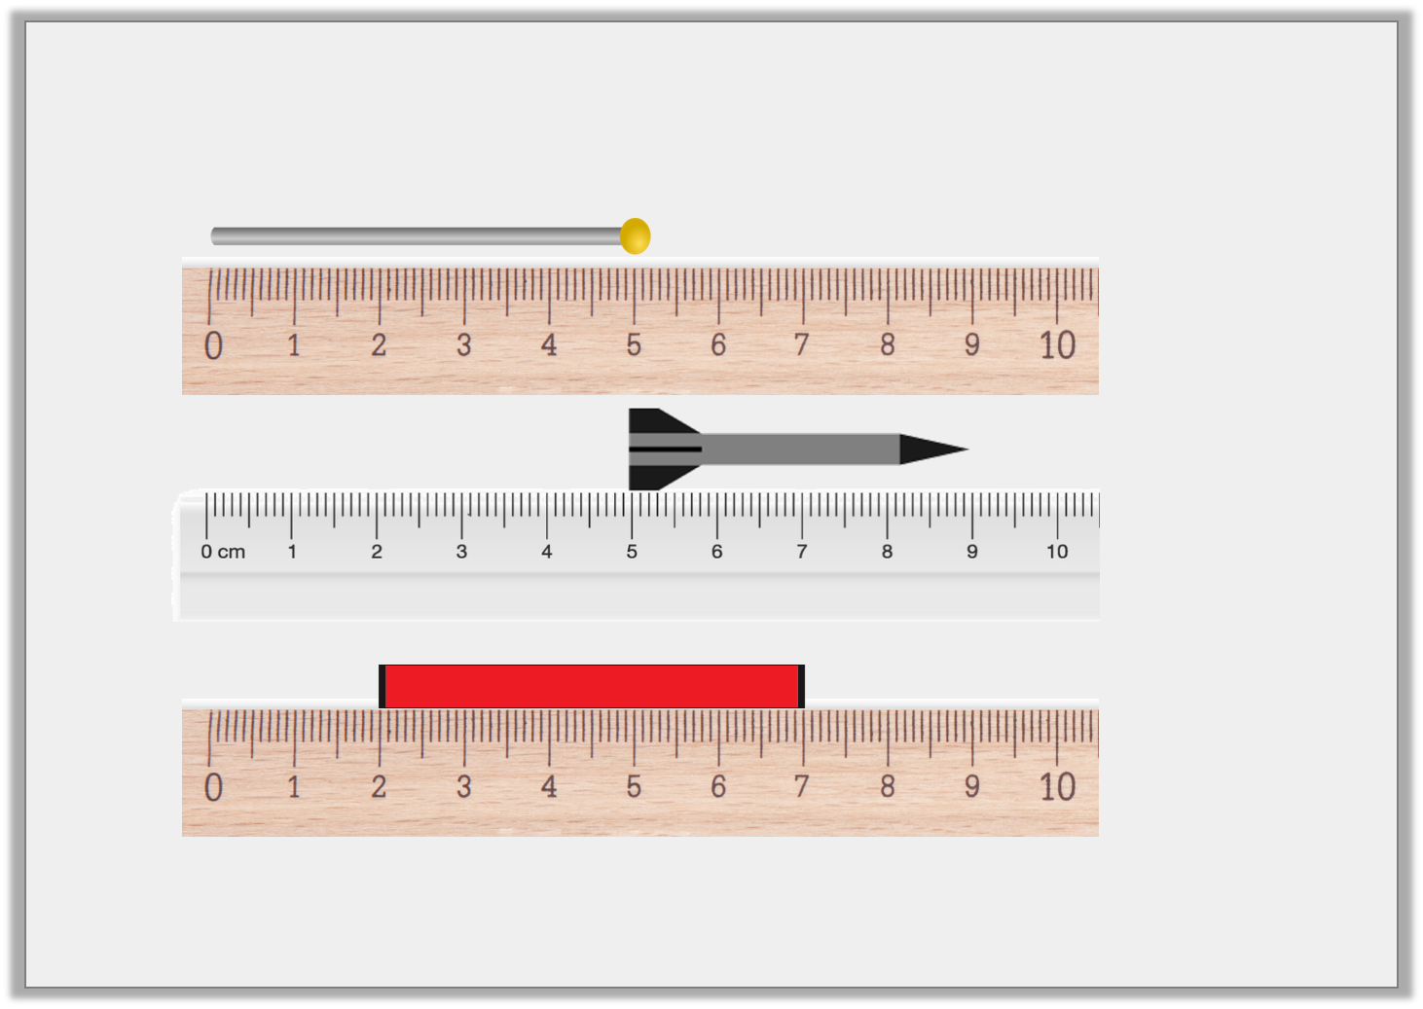
Reasoning 1
Which is the odd one out?
A.
B.
C.
© Classroom Secrets Limited 2019

Slide 14
Reasoning 1
Which is the odd one out?
B is the odd one out because…
A.
B.
C.
© Classroom Secrets Limited 2019

Slide 15
Reasoning 1
Which is the odd one out?
B is the odd one out because it is 4cm. The other two are 5cm long.
A.
B.
C.
© Classroom Secrets Limited 2019

Slide 16
Reasoning 2
James and Laura are measuring the length of a train.
James says,
Laura says,
Who is correct? Explain your answer.
The train is 5cm long.
The train is 6cm long.
© Classroom Secrets Limited 2019

Slide 17
Reasoning 2
James and Laura are measuring the length of a train.
James says,
Laura says,
Who is correct? Explain your answer.
Laura is correct because…
The train is 5cm long.
The train is 6cm long.
© Classroom Secrets Limited 2019

Slide 18
Reasoning 2
James and Laura are measuring the length of a train.
James says,
Laura says,
Who is correct? Explain your answer.
Laura is correct because she has taken into account that the object is measured from 1cm and not 0cm.
The train is 5cm long.
The train is 6cm long.
© Classroom Secrets Limited 2019

Slide 19
Problem Solving 1
George’s flag measures between 7cm and 12cm in length.
What are the possible lengths his flag could be?
© Classroom Secrets Limited 2019

Slide 20
Problem Solving 1
George’s flag measures between 7cm and 12cm in length.
What are the possible lengths his flag could be?
Various answers, for example: 8cm, 9cm, 10cm and 11cm.
© Classroom Secrets Limited 2019

