Slide 3
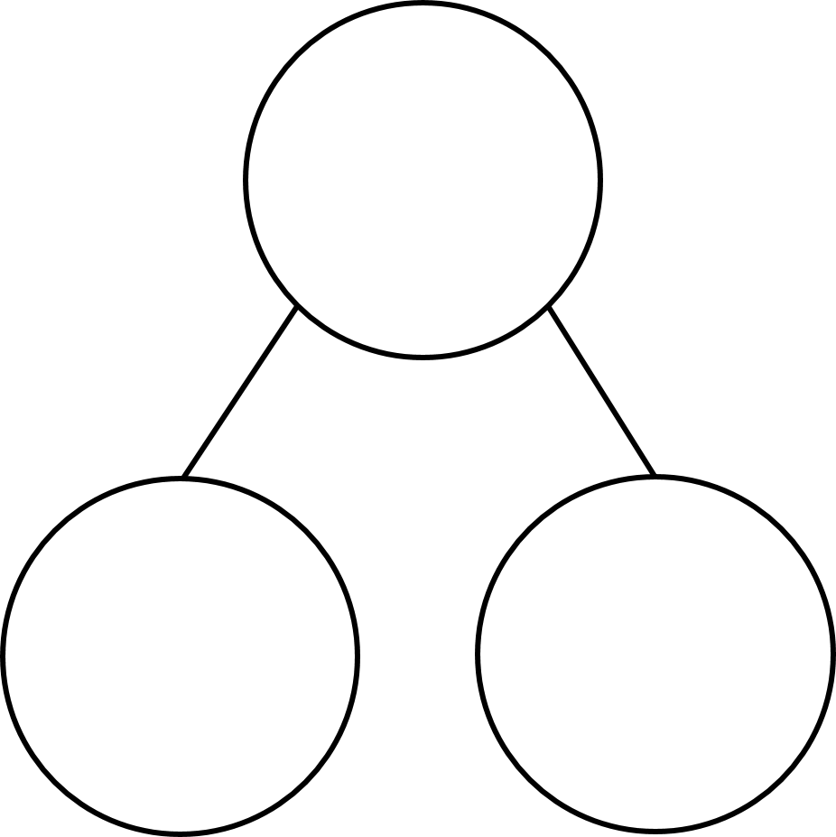
1) What is one less than 9?
2) What is take away
3) If 3 + 7 = 10, then 7 + 3 =
4) What number is missing?
5
8

Slide 4
1) What is one less than 9?
2) What is take away
3) If 3 + 7 = 10, then 7 + 3 =
4) What number is missing?
8
1
10
5
8
3

Slide 6
Do you remember what a fact family is?
7
4
$$+$$
3
$$=$$
7
3
$$+$$
4
$$=$$
7
4
3
7
$$=$$
4
$$+$$
3
I can write 4 facts!
7
$$=$$
3
$$+$$
4

Slide 7
Have a think
4
4
1
3
3
1
4
$$−$$
1
$$=$$
3
$$−$$
$$=$$
?
4
3
1
?
What is the same?
What is different?

Slide 8
6
$$+$$
4
$$=$$
10
4
$$+$$
6
$$=$$
10

Slide 9
6
$$+$$
4
$$=$$
10
4
$$+$$
6
$$=$$
10
10
$$−$$
4
$$=$$
6
10
$$−$$
6
$$=$$
4

Slide 10
What do you notice?
6
$$+$$
4
$$=$$
10
10
4
$$+$$
6
$$=$$
10
10
$$−$$
4
$$=$$
6
6
4
10
$$−$$
6
$$=$$
4

Slide 11
Have a go at question 1 on the worksheet

Slide 12
Have a think
2
$$+$$
5
$$=$$
7
7
$$+$$
$$=$$
$$−$$
$$=$$
2
5
$$−$$
$$=$$

Slide 13
Have a think
2
$$+$$
5
$$=$$
7
7
5
$$+$$
2
$$=$$
7
7
$$−$$
5
$$=$$
2
2
5
7
$$−$$
2
$$=$$
5

Slide 14
If you know these, then you know…
2
$$+$$
5
$$=$$
7
7
$$=$$
5
$$+$$
2
5
$$+$$
2
$$=$$
7
7
$$=$$
2
$$+$$
5
7
$$−$$
5
$$=$$
2
2
$$=$$
7
$$−$$
5
7
$$−$$
2
$$=$$
5
5
$$=$$
7
$$−$$
2

Slide 15
Have a go at the rest of the questions on the worksheet

