Slide 1
Monday 2nd November 2020
Animal Classifications
LO: To discuss how animals are grouped together into classes.

Slide 2
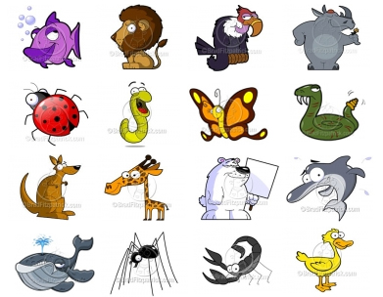
There are six different ways
we can class animals...

Slide 3
1) Mammals
How can we tell if an animal is a mammal?

Slide 4
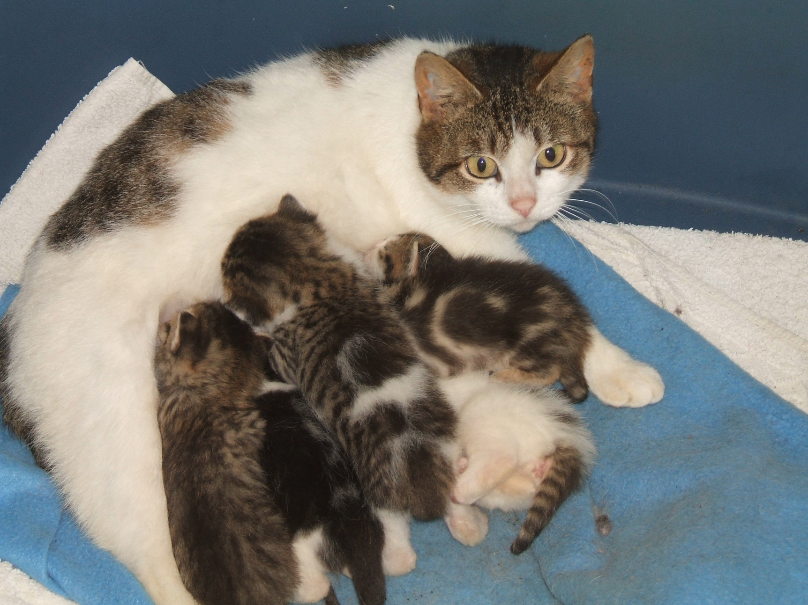
They give birth to live young...

Slide 5
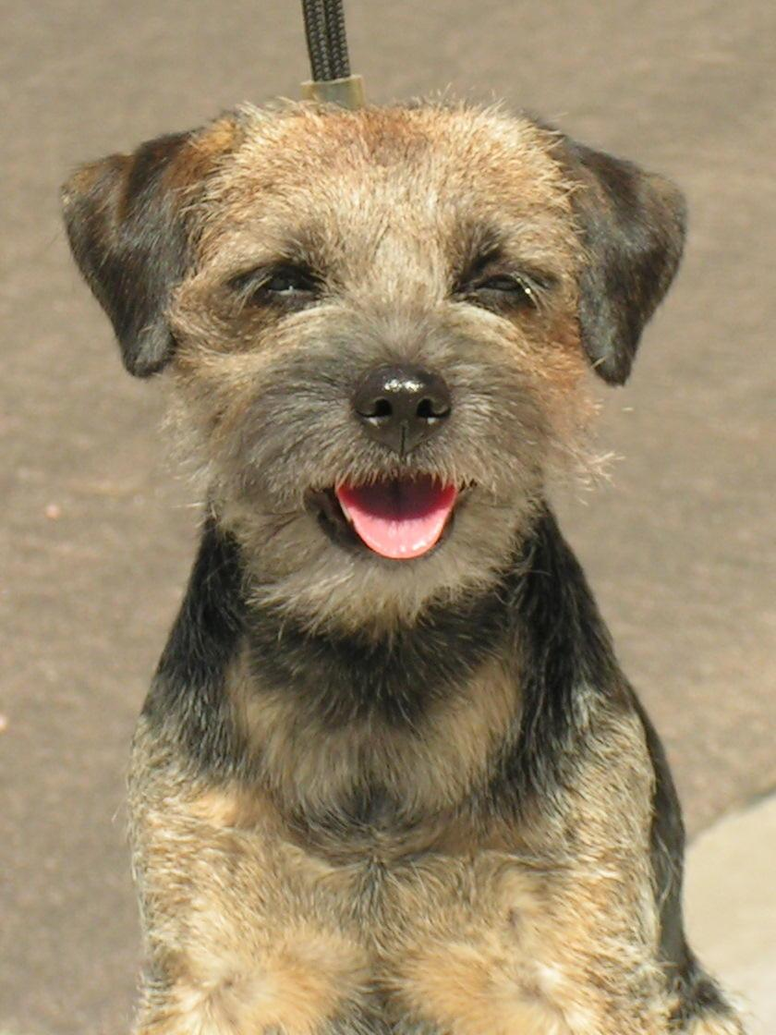
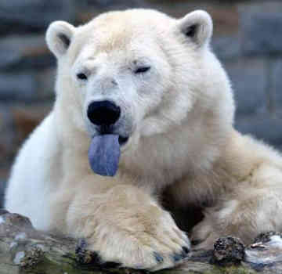
They have hair or fur...

Slide 6
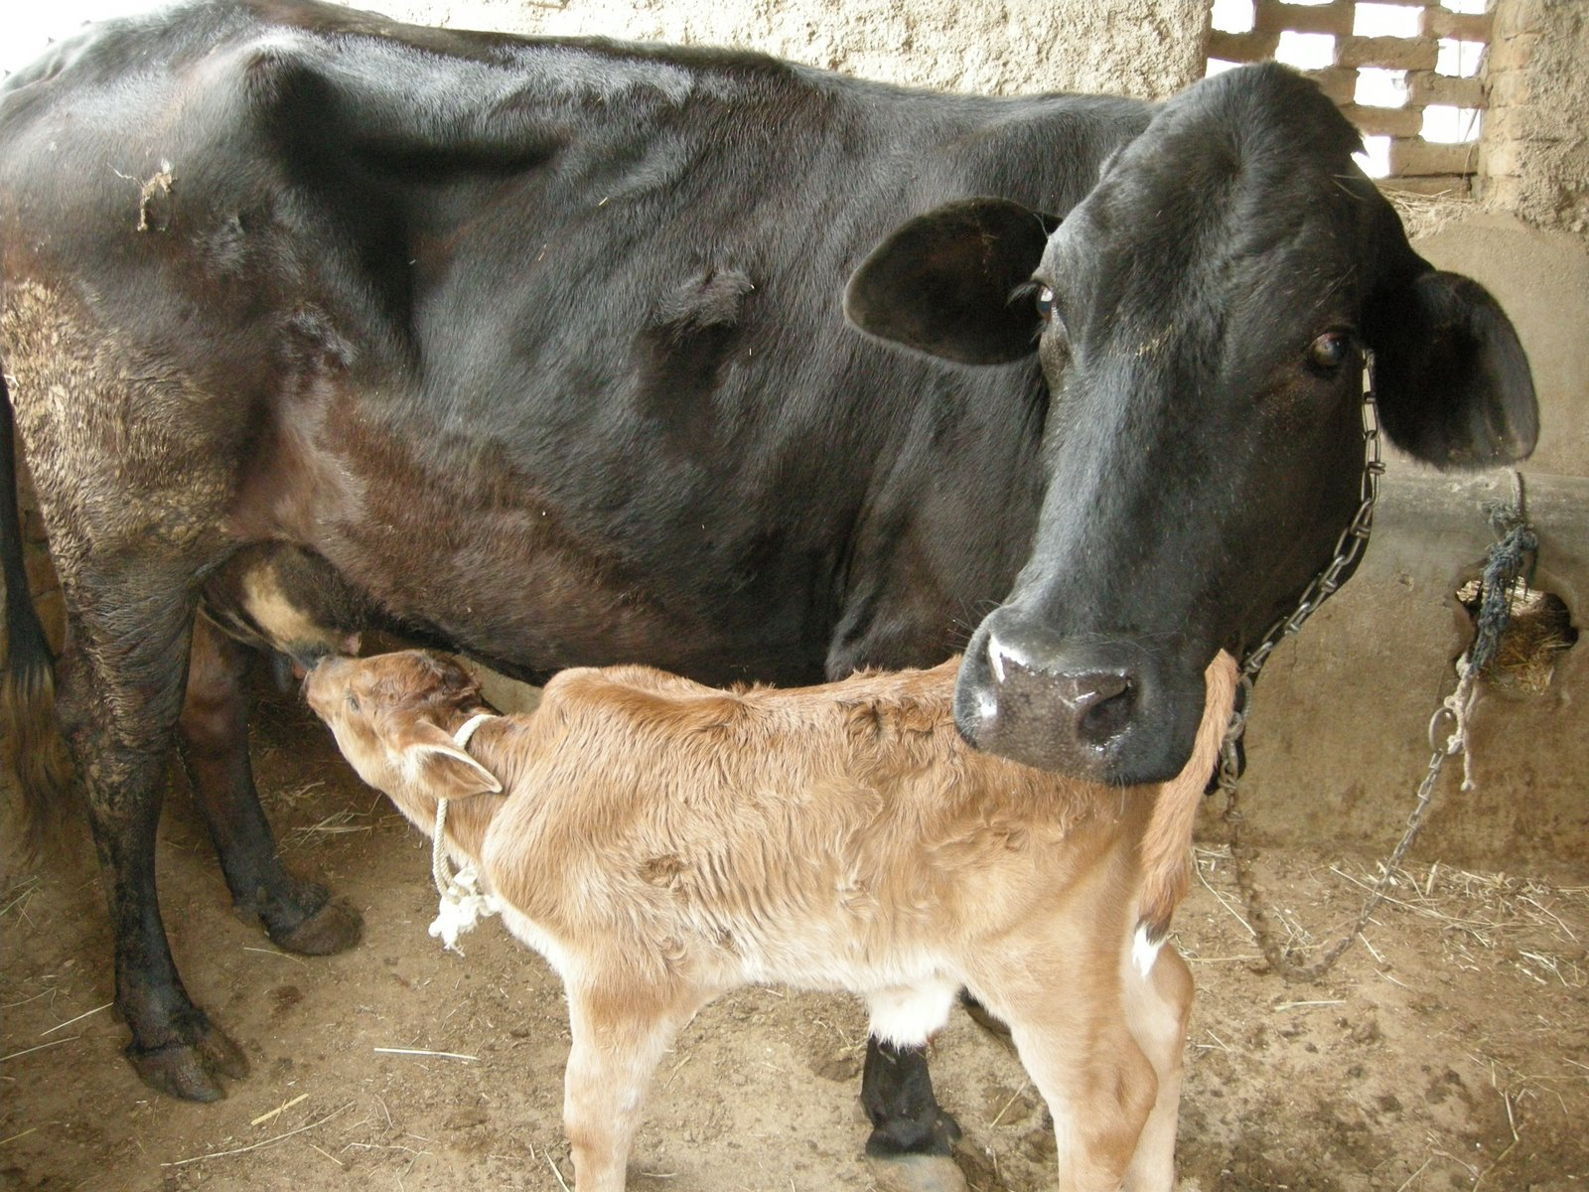
Mammal mothers feed their children with their own milk...

Slide 7
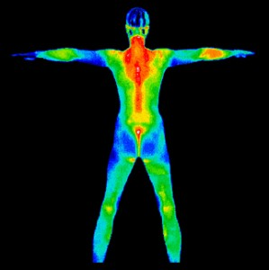
They are warm blooded...

Slide 8
2) Reptiles
How can we tell if an animal is a reptile?

Slide 9
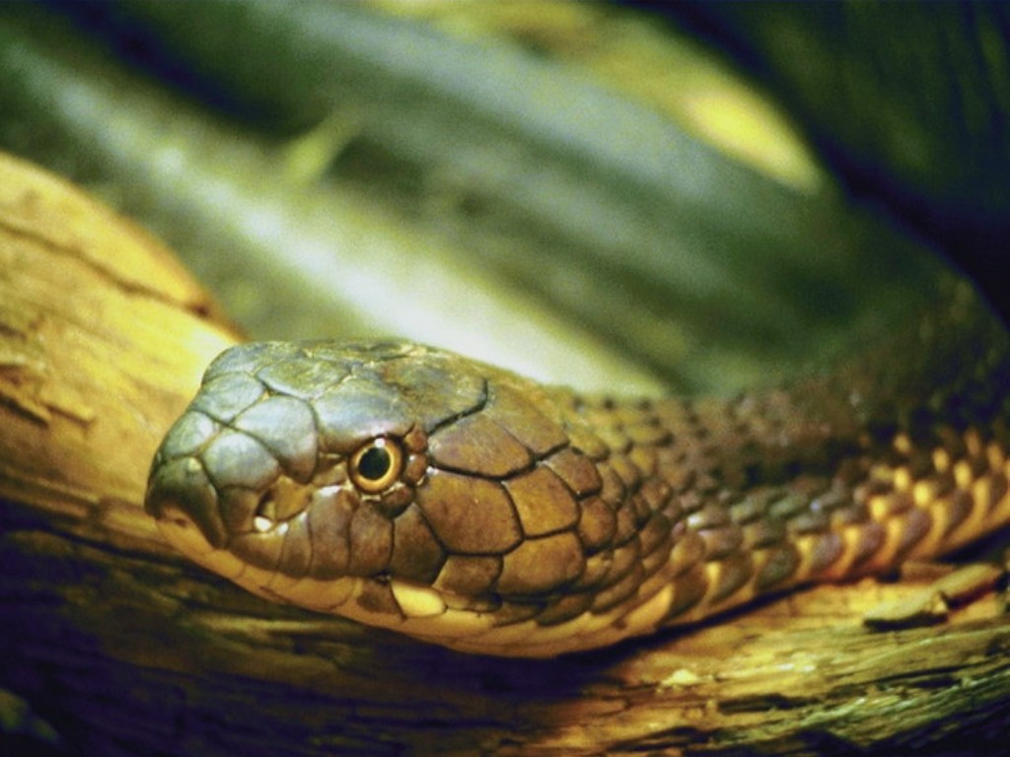
They have scales, not fur...

Slide 10
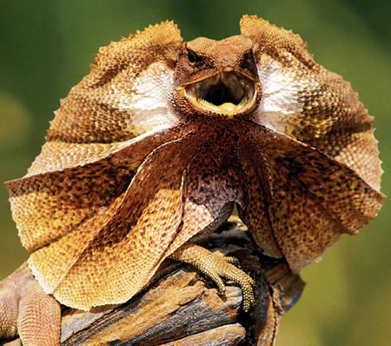
They have dry skin...

Slide 11
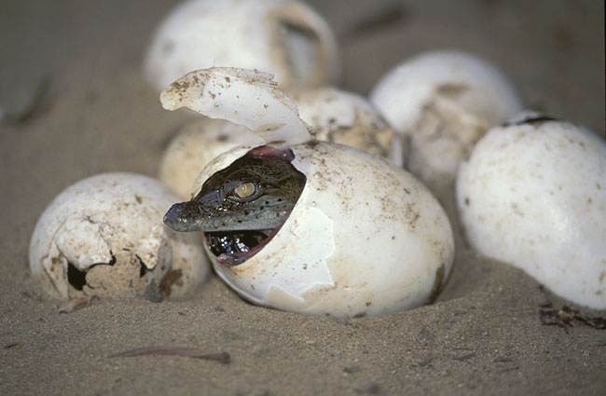
They usually lay eggs...

Slide 12
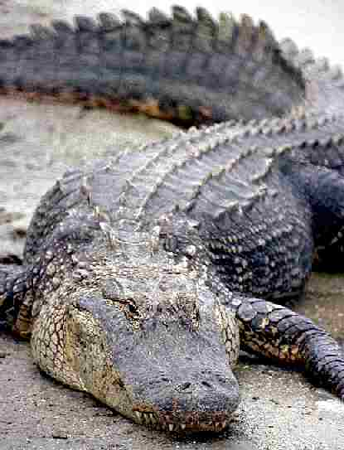
They are cold blooded...

Slide 13
3) Birds
How can we tell an animal is a bird?

Slide 14
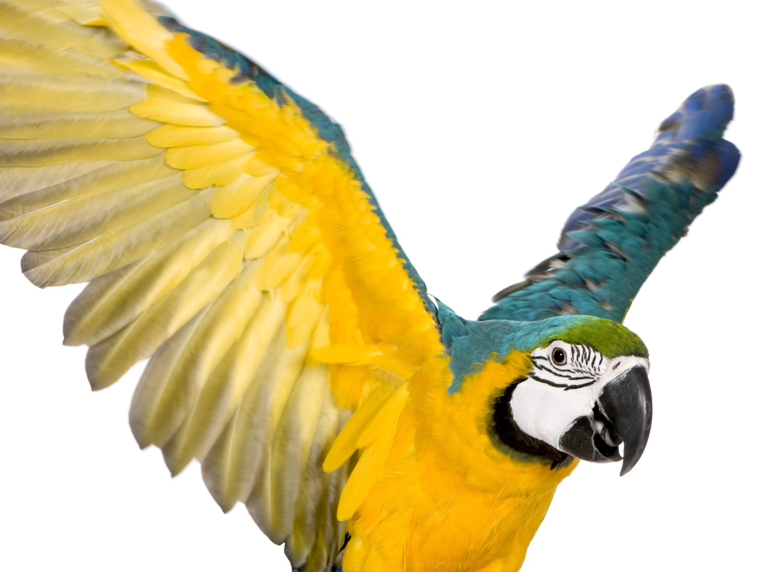
They have feathers
and wings...

Slide 15
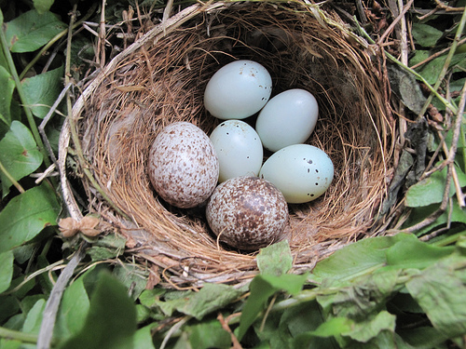
They lay eggs...

Slide 16
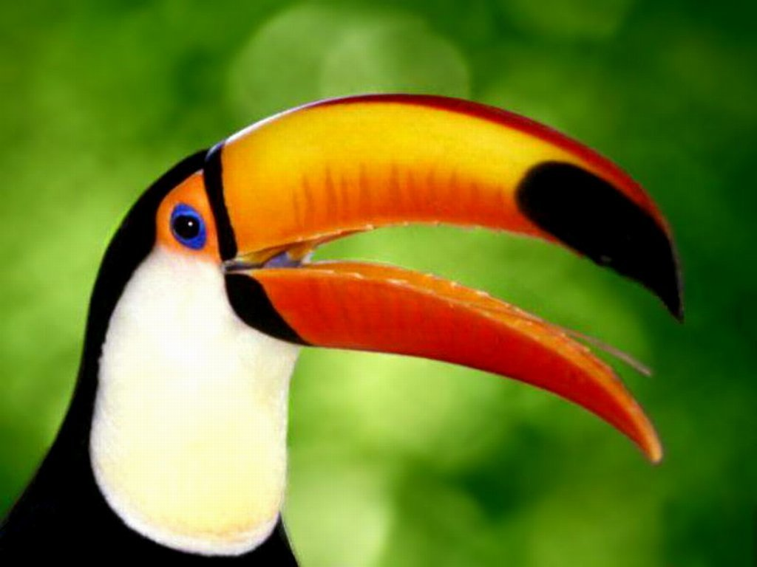
They are warm blooded...

Slide 17
4) Amphibians
How do we know if an animal is an amphibian?

Slide 18
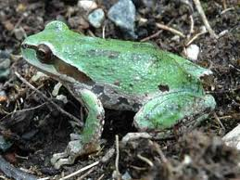
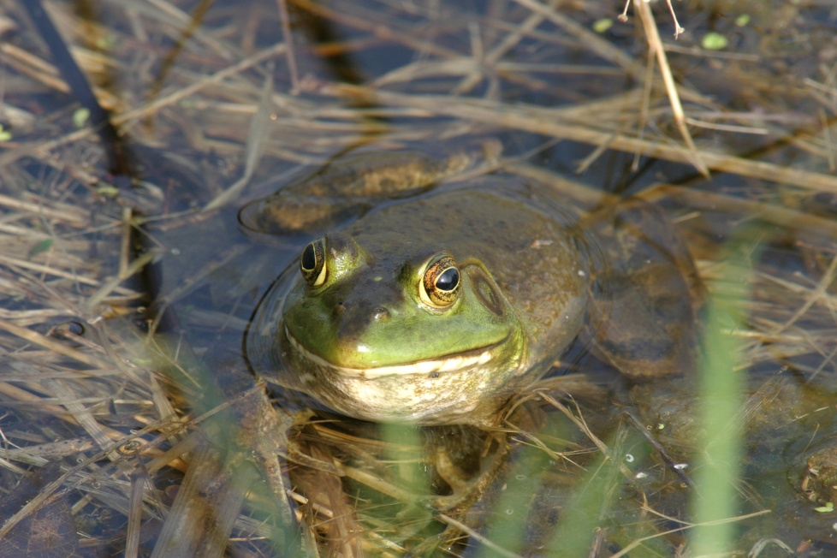
They live on land and water...

Slide 19
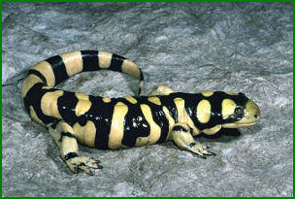
They are cold blooded...

Slide 20
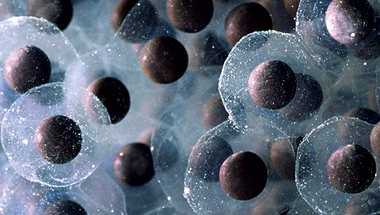
They lay eggs...

Slide 21
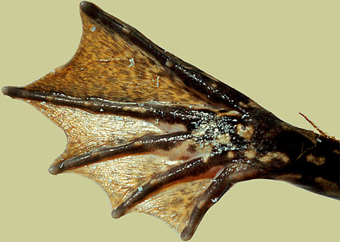
They have moist skin and webbed feet...

Slide 22
5) Fish
How do we know if an animal is a fish?

Slide 23
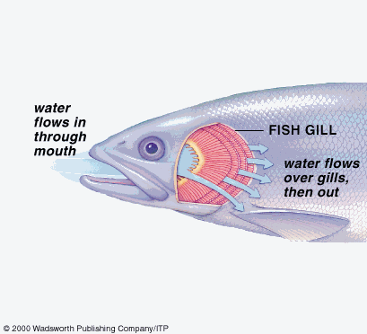
They breathe under water using gills...

Slide 24
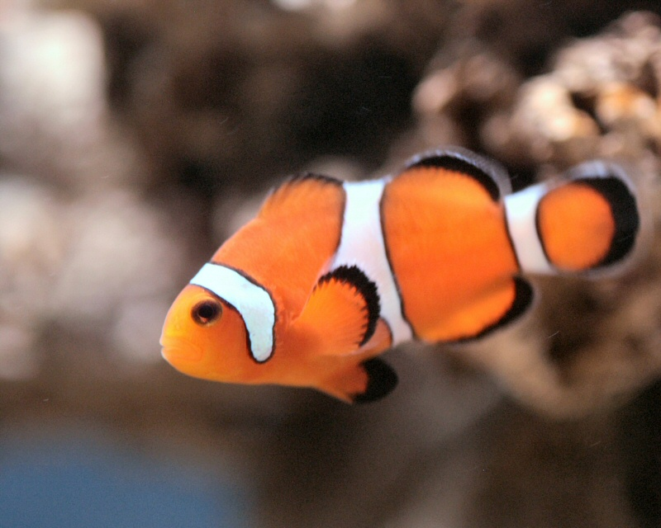
They have scales
and fins...

Slide 25
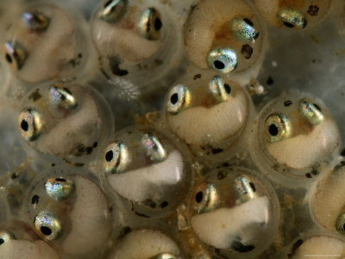
They lay eggs...

Slide 26
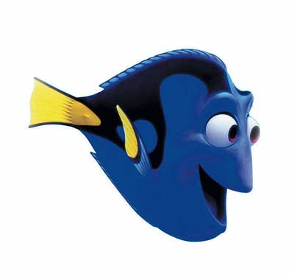
They are cold blooded...

Slide 27
5) Invertebrates
How do we know if an animal is an invertebrate?

Slide 28
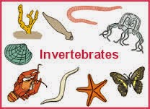
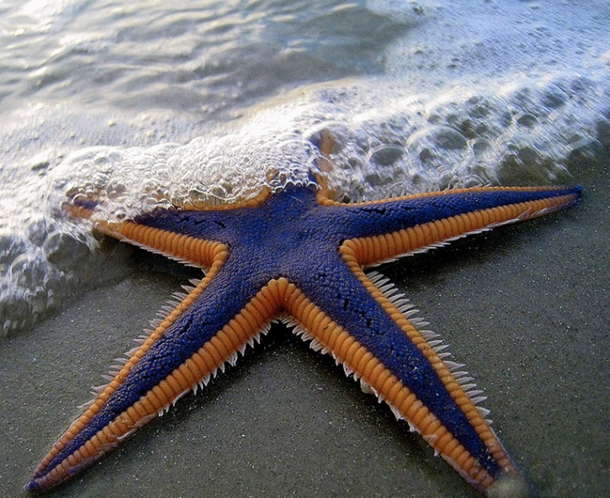
They don’t have a backbone…

Slide 29
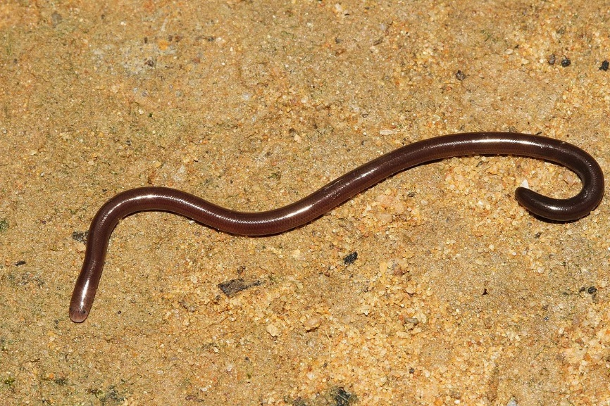
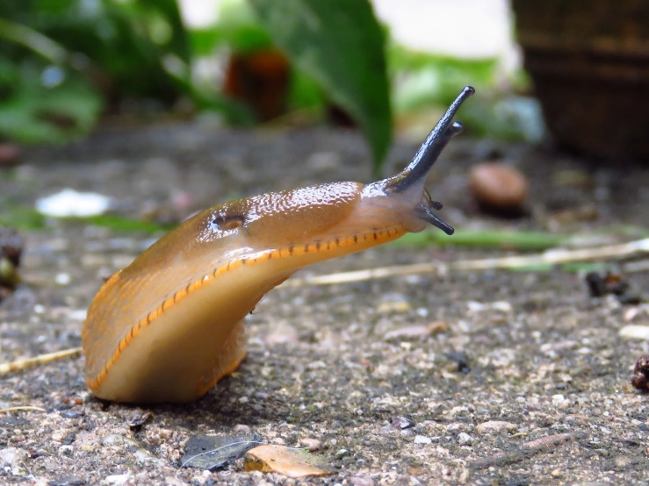
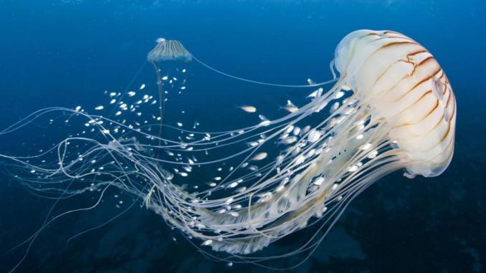
Some have soft bodies…

Slide 30
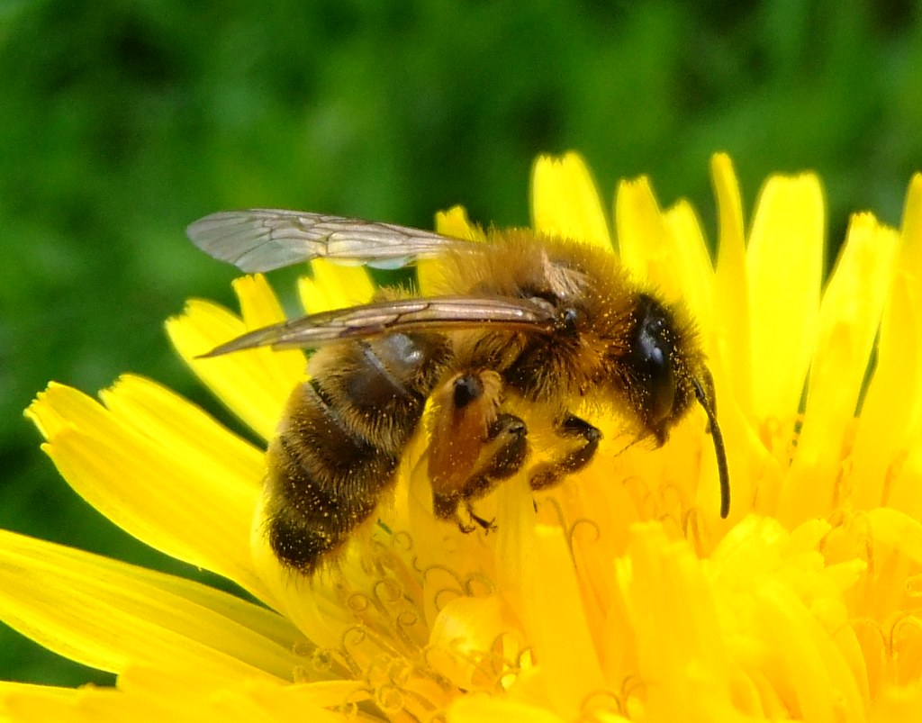
Some have a hard body…

Slide 31
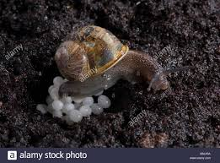
They lay eggs…

Slide 32
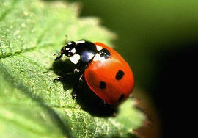
They are cold blooded…

Slide 33
What types of animals are these?...

Slide 34
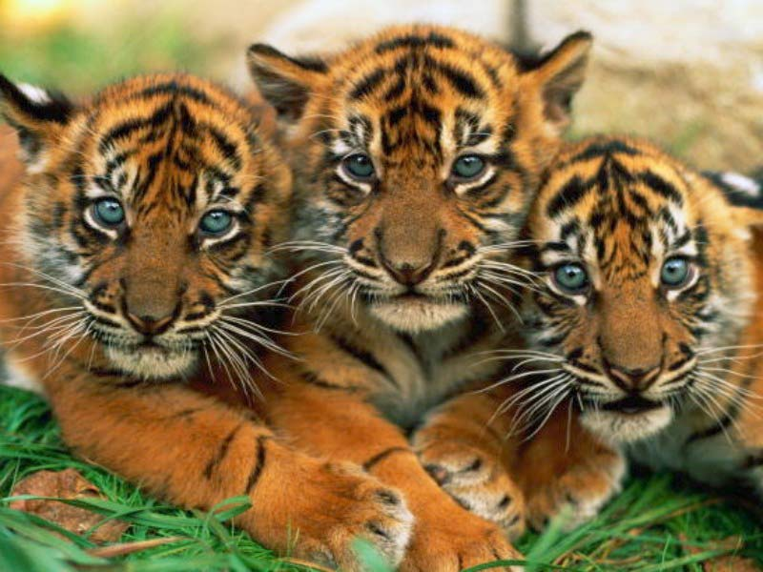

Slide 35
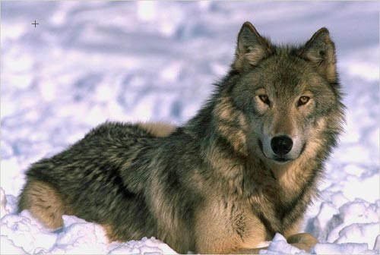

Slide 36
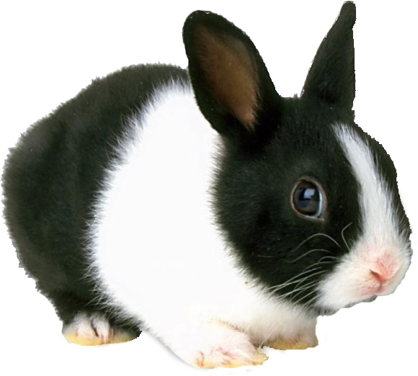

Slide 37
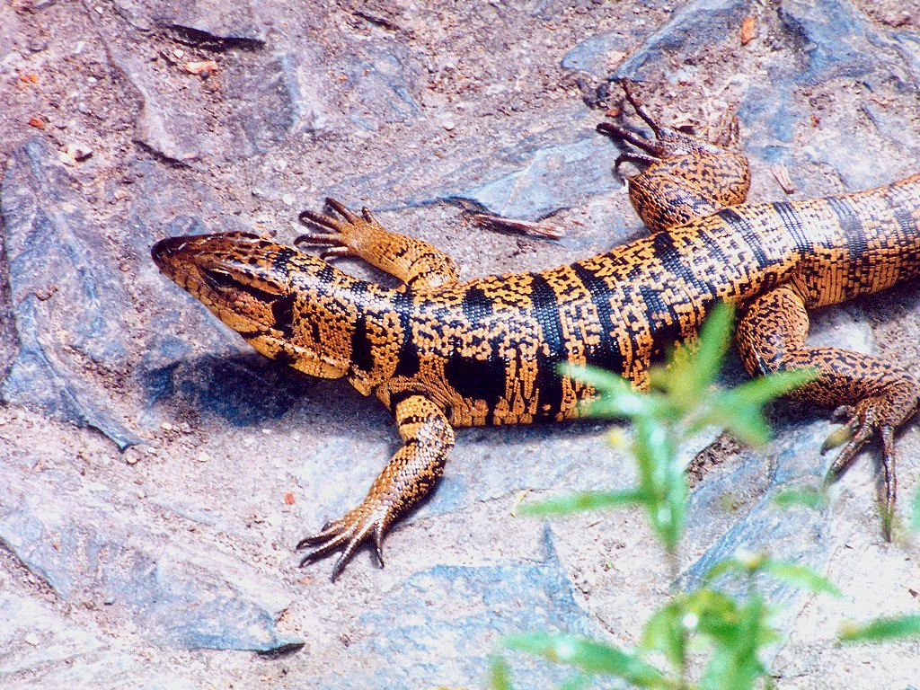

Slide 38
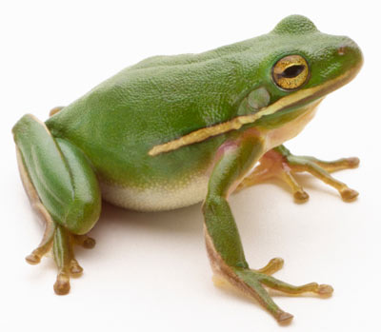

Slide 39
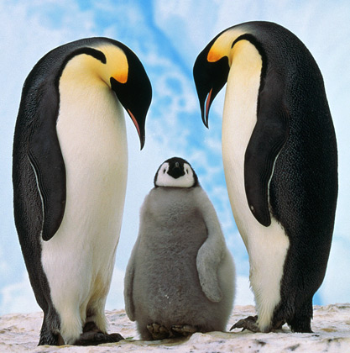

Slide 40
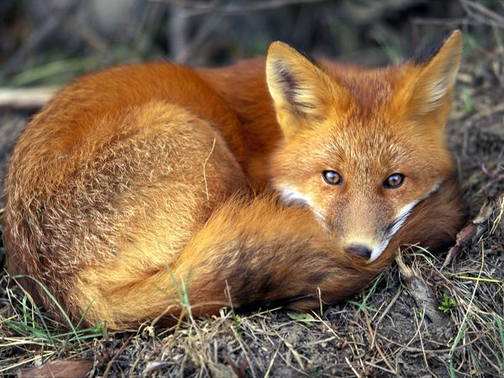

Slide 42
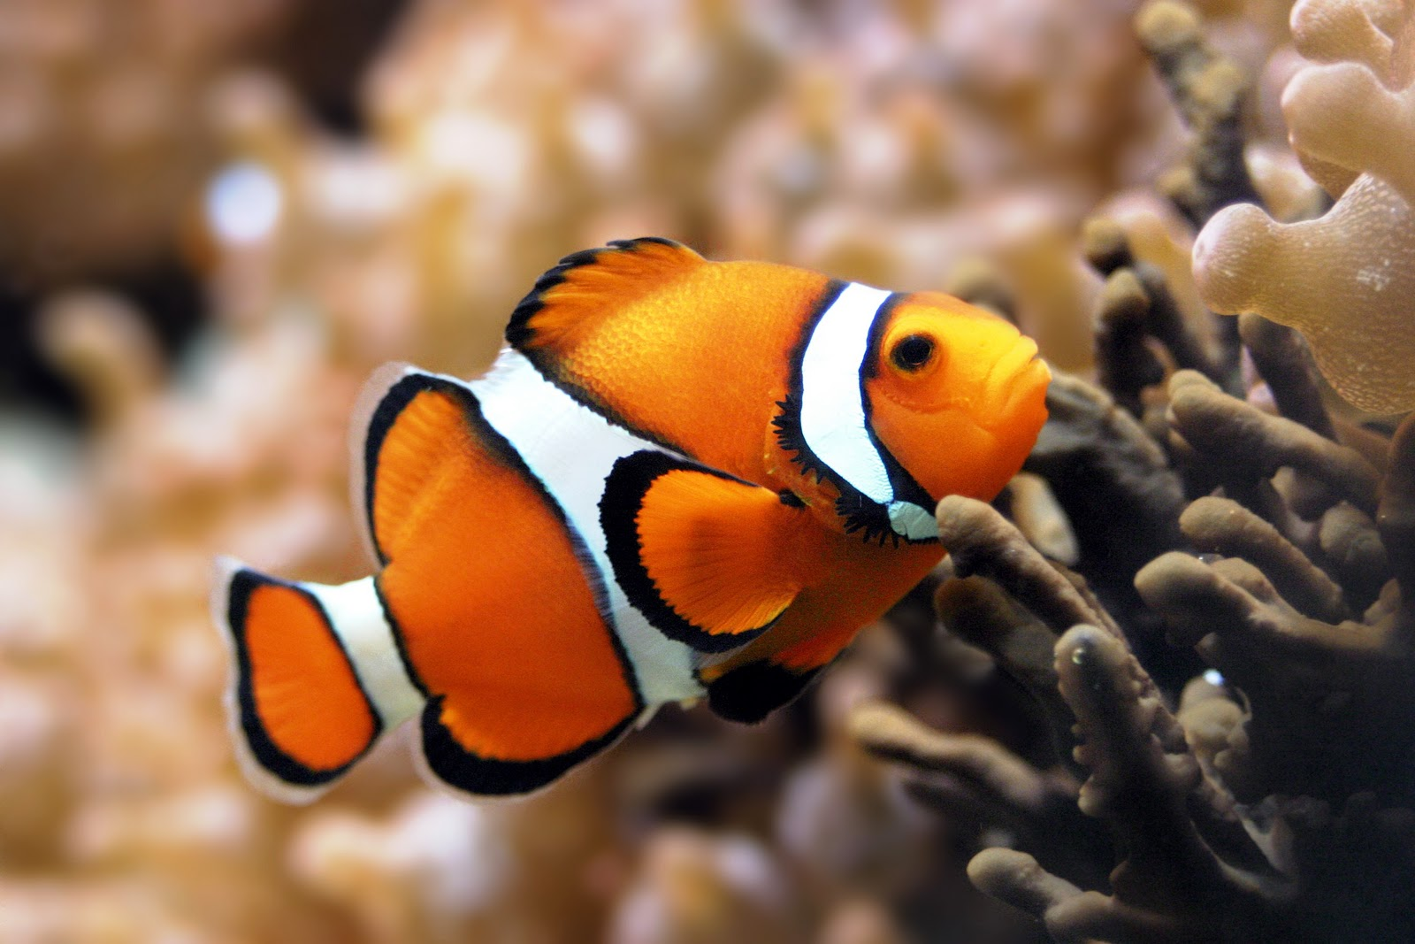

Slide 43
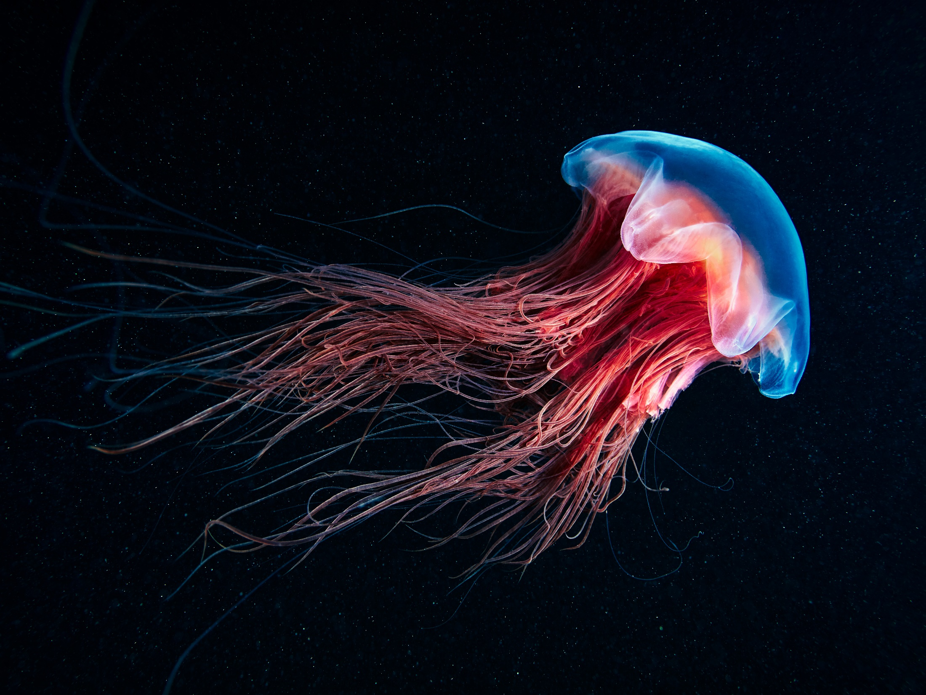

Slide 44
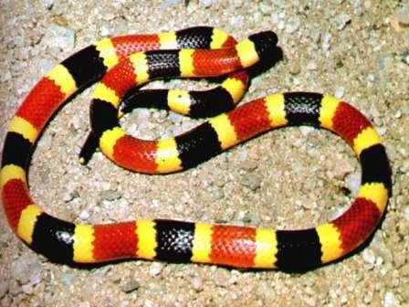

Slide 45
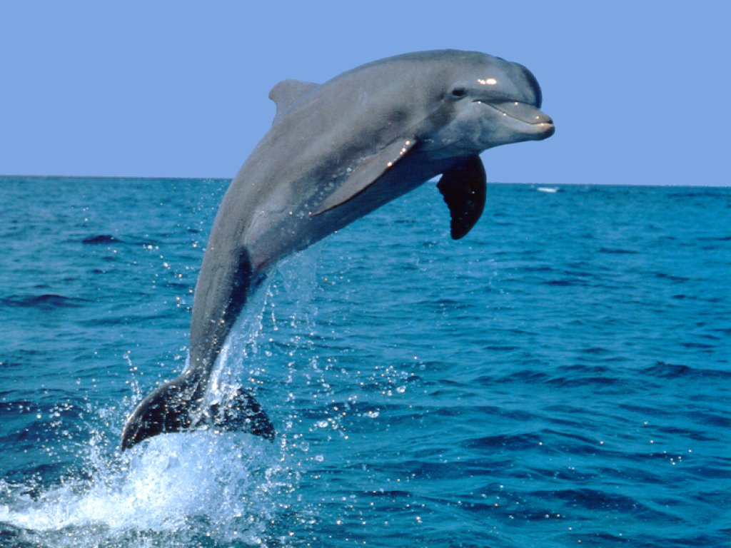

Slide 46
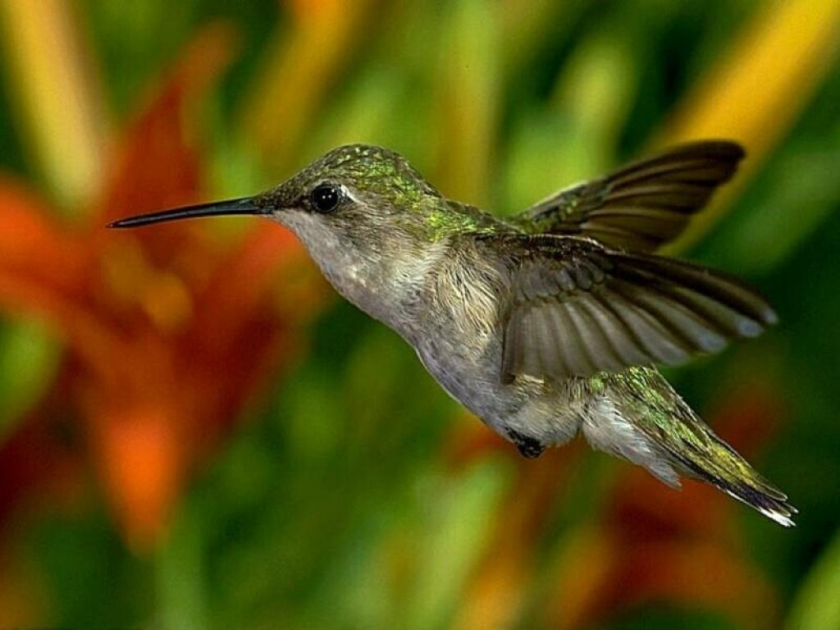

Slide 47
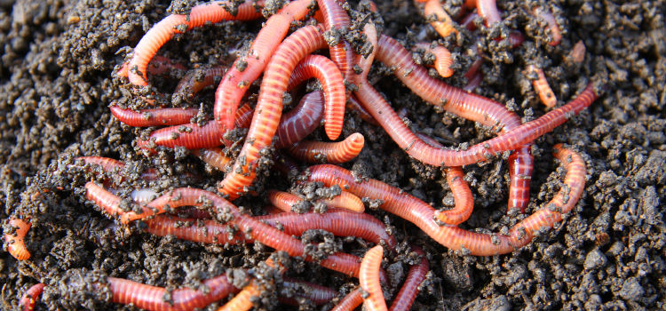

Slide 48
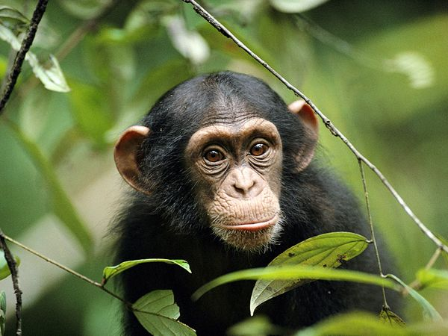

Slide 49
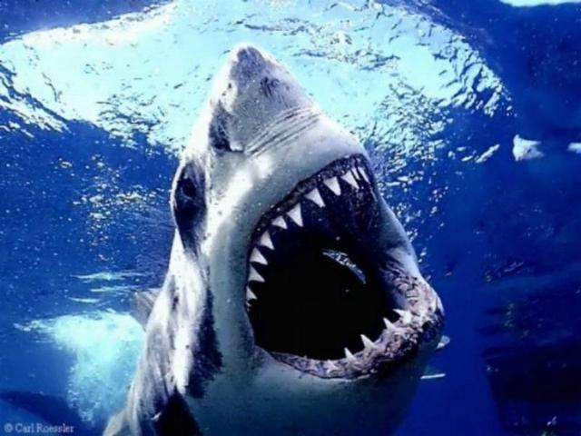

Slide 50
