Slide 1


Use short multiplication to multiply 3-digit by 1-digit numbers.
Use the grid method
or short multiplication
to calculate 3 × 235.
2 3 5
x 3
× | 200 | 30 | 5
3 | 600 | 90 | 15 | 705
1 1
7 0 5

Slide 2
Use short multiplication to multiply 4-digit by 1-digit numbers.
3 × 4235
× | 4000 | 200 | 30 | 5
3
12,000
600
90
15
12,705
Add the four numbers.
We
need
an
extra
column!
4 2 3 5 × 3
Multiply the 1s first,
then the 10s,
then the 100s,
then the 1000s.
Remember to leave a line for any ‘carry’ digits during addition.
1 2
7
1
5
1
0

Slide 3
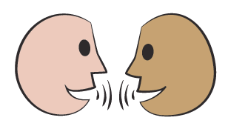

Use short multiplication to multiply 4-digit by 1-digit numbers; Use rounding to approximate.
Use the grid method or short multiplication to find 6 × 3241.
First, estimate the answer.
The answer must be more than 18,000
(6 × 3000) but quite a bit less than 24,000
(6 × 4000). Knowing the range of the answer helps us see if we’ve made a mistake with place value.
Now go ahead and calculate the answer...
Does your answer look sensible?
6 × 3241 = 19,446
Use the grid method or short multiplication to find
5734 × 4.
First, estimate the answer…
The answer must be between 20,000
(4 × 5000) and 24,000 (4 × 6000).
Now go ahead and calculate the answer.
Does your answer look sensible?
5734 × 4 = 22,936

