Slide 1
Year 2 – Home Learning English – Spring 1 – Week 1
Story writing

Slide 2
Day 1
We have spent the weeks before Christmas looking at what makes a good story. You have planned your stories and used a beginning, middle and end.
Imagine you have been on a journey far away.
You must plan…
Where your journey started
What transport you used
What other characters you met
A problem you had on your journey and how you fixed it
How you got home

Slide 3
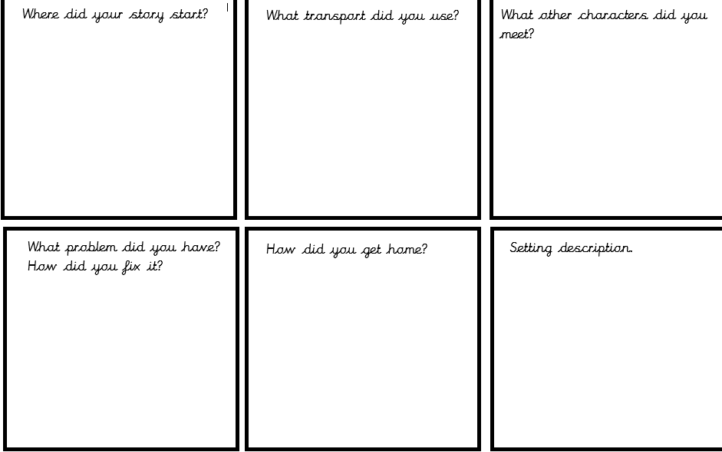
Story planning Use the planning sheet to make sure that you have thought about each part of your story. Challenge: Can you plan adjectives and similes to use in a setting description in your story?

Slide 4
Day 2
You have now created a detailed plan for your journey story.
Now you must write your story up in detail. You have worked over the past few months looking at exciting story openers, paragraphs, adjectives and similes.
Use the example short story to help you to set out your own work.
You have been given 2 sessions to complete your story.

Slide 5
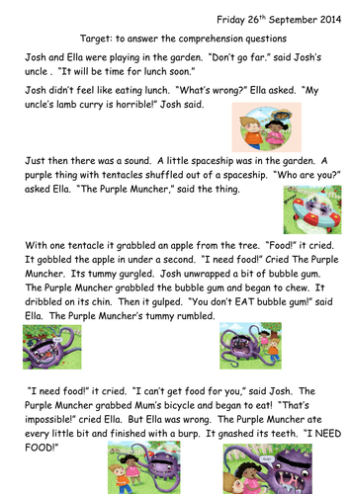

Slide 6
Day 3
This is your final session to complete your story.
If you feel that you have already finished, go back through your work to edit.
Does it make sense?
Have you included all parts of the story?
Are all of your sentences punctuated accurately?
Have you described the setting?
Have you chosen the best vocabulary?

Slide 7
Day 4 - SPAG
You have been set a task based on the correct use of capital letters and full stops.
We have worked really hard to look at where we must use capital letters and full stops.
Think carefully about which star sheet you should complete.
1 star – need support
2 star - independent

Slide 9
Day 5 – Reading task
You have been given a reading comprehension. Read through the text carefully and answer the questions based on the comprehension.
Remember to answer using full sentences.
Think carefully about which star you feel is best to complete.
1 star – support needed reading
2 star – support needed locating answers
3 star – independent

