Slide 1
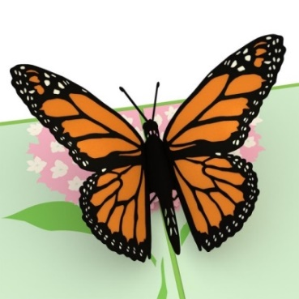
fluttered:
Verb
If something thin or light flutters, or if you flutter it, it moves up and down or from side to side with a lot of quick, light movements.
Synonyms:
beat, bat, flap, tremble, flit, flitter.
“Grandad wasn’t one to let go of
An idea once it had fluttered down and settled.”
1
tendrils:
Noun
A tendril is something light and
thin, for example a piece of hair
which hangs loose and is away from
the main part.
Synonyms:
wisp, like a wisp of hair
“Sprouting from the cactus arms were vivid yellow and orange tendrils, like bursts of flames.”
1

Slide 2
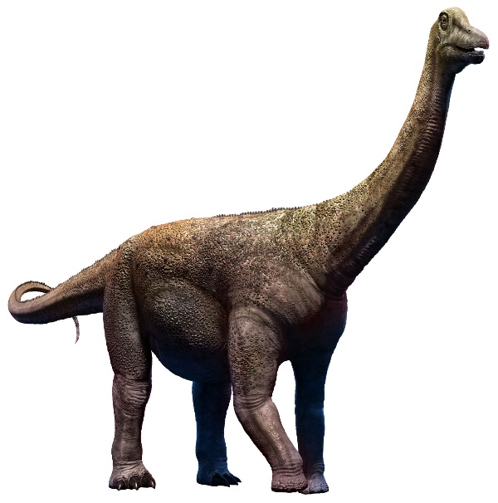
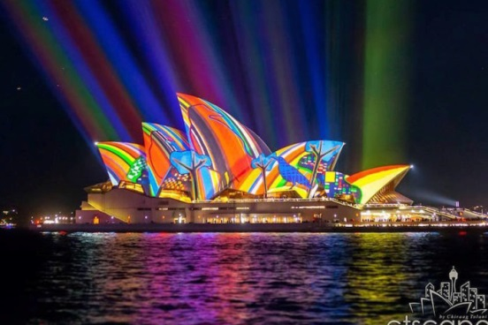
vast:
Adjective
A huge area or space or
something enormous in size.
Synonyms:
Huge, colossal, expansive
“He imagine a vast plate-sized jam tart with different coloured sections .”
1
vivid:
Adjectives
If you describe memories and
descriptions as vivid, you mean
that they are very clear and
detailed.
It can also describe something
that is very bright in colour.
Synonyms:
Clear, detailed, bright, intense, sharp
“Sprouting from the cactus arms were vivid yellow and orange tendrils, like bursts of flames.”
1

