Slide 1
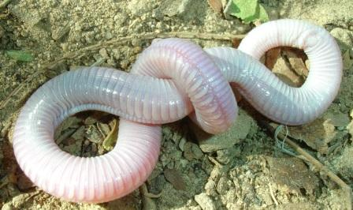
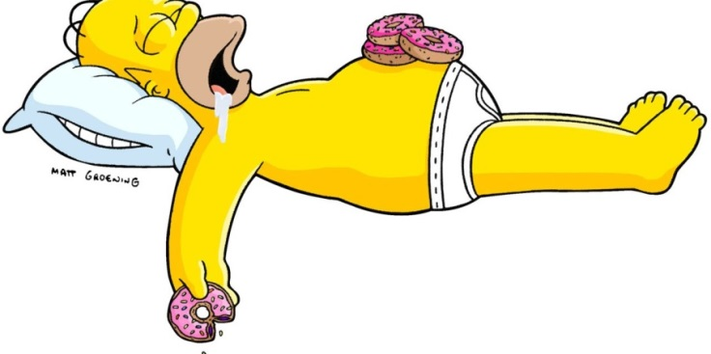
squirm:
Verb
If you squirm, your body twists
and turns backwards
and forwards.
Synonyms:
writhe, twist, toss, jerk, wriggle
“There was something wriggling underneath, trying to squirm its way out.”
1
bulge:
Noun
Something swollen
and sticking out
Synonyms:
swell out, project, expand.
“The fruit began to shake and move and I clearly saw one side bulge.’
1

Slide 2
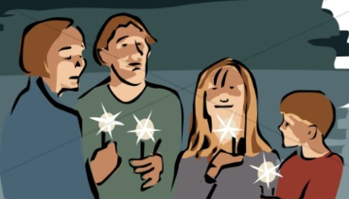
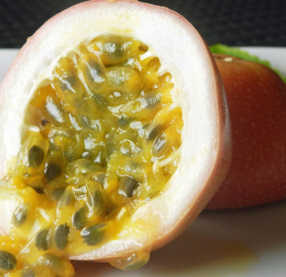
vigil:
Noun
A period of time awake to
keep watch on something
or pray.
Synonyms:
Watch, observe, pray.
“I was so tired my night time vigil probably lasted about three minutes.”
1
pulp:
Noun
A soft, shapeless, wet
amount of something.
Synonyms:
Mush, puree, mash.
“A spray of messy pulp and little black seeds covered the floor.”
1

