Slide 1


Slide 2
1st February 2021
What’s going on this week?
A team of climbers from Nepal have become the first ever to summit the world’s second highest
mountain, K2, in winter. The 10 climbers reached the summit of Pakistan's K2, more than 20 years
after the first winter attempt to reach the 8611m summit. K2 is considered incredibly difficult to
climb due to the high winds and sub-zero temperatures.
Things to talk about at home…
Think of a time when you completed a challenge or finished something you found difficult.
What was it? Talk about how you felt before, during and after. Are you glad you did it?
How do you think the climbers felt when they reached the summit? Why do you think they wanted to take part in the challenge?

Slide 3
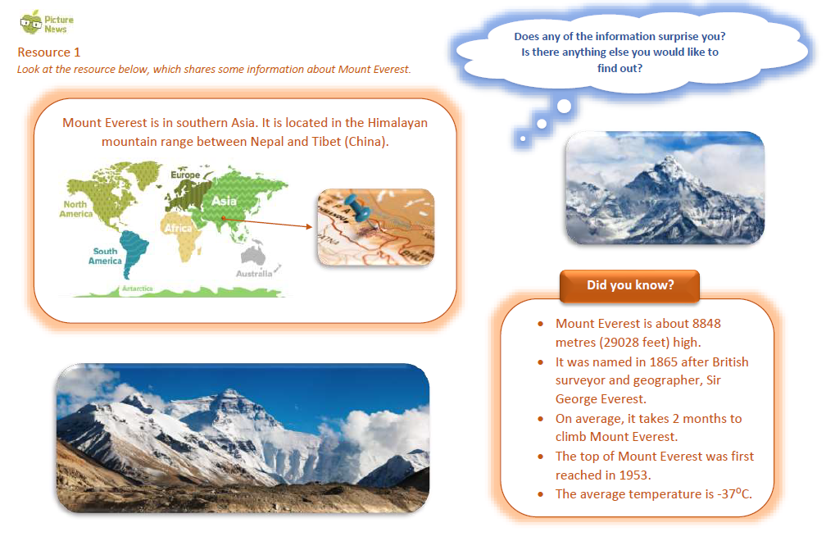

Slide 4
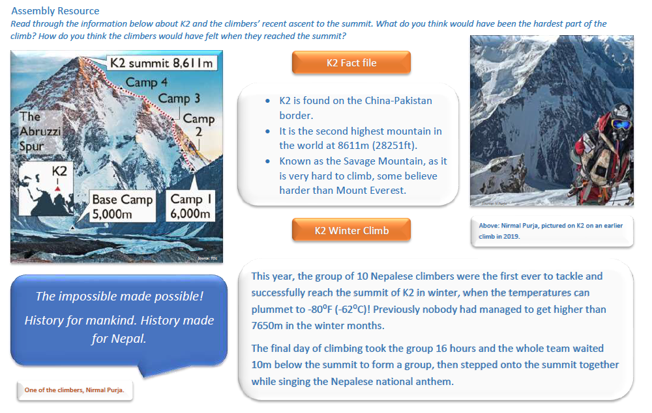

Slide 5
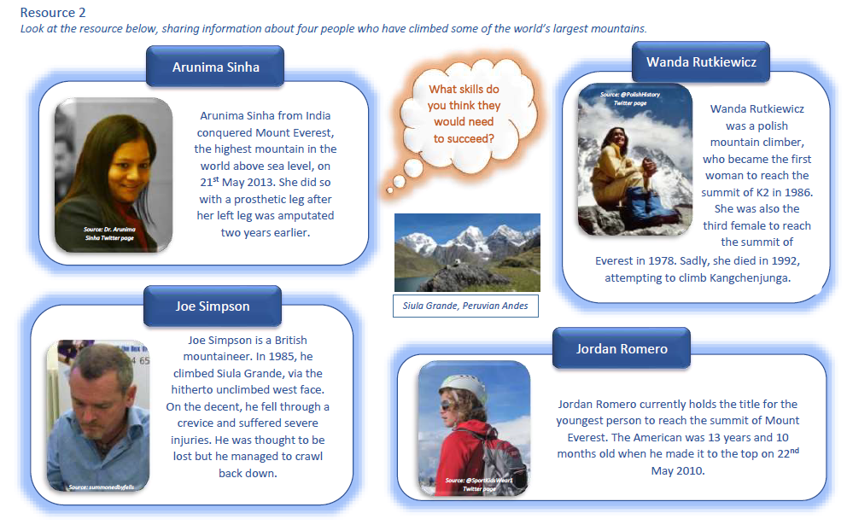

Slide 6
