Slide 1
Year 2 – Home Learning English – Spring 1 – Week 5
Poetry

Slide 2
Day 1 - To interpret information from a text.
Read through ‘How to catch a star’ – By Oliver Jeffers.
If you have access to YouTube, follow the link to watch someone read the story…
https://www.youtube.com/watch?v=rpyR6hJPxiw&feature=emb_title
Think about the following questions:
Why might he want a star so much?
What would you do with a star?
Who would want a star?
What might the star feel like?

Slide 3
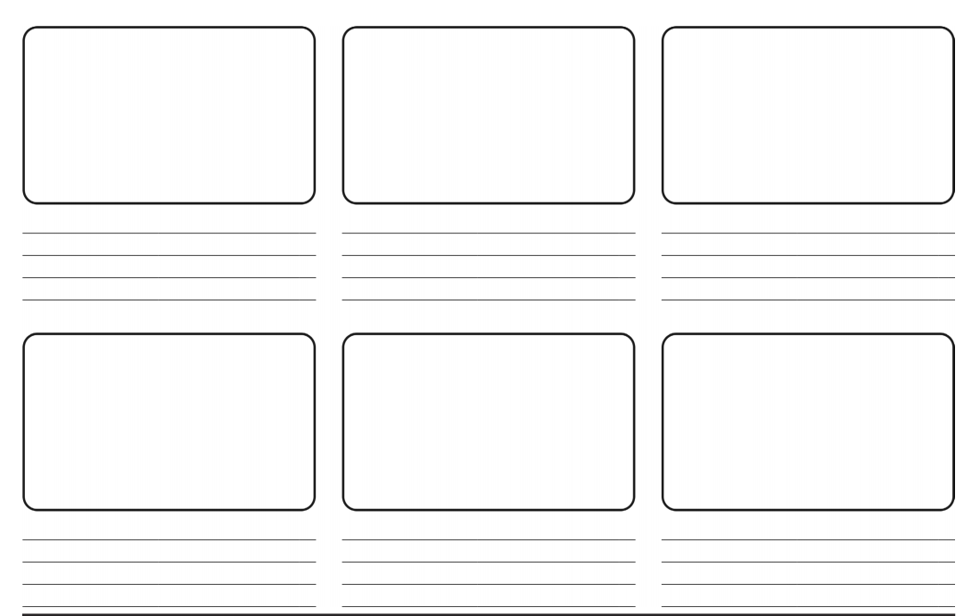
Use the storyboard to show the main events that happen in the story.
Think carefully about each way the boy wants to catch the star.
You can do this by printing out the story board, drawing pictures and writing the key parts of the story.
Or, there is a storyboard 2Do on Purple Mash that you could complete.

Slide 4
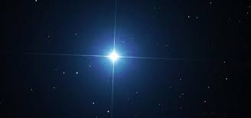
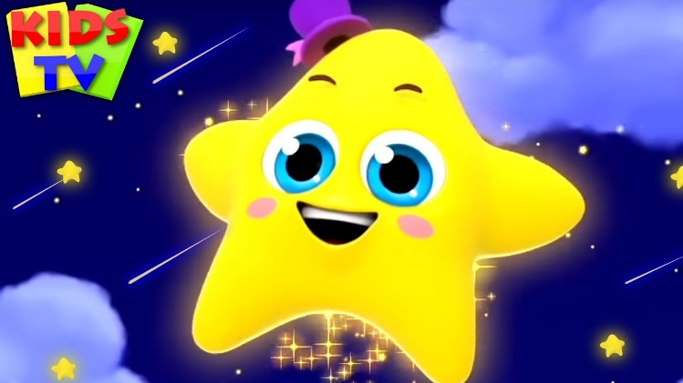
Day 2 - Creating adjectives
Think carefully about the story from day one. The boy was so desperate to catch a star. Think about why a star might have been so special to him.
Think about what you already know about stars, when you look up and see a star in the sky, what does it look like? If you are watching a cartoon, what does a star look like?

Slide 5
In this session you will be creating adjectives to describe a star.
Remember adjectives are used to describe something. For example;
The bright, blue ball.
The sparkling diamond.
Shiny, silky scarves.
Emerald green slippers.
1 star – think of as many adjectives as you can to describe a star. Write all of your exciting adjectives inside the star on the sheet.
2 star – once you have written your adjectives, try to put them into full sentences. E.g. – the shimmering star was sat quietly in the midnight sky.

Slide 6
Day 3 - Speaking and Listening
Read the poem ‘Night and stars’ by Stanley Cook.
What do you think the meaning of this poem could be?
Why do you think the poet has described the night in this way?
Think about how the poet has used similes to compare two objects.
For example; the tree was as tall as a tower.
Can you create your own similes?

Slide 7
If you have access to YouTube, watch some of the videos of Michael Rosen performing a poem.
He puts a lot of energy into his performances. He thinks carefully about the words in the poem and the meaning and uses these to help his performance.
https://www.youtube.com/channel/UC7D-mXO4kk-XWvH6lBXdrPw
Think about the meaning of the poem, can you perform it to a family member? Could they make notes on your performance. You could send a picture or a video to the school email address to show us your performance!

Slide 8
Day 3 -
People have been fascinated by stars for many, many years. Hundreds of thousands of people study the stars for many different reasons.
Here is some more information about stars;

Slide 9
At night you can see lots of beautiful stars in the sky.

Slide 10
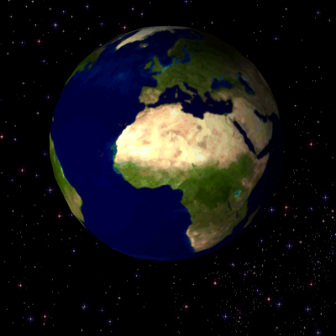
These are huge balls of hot gas in space that give out light. They are a long, long way away from earth.

Slide 11
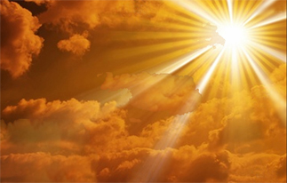
The nearest star to earth is the sun.

Slide 12
Some groups of stars have been given names because of what they look like.

Slide 13
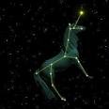
This is called ‘The unicorn’.

Slide 14
This is called ‘The twins’.

Slide 15
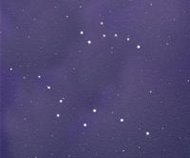
This called ‘Great bear and little bear’.

Slide 16
This called ‘Great bear and little bear’.

Slide 17
Can you create your own short story about stars?
Remember a story should have a clear beginning, middle and end.
You should use adjectives in your story to describe the stars and your characters.
Maybe, your character to go on a star hunt.
Or, finds a fallen star and tries to put it back in the sky.
Be as imaginative as possible!

Slide 18
Day 5 - SPAG-adjectives

Slide 19
An adjective is a describing word.

Slide 20
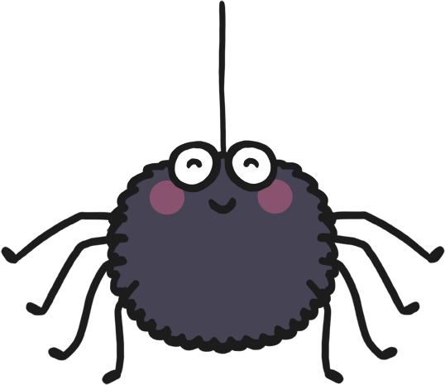
There was a spider in the bathroom.
+ adjectives =
There was a huge, hairy spider in the bathroom.

Slide 21
A slug was in my kitchen.
+ adjectives =
A slimy, sticky slug was in my kitchen.

Slide 22
I found a ladybird on a leaf.
+ adjectives =
I found a tiny ladybird on a big leaf.

Slide 23
A butterfly flew into my house.
+ adjectives =
A blue and white butterfly flew into my house.

Slide 24
The worm dug through the soil.
+ adjectives =
The wiggly, pink worm dug through the soil.

Slide 25
Now that you have learnt a little bit more about adjectives, have a go at the worksheet.
If you are still unsure, try 1 star or 2 star.

