Slide 1
Recap Set 2 sounds
Say each diagraph below that you can remember!

Slide 2
Recap ‘ay’
Read these green words :
play say lay
day way spray

Slide 3
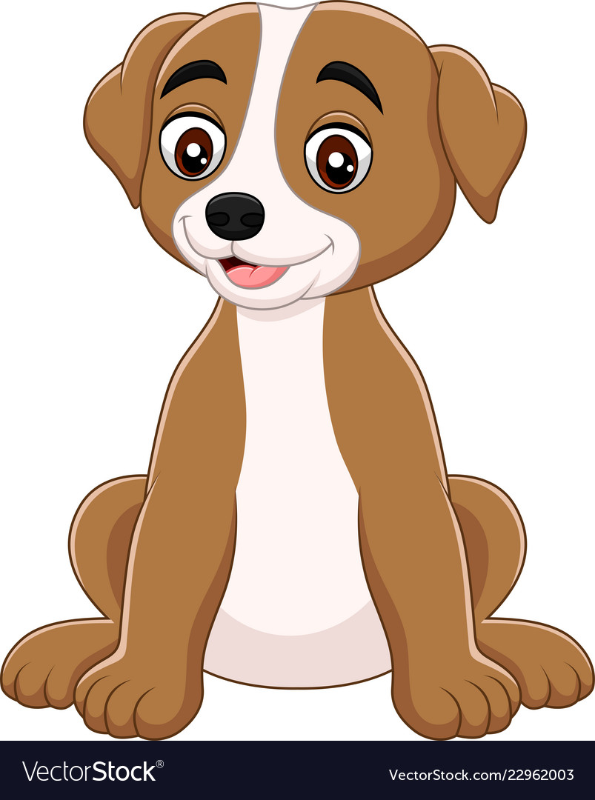
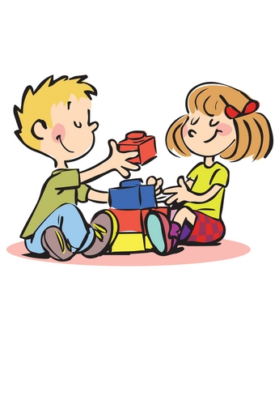
Read and underline the ‘ay’ sounds in these sentences
“Sit and stay” I said to my dog.
“Can I play with you?”

Slide 4
Can you write a sentence using the ‘ay’ sound?
_____________________________________________
_____________________________________________

