Slide 1
Recap Set 2 sounds
Say each diagraph below that you can remember!

Slide 2
Recap ‘ee’
Read these green words :
see bee tree
sleep been three

Slide 3
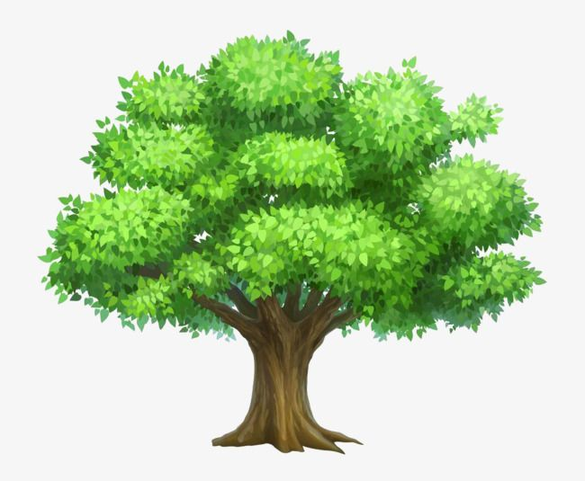
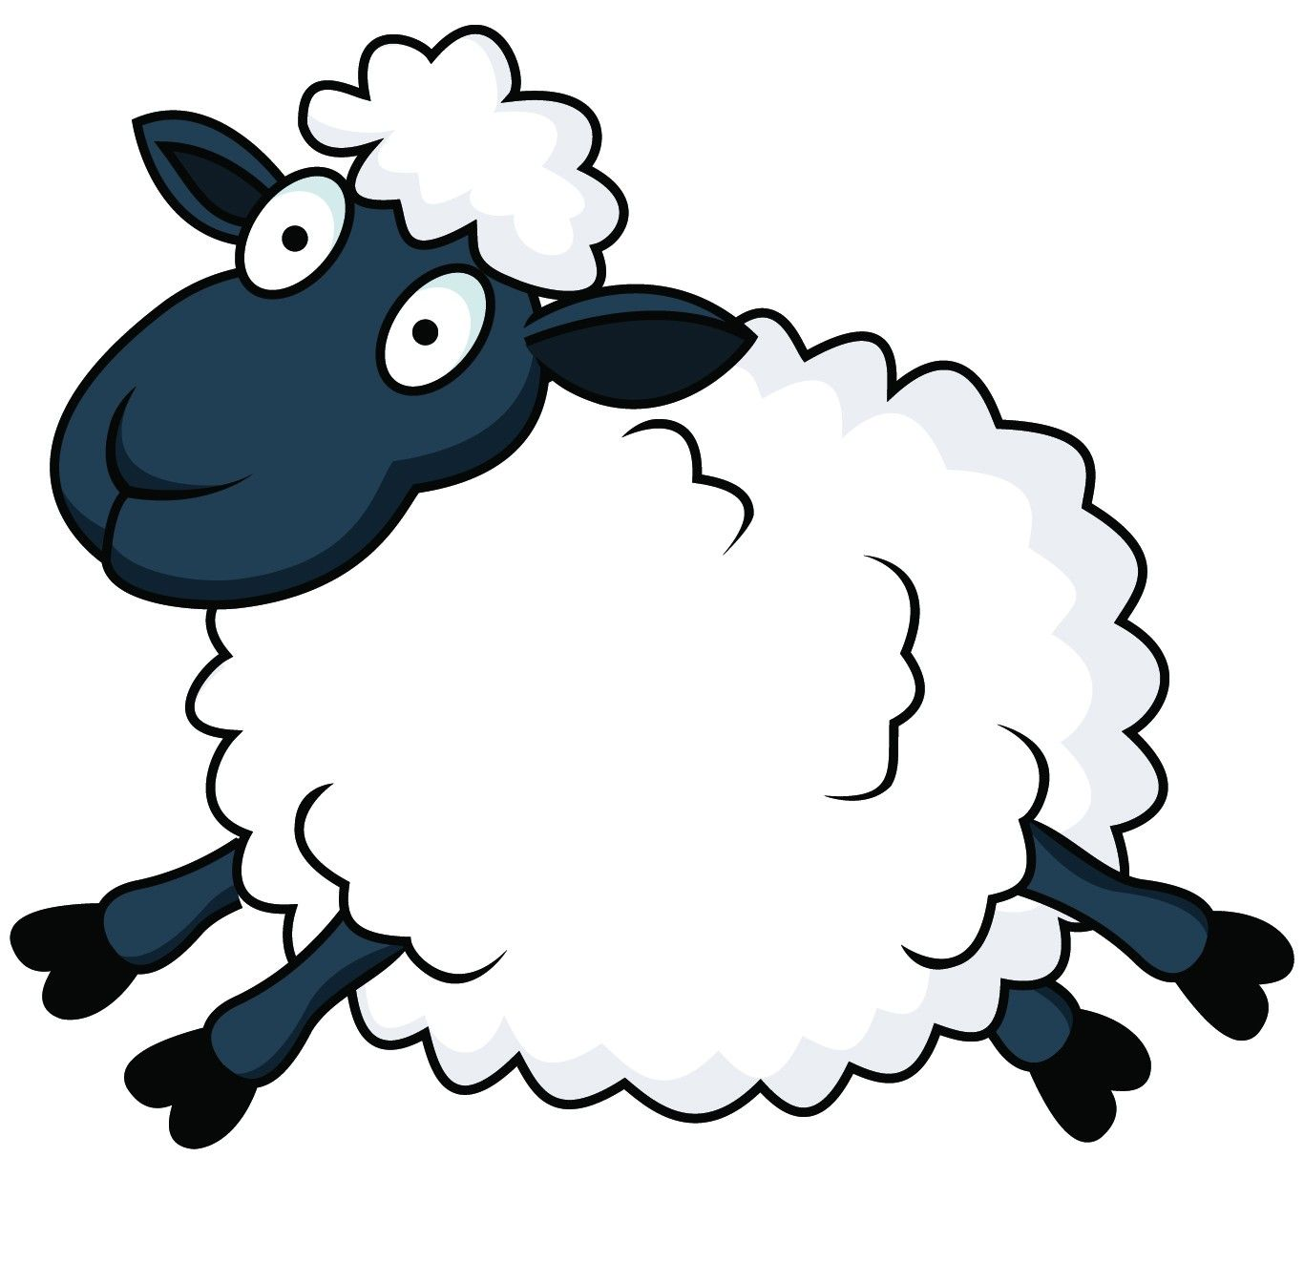
Read and underline the ‘ee’ sounds in these sentences
What a big tree.
Can you see the sheep?

Slide 4
Can you write a sentence using the ‘ee’ sound?
_____________________________________________
_____________________________________________

