Slide 1
Recap Set 2 sounds
Say each diagraph below that you can remember!

Slide 2
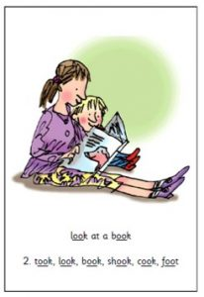
Recap ‘oo’
Read these green words :
took hook look
foot shook

Slide 3
Can you write a sentence using the ‘oo’ sound?
_____________________________________________
_____________________________________________

Slide 4
Read and underline the ‘oo’ sounds in these sentences
I am good.
The wood is big.

