Slide 1
Year 2 – Home Learning Maths – Spring 1 – Week 6
Measures

Slide 2
This week we will be looking at length and height.
There will be a video for you to watch at the beginning of each lesson and then following activities set.
While you are watching the video decide if you feel confident with the objective (3 star), you think the objective looks ok (2 star) or you are really unsure about what you are doing (1 star). Choose which activity you think will suit you best.
Some of the activities may require you to logon to Purple Mash.

Slide 3
Day 1 – measuring in cm
Today you will be learning how to accurately measure using a ruler.
Read through the PowerPoint.
You have then been set a 2Do on Purple Mash to practice measuring the length of different objects.

Slide 4
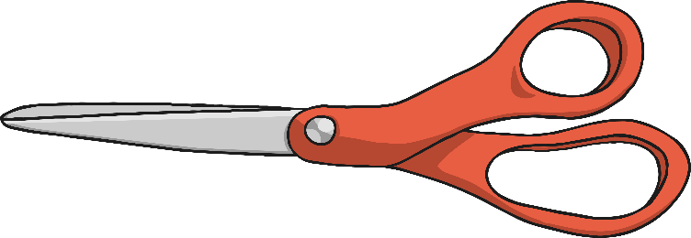
Step 1
Place the 0cm mark on the ruler at one end of the object you are measuring. Make sure you are using the centimetre scale. Do not measure from the end of the ruler.

Slide 5
Step 2
To find the length of the object to the nearest centimetre, round the length up or down to the nearest number on the ruler.

Slide 6
Step 3
Count the number of intervals after the whole centimetre to find the length of the object to the nearest millimetre.
Remember: 10mm = 1cm.

Slide 7
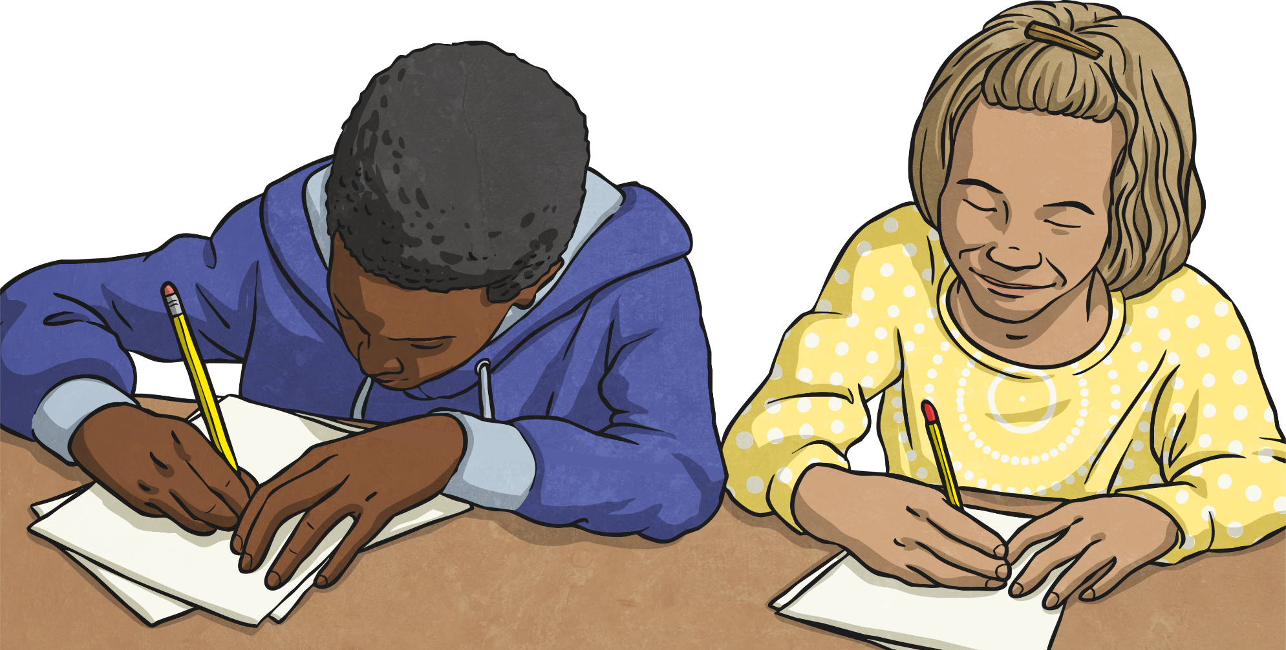
Step 4
Write down the length of the object in either centimetres or millimetres.

Slide 8
Day 2 – comparing lengths
Video - https://vimeo.com/403260907
Choose which star activity you would like to complete and use the links on the website to download the activities.

Slide 9
Day 3 –
Video - https://vimeo.com/405439836
For this activity if you have chosen to complete the 1 star activity – you have been set a 2Do on Purple Mash called measuring lengths.
Choose which star activity you would like to complete and use the links on the website to download the activities.

Slide 10
Day 4 –
Watch the two videos on the following website:
https://www.bbc.co.uk/bitesize/articles/zf4vbdm
Use what you have learnt to have a go at the quiz on the website.
Choose which star activity you would like to complete and use the links on the school’s website to download the activities.

Slide 11
Day 5 – Arithmetic Work
You have been given an arithmetic test paper to complete. Try to read each question carefully and write your answer in the box.
Remember that you can use paper to do any working out that you need to.
Once you have completed your paper, ask an adult to help you mark it.
Good luck! ☺

Slide 12
