Slide 1
Appreciate and be Thankful

Slide 2
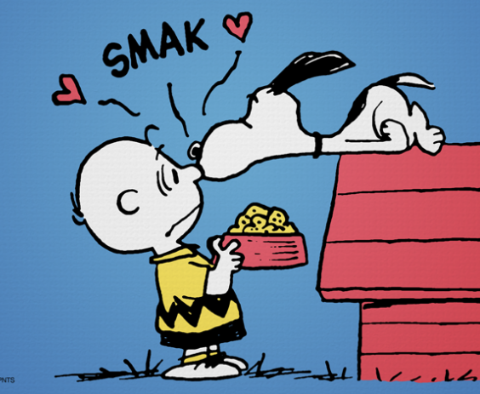
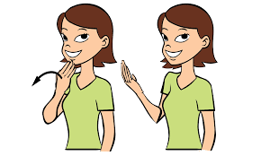
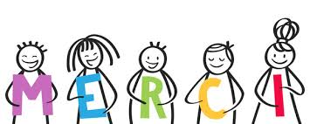

Slide 3
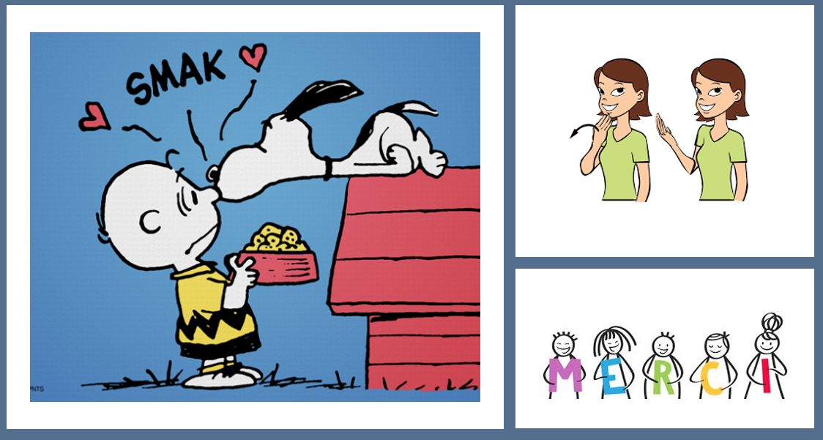
What do you see in the picture?
Can you make a prediction about what we are going to be talking about?
What questions do you have about this picture?
Come up with three questions.

Slide 4
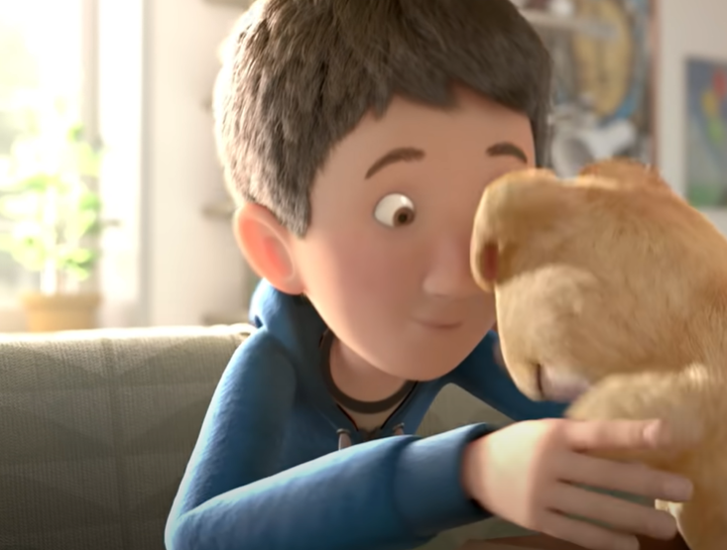
This is a short clip about a boy who is less than thankful for the present that his mum has bought him… https://www.youtube.com/watch?v=WjqiU5FgsYc

Slide 5
Why is showing gratitude so important?
How do you feel about this story?
What do you think we can learn from this story?
What is your one key emotional response word?

Slide 6
Why is showing gratitude so important? Luke 17:11-19
Be Thankful
11 Jesus was on his way to Jerusalem. Traveling from Galilee to Samaria, 12 he came into a small town. Ten men met him there. These men did not come close to Jesus, because they all had a harmful skin disease. 13 But they called to him, “Jesus! Master! Please help us!”
14 When Jesus saw the men, he said, “Go and show yourselves to the priests.”
While the ten men were going, they were healed. 15 When one of them saw that he was healed, he went back to Jesus. He praised God in a loud voice. 16 Then he bowed down at Jesus’ feet and thanked him. (This man was a Samaritan.) 17 Jesus asked, “Ten men were healed; where are the other nine? 18 Is this Samaritan the only one who came back to thank God?” 19 Then Jesus said to him, “Stand up and go on your way. You were healed because you believed.”
What do you think we can learn from this story?
How do you feel when people don’t say thank you to you?

Slide 7
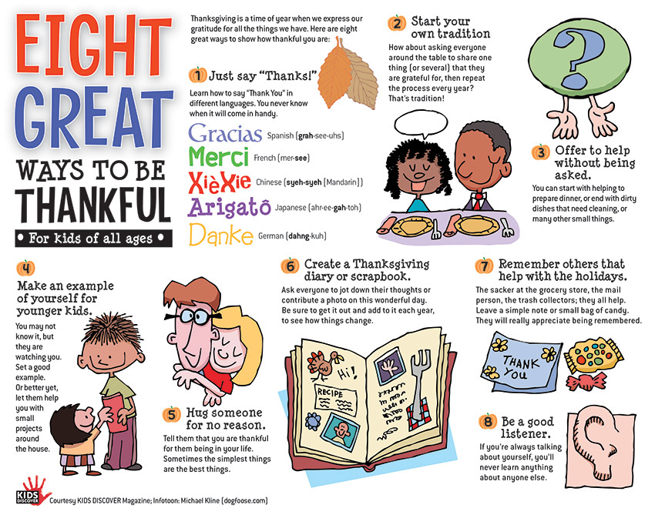
Challenge Question: What else can you do to be thankful? Try to think of at least three other examples. Choose one to put into action today.

Slide 8
reflection
There are so many powerful benefits of living a life of gratitude and thankfulness.
It can even have a benefit for your own health.
And being thankful not only applies to everyday life but for many people to God as well.
A person who has a foundation of gratitude creates an atmosphere of appreciation and positivity that encourages others to act in the same way.

Slide 9
British Values
Individual Liberty
We promote the freedom of choice and the right to respectfully express views and beliefs in a safe environment. With this comes a responsibility to make good choices that impact ourselves and others in a positive way.
This Photo by Unknown Author is licensed under CC BY-SA

