Slide 1
Recap Set 2 sounds
Say each diagraph below that you can remember!

Slide 2
Recap ‘or’
Read these green words :
for sort fork
short fort

Slide 3
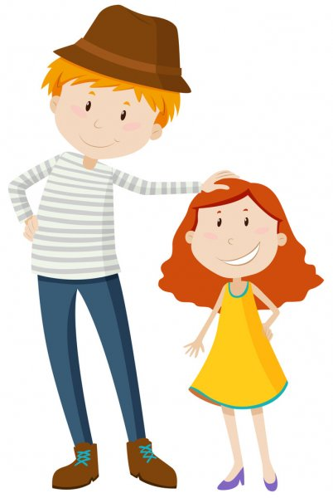
Read and underline the ‘or’ sounds in these sentences
The fork is long.
The girl is short.

Slide 4
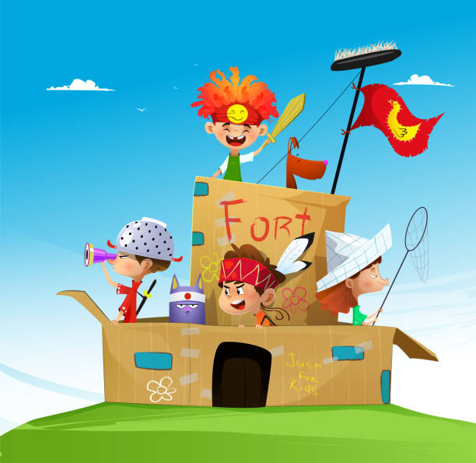
Can you write a sentence using the ‘or’ sound?
_____________________________________________
_____________________________________________

