Slide 1
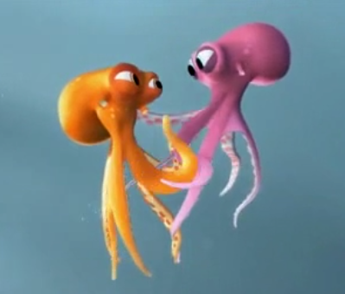
Monday 22nd February 2021
English – Octapodi Learning Objective: To make notes

Slide 2
Watch the video: Octapodi https://www.literacyshed.com/oktapodi.html
Watch the video again and make notes on what is happening, for example:
* two octopuses are hugging then the pink one is grabbed, put in a box and taken to a van * the orange octopus escapes and clings on to the van before it drives off * the driver spots Orange and tries to push him out of the window * the van swerves and Orange lands on the windscreen * the van stops and both octopuses are free. They jump into swimming pools as the driver chases them * the driver catches then but an octopus squirts ink at him and he crashes * a seagull grabs Orange so Pink uses her tentacles to slingshot herself after him.

Slide 3
Tuesday 23rd February 2021
English – Octapodi Learning Objective: To plan using a storyboard

Slide 4
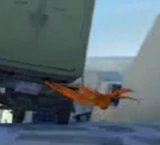
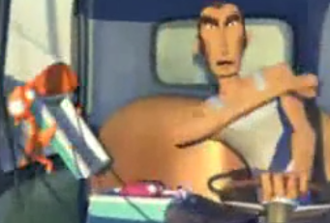
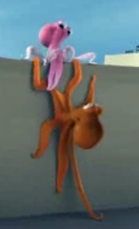
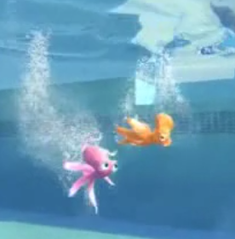
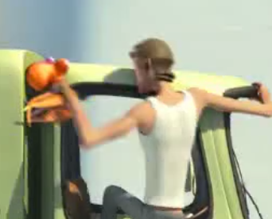
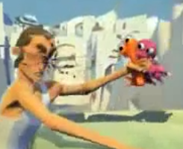
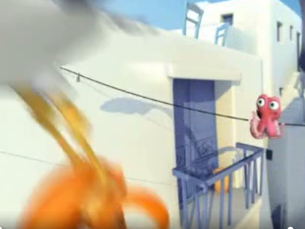
Use the storyboard to retell the story of Octapodi
* Two octopuses are hugging when suddenly Pink octopus is taken from the tank and put in a box. Orange octopus escapes and grabs onto the van to rescue her.
* The driver spots Orange and tries to push him out of the window. The van swerves and both octopuses fall out onto the floor.
* The octopuses jump into swimming and then leap from pool to pool with the driver chasing them, Eventually, the driver catches them.
* The octopuses squirt ink into the drivers face and he ends up crashing the van. A seagull grabs Orange so Pink slingshots herself after them .

Slide 6
Wednesday 24th and Thursday 25th February 2021
English – Octapodi Learning Objective: To retell a story using adjectives to describe

Slide 7
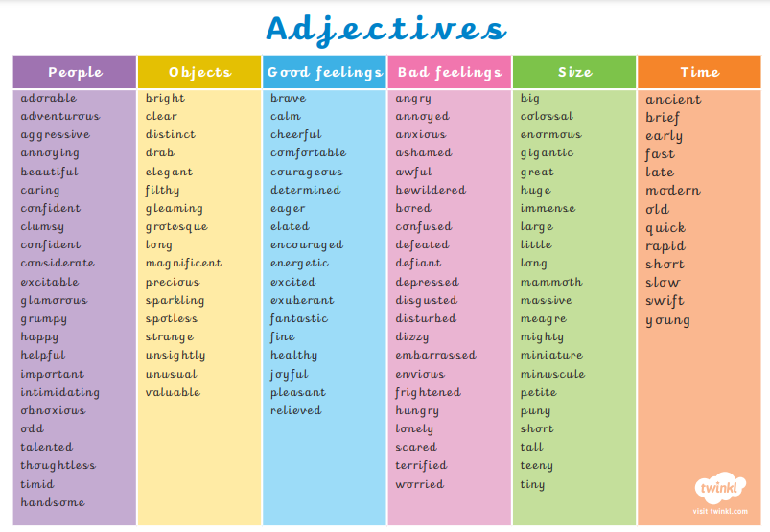
Using the plan from yesterday, can you retell the story of Octapodi. Remember to add adjectives to make your writing even better and give rich descriptions

Slide 8
When you have completed your re-telling of the story, can you please send it in to school. You can do this in a number of ways: * Class Dojo –take a photo of the piece of work and upload it in a message to me * Drop it off at the main office * Hand it to a member of staff if you are having home visits * Purple Mash – upload it to your Purple Mash account * Email it to the school office – a3317@telford.gov.uk stating your name and Y1 English

Slide 9
Friday 26th February 2021
English – SPAG
Learning Objective – To use exclamation marks

Slide 10
Spelling, Punctuation and Grammar
Exclamation Marks
Year One
SPaG | Exclamation Marks

Slide 11
Exclamation Marks

Slide 12
Exclamation Marks
Introductory Activity
Independent Focused Activity
Review Activity
Consolidation Activity
Assessment

Slide 13
Aim
I can use exclamation marks in my writing.
Success Criteria
I can say why an exclamation mark should be used.
I can spot sentences that need an exclamation mark.
I can change the way I read a sentence to show that it has an exclamation mark.
I can write a sentence using an exclamation mark.

Slide 14
Introductory Activity

Slide 15
Perfect Punctuation
Talk to your partner and try to answer these questions together:
What are punctuation marks?
Why are they important?
What punctuation marks do you know?

Slide 16
Perfect Punctuation
What are punctuation marks?
Why are they important?
Punctuation marks are the marks that you see at the end of sentences in writing.
Punctuation marks tell the reader when to take a breath and how the sentence should be read.
What punctuation marks do you know?
You might have thought of full stops, question marks or exclamation marks. Did anybody think of any others?

Slide 17
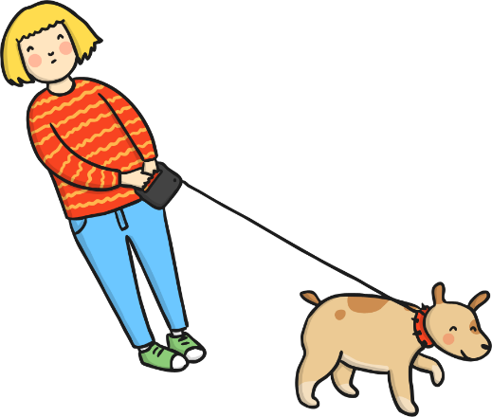
Perfect Punctuation: The Full Stop
.
Most sentences end with a full stop.
The sentence after a full stop always starts with a capital letter.
Tilly was a lovely dog. Every morning Tilly and her owner went for a walk.
Can you spot the capital letters and full stops in each sentence?

Slide 18
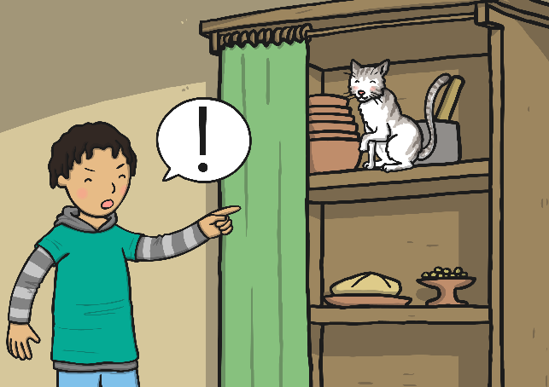
Perfect Punctuation: The Exclamation Mark
!
An exclamation mark ends a sentence that shows a strong feeling, like surprise or anger. They can also show that someone is raising their voice or shouting.
Exclamation marks are often used in speech.
The sentence after an exclamation mark
always starts with a capital letter.
Get out! You are not allowed to go in that cupboard!
Can you spot the capital letters and exclamation marks?

Slide 19
Perfect Punctuation Quiz
. Or !
Listen to your teacher read some sentences.
Hold up your punctuation card to show which punctuation mark is needed at the end of the sentence.
or

Slide 20
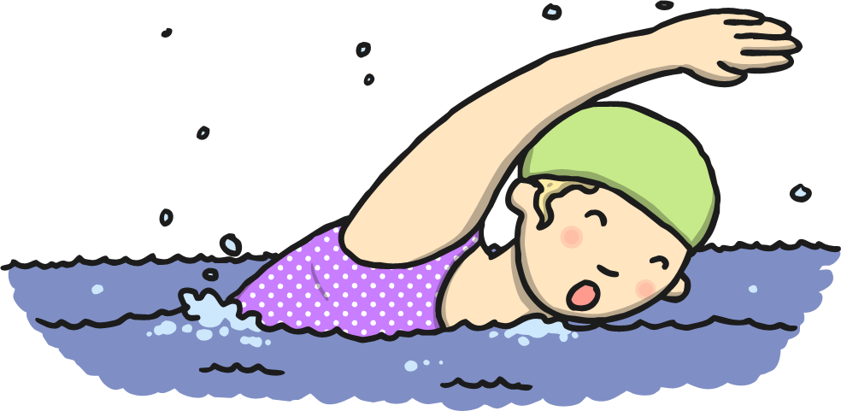
Perfect Punctuation
. Or !
Callie is going swimming tomorrow

Slide 21
Perfect Punctuation
.
Callie is going swimming tomorrow.

Slide 22
Perfect Punctuation
. Or !
Hey that’s my coat

Slide 23
Perfect Punctuation
!
Hey that’s my coat!

Slide 24
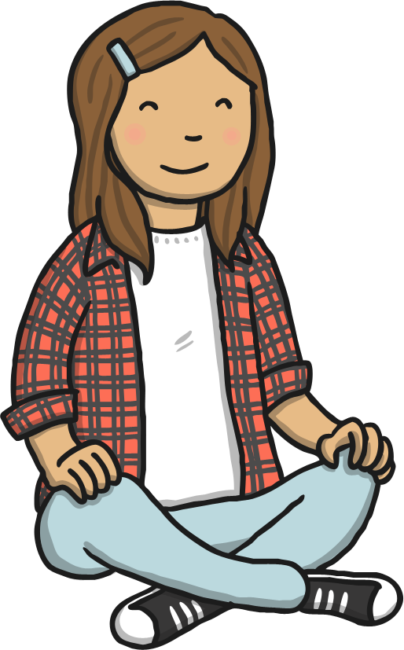
Perfect Punctuation
. Or !
Come and sit on the carpet please

Slide 25
Perfect Punctuation
.
Come and sit on the carpet please.

Slide 26
Perfect Punctuation
. Or !
Granny is coming to visit next week

Slide 27
Perfect Punctuation
.
Granny is coming to visit next week.

Slide 28
Perfect Punctuation
. Or !
Our class party was brilliant

Slide 29
Perfect Punctuation
!
Our class party was brilliant!

Slide 30
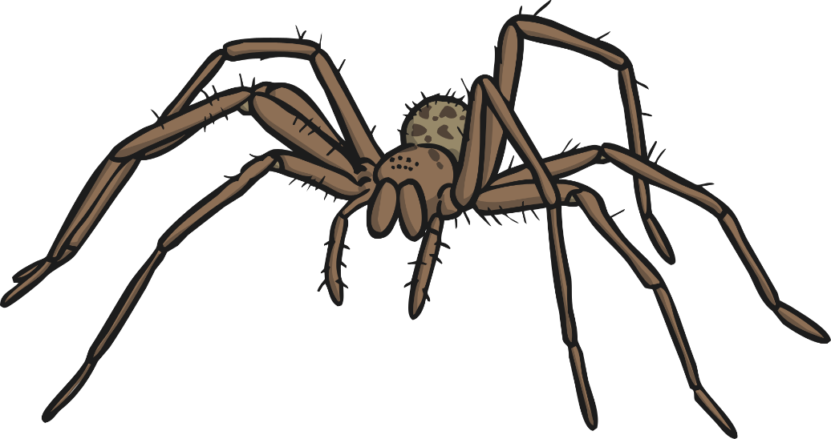
Perfect Punctuation
. Or !
That spider is huge

Slide 31
Perfect Punctuation
!
That spider is huge!

Slide 32
Independent Focused Activity

Slide 33
