Slide 1
YEAR 1
Place value (within 50)
Order numbers within 50
Count in 2s
Count in 5s
Block 2 – Week 7

Slide 2
Lesson 1
Step: Order numbers within 50 (Practical)

Slide 3
Fluency
Order the numbers from smallest to greatest.
17
12
15
12
15
17

Slide 4
Fluency
Order the numbers from smallest to greatest.
41
39
50
39
41
50

Slide 5
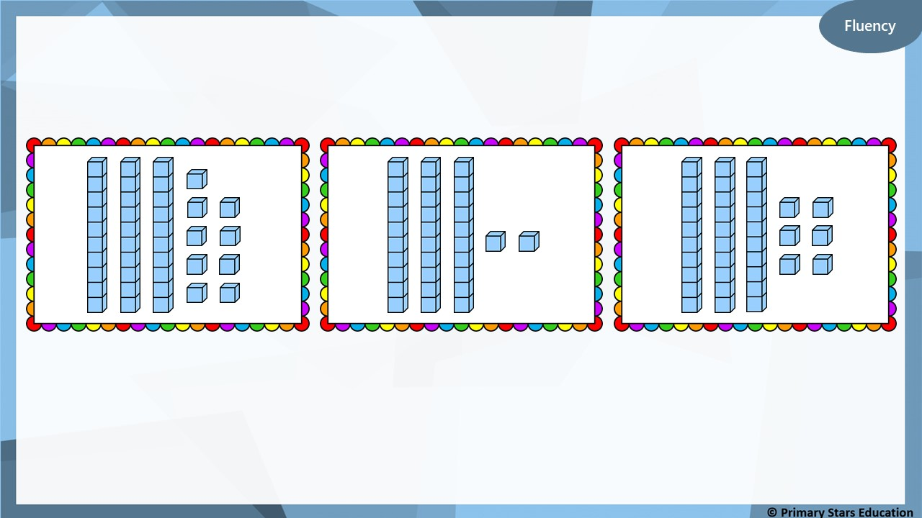
Order smallest to greatest.
39
32
36
32
36
39

Slide 6
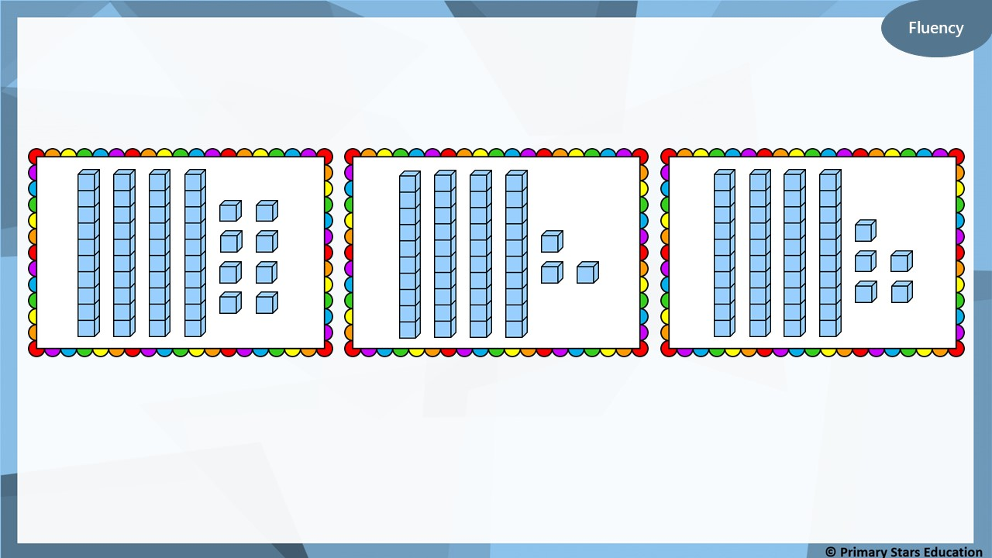
Order smallest to greatest.
48
43
45
43
45
48

Slide 7
I have ordered these numbers from smallest to greatest.
28 | 31 | 35 | 27 | 40
What mistake has Che made?
Che has put the number 27 between 35 and 40.
How could this be corrected? List all possible answers.
36, 37, 38 or 39

Slide 8
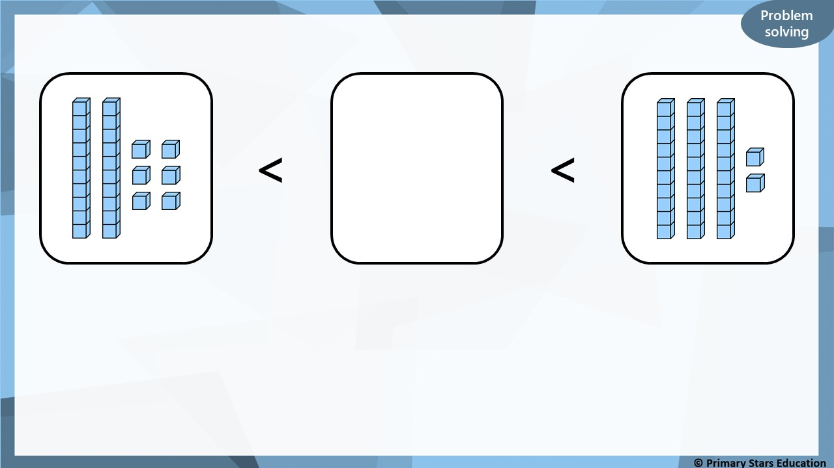
?
What numbers could go in the box?
27, 28, 29, 30 or 31.

Slide 9
Lesson 2
Step: Order numbers within 50

Slide 10
Fluency
Count how many in each group then order the groups.
A
7
B
9
C
6
smallest
6
7
9
greatest

Slide 11
Fluency
Count how many in each group then order the groups.
A
13
B
9
C
11
>
>
13
11
9

Slide 12
Fluency
Count how many in each group then order the groups.
A
8
B
12
C
10
<
<
8
10
12

Slide 13
Fluency
Order the numbers.
20 | 21 | 22 | 23 | 24
25 | 26 | 27 | 28 | 29
>
>
>
25
24
21
20

Slide 14
Fluency
Order the numbers.
33 | 34 | 35 | 36 | 37
38 | 39 | 40 | 41 | 42
>
>
>
39
38
37
35

Slide 15
Fluency
Order the numbers.
14 | 15 | 16 | 17 | 18
19 | 20 | 21 | 22 | 23
>
>
>
22
20
18
14

Slide 16
Fluency
Order the numbers.
35 | 36 | 37 | 38 | 39
40 | 41 | 42 | 43 | 44
<
<
<
35
36
40
41

Slide 17
Fluency
Order the numbers.
41 | 42 | 43 | 44 | 45
46 | 47 | 48 | 49 | 50
<
<
<
43
46
49
50

Slide 18
Fluency
Order the numbers.
11 | 12 | 13 | 14 | 15 | 16 | 17 | 18 | 19 | 20
21 | 22 | 23 | 24 | 25 | 26 | 27 | 28 | 29 | 30
31 | 32 | 33 | 34 | 35 | 36 | 37 | 38 | 39 | 40
>
>
>
29
27
20
18

Slide 19
Fluency
Order the numbers.
19 | 20 | 21 | 22 | 23 | 24 | 25 | 26 | 27 | 28
29 | 30 | 31 | 32 | 33 | 34 | 35 | 36 | 37 | 38
39 | 40 | 41 | 42 | 43 | 44 | 45 | 46 | 47 | 48
>
>
>
43
32
30
24

Slide 20
Fluency
Order the numbers.
21 | 22 | 23 | 24 | 25 | 26 | 27 | 28 | 29 | 30
31 | 32 | 33 | 34 | 35 | 36 | 37 | 38 | 39 | 40
41 | 42 | 43 | 44 | 45 | 46 | 47 | 48 | 49 | 50
<
<
<
25
29
40
50

Slide 21
Reasoning
Which group shows a mistake?
A)
13, 14, 15, 16, 17, 18
B)
30, 31, 23, 33, 34, 35
C)
45, 46, 47, 48, 49, 50
Explain your answer.
B shows a mistake as the number 23 should be the number 32.

Slide 22
Problem solving
49
43
?
>
>
What numbers could go in the box?
48, 47, 46, 45 or 44.

Slide 23
Lesson 3
Step: Count in 2s

Slide 24
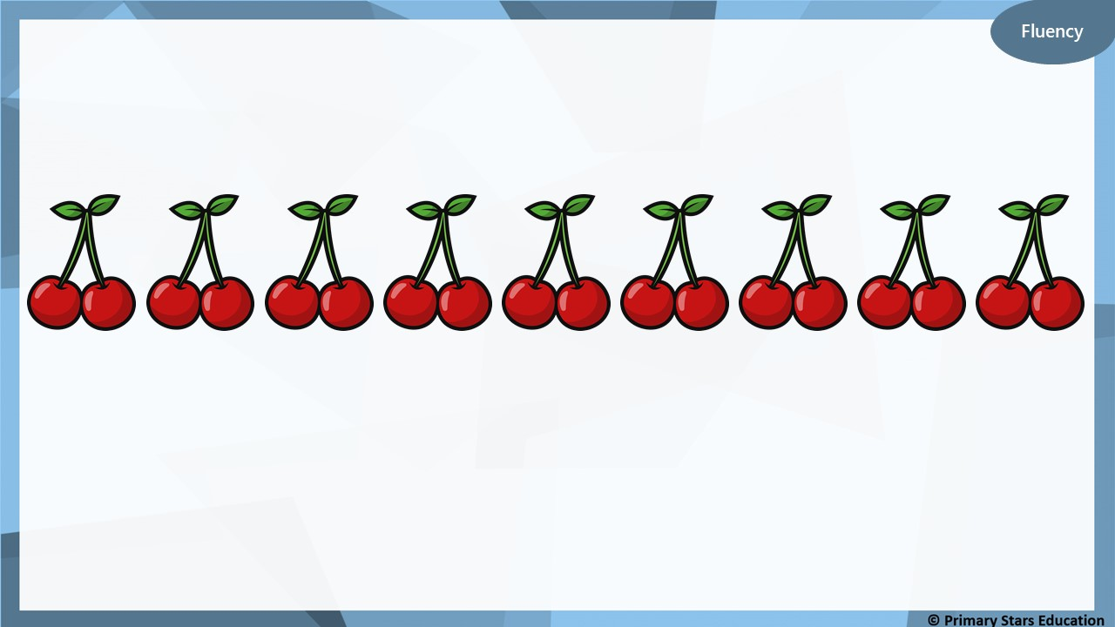
How many cherries are there?
18
There are ______ cherries in total.

Slide 25
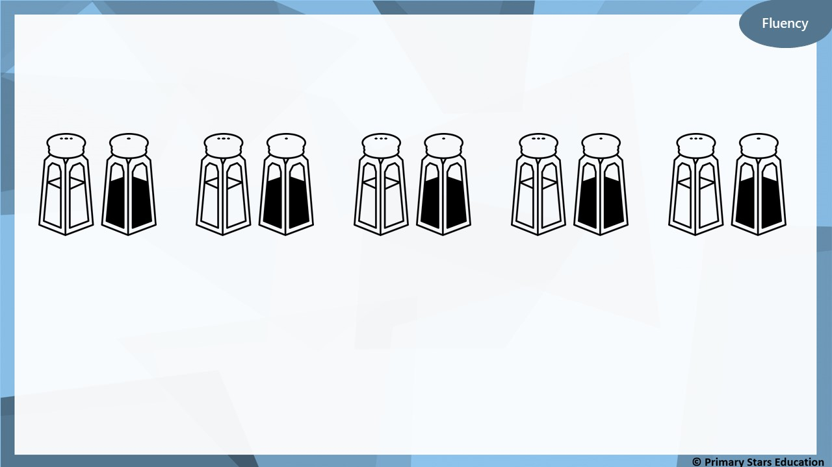
How many salt and pepper pots are there?
10
There are ______ salt and pepper pots in total.

Slide 26
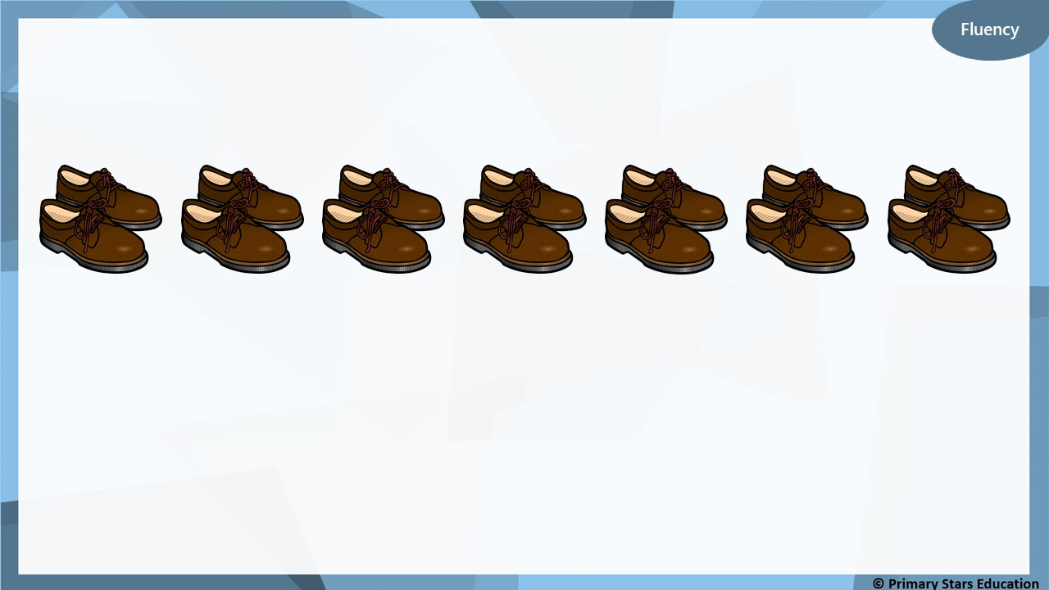
How many shoes are there?
14
There are ______ shoes in total.

Slide 27
Fluency
Count in 2s starting from 2.
1 | 2 | 3 | 4 | 5 | 6 | 7 | 8 | 9 | 10
11 | 12 | 13 | 14 | 15 | 16 | 17 | 18 | 19 | 20
 | 2 |  | 4 |  | 6 |  | 8 |  | 10
 | 12 |  | 14 |  | 16 |  | 18 |  | 20
What do you notice?
The pattern is white, pink, white, pink … All even numbers have been shaded.

Slide 28
Fluency
Complete the number lines by counting in 2s.
0
2
4
6
8
10
14

Slide 29
Fluency
Complete the number lines by counting in 2s.
16
18
20
22
24
26
14

Slide 30
Fluency
Complete the number lines by counting in 2s.
12
14
16
18
20
22
14

Slide 31
Fluency
Complete the number lines by counting in 2s.
40
42
46
48
50
44
14

Slide 32
Reasoning
30
32
34
38
40
42
14
What mistake has been made on the number line?
The number 36 is missing from the number line.

Slide 33
Ben counts backwards from 30 in 2s.
Beth counts forwards from 0 in 2s.
30, 28, 26, 24 …
0, 2, 4, 6 …
They say the numbers together at the same time.
Who will say 16 first?
Ben
Ben: 30 28 34 24 22 20 18 16 Beth: 0 2 4 6 8 10 12 14 16.

Slide 34
Lesson 4
Step: Count in 5s

Slide 35
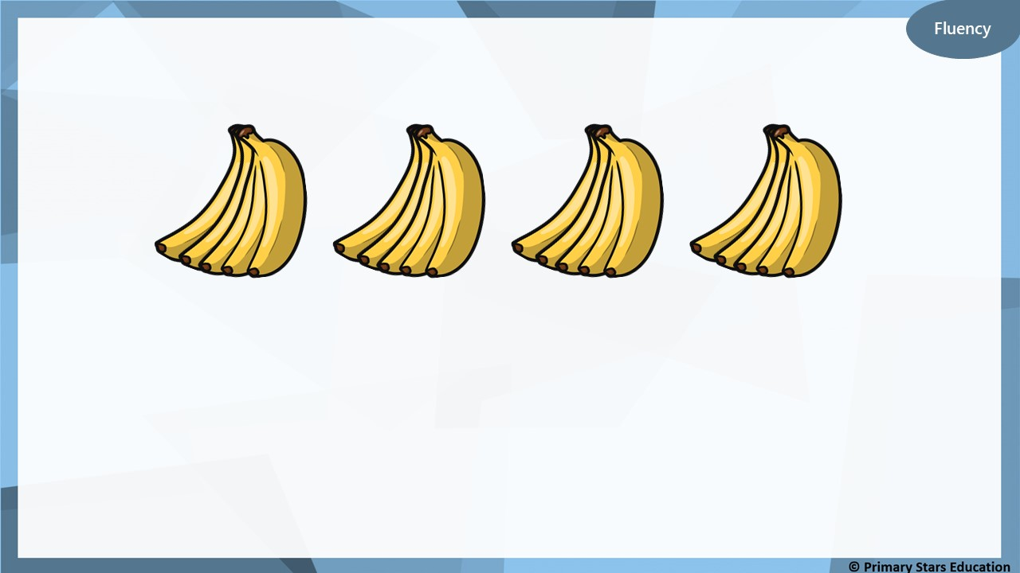
How many bananas are there?
5
There are ______ bananas in each bunch.
4
There are ______ bunches.
20
There are ______ bananas in total.

Slide 36
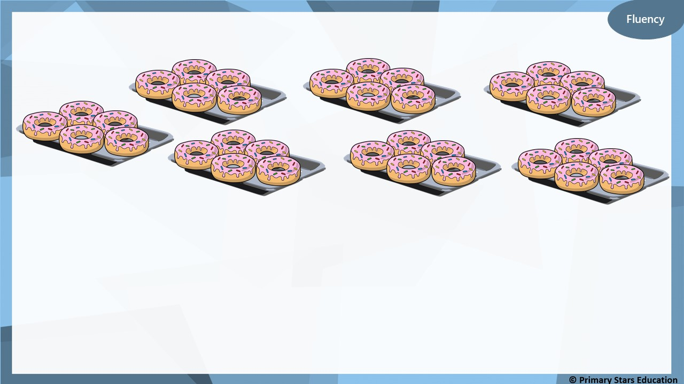
How many doughnuts are there?
5
There are ______ doughnuts on each tray.
7
There are ______ trays.
35
There are ______ doughnuts in total.

Slide 37
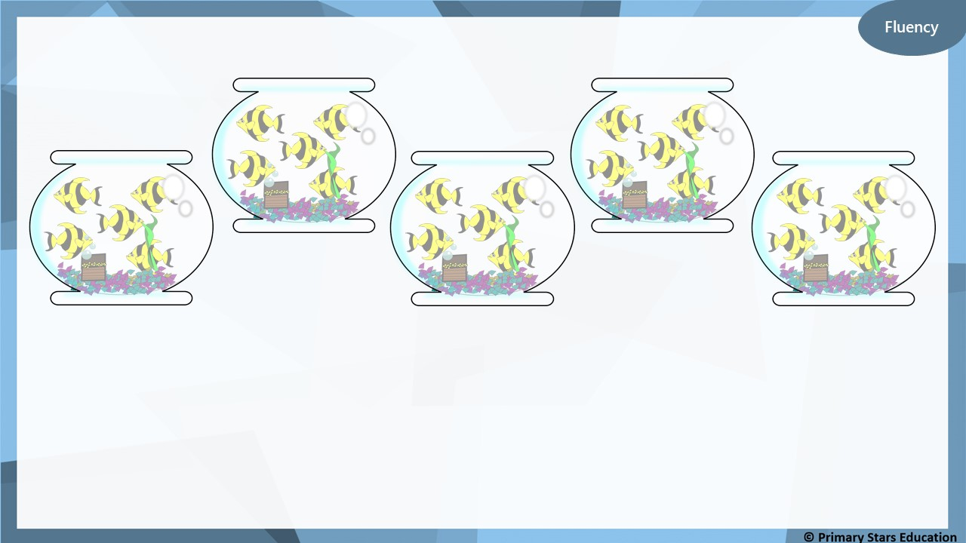
How many fish are there?
5
There are ______ fish in each tank.
5
There are ______ tanks.
25
There are ______ fish in total.

Slide 38
Fluency
Count in 5s starting from 5.
 |  |  |  | 5 |  |  |  |  | 10
 |  |  |  | 15 |  |  |  |  | 20
 |  |  |  | 25 |  |  |  |  | 30
1 | 2 | 3 | 4 | 5 | 6 | 7 | 8 | 9 | 10
11 | 12 | 13 | 14 | 15 | 16 | 17 | 18 | 19 | 20
21 | 22 | 23 | 24 | 25 | 26 | 27 | 28 | 29 | 30
What do you notice?
All the numbers ending in 5 and 0 have been shaded.

Slide 39
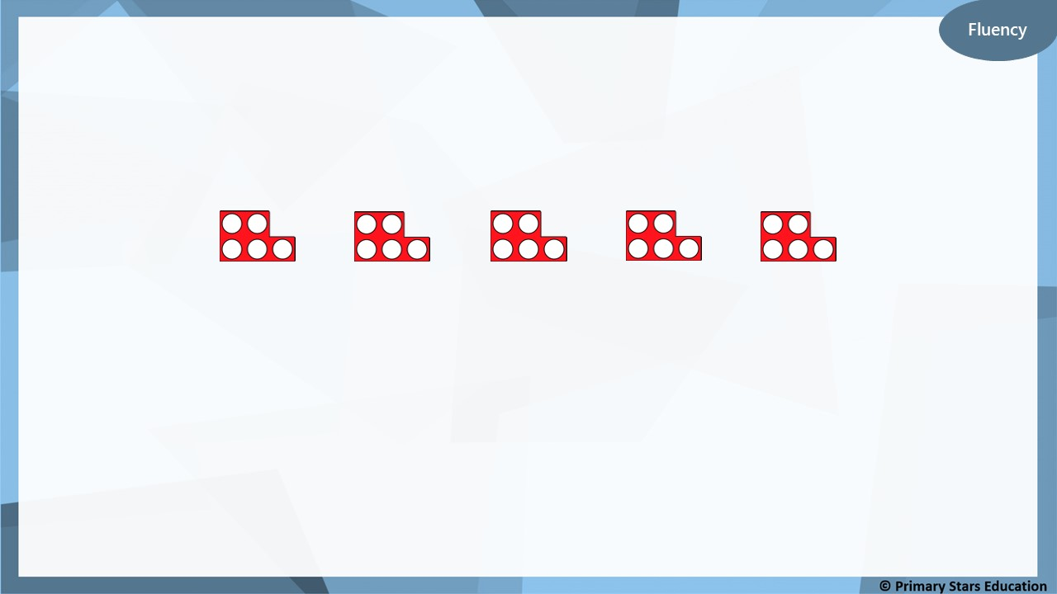
Complete the number lines by counting in 5s.
0
5
10
15
20
25
14

Slide 40
Complete the number lines by counting in 5s.
15
20
25
30
35
40
14

Slide 41
Fluency
Complete the number lines by counting in 5s.
15
20
25
30
14
10
35

Slide 42
Fluency
Complete the number lines by counting in 5s.
25
30
40
50
35
45
14

Slide 43
Reasoning
Which number is the odd one out?
40
35
29
20
Explain how you know.
29 is the odd number out as it is not divisible by 5.

Slide 44
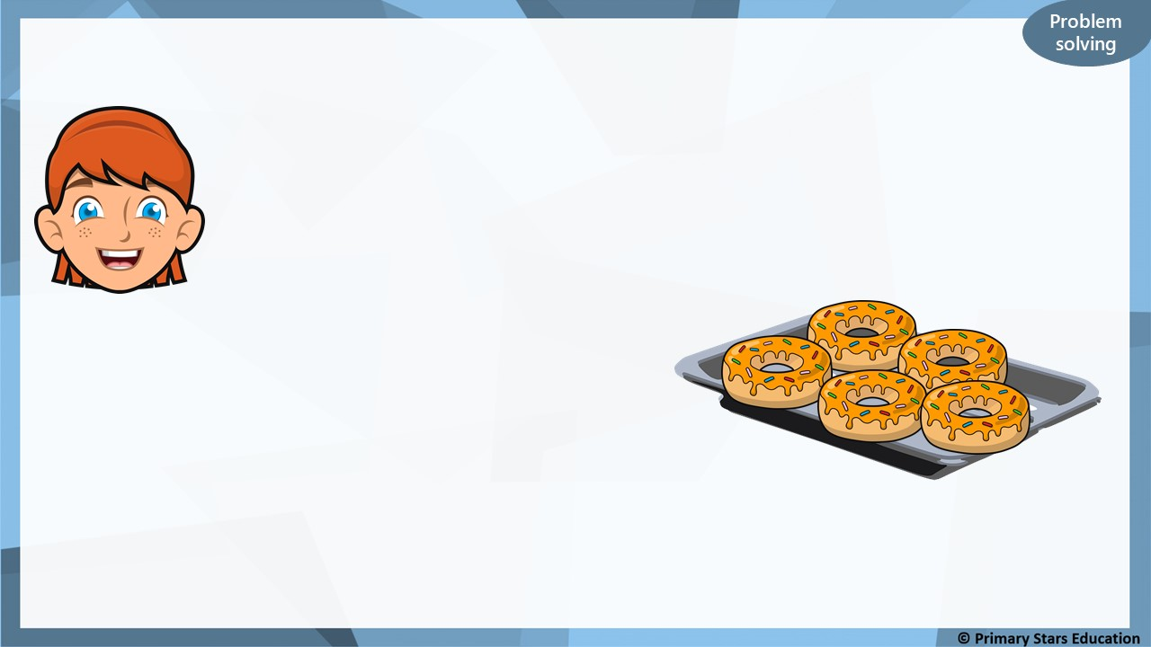
I have 30 doughnuts.
Each tray holds 5 doughnuts.
How many trays are there?
Explain your working.
6 trays. Counting up in 5s six times will get the answer of 30.

