Slide 1
Lesson 1 To plot the narrative from the perspective of one of the characters

Slide 2
https://www.literacyshed.com/oktapodi.html

Slide 3
+10
Reader
Plot point
-10

Slide 4
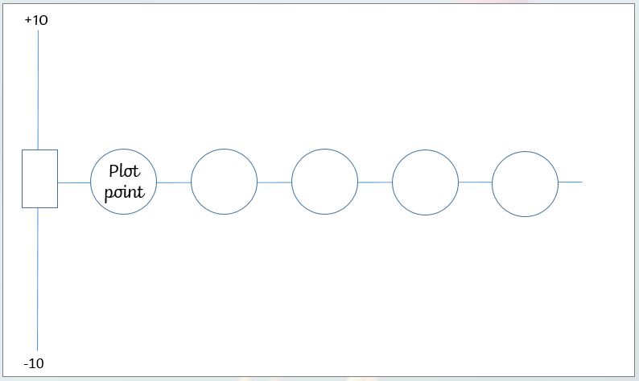
boy octopus
girl octopus
van man

Slide 5
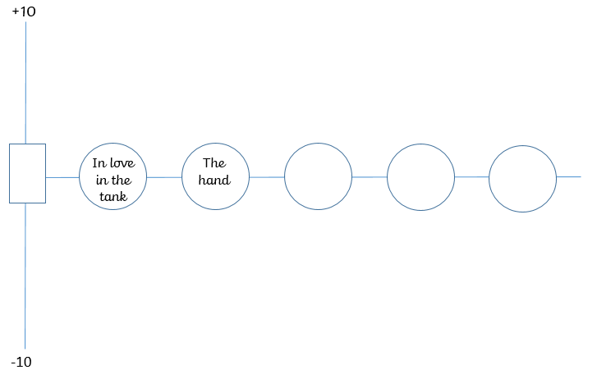
in love, happy
Boy Octopus
scared, shocked

