Slide 1
Lesson 3
To write an inner monologue
https://www.literacyshed.com/oktapodi.html

Slide 2
What is an inner monologue?
I don’t know what to do……
How can I get home?
I never should have run away!

Slide 3
Oh my pod!
Whose are those hands.
Where are they taking me??
Only two deliveries,
then I can go home and relax.
Who do you think these inner monologues belong to?

Slide 4
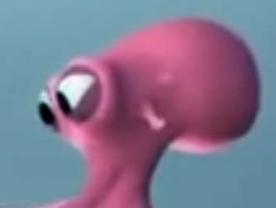
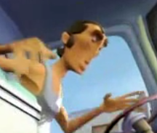
Oh my pod!
Whose are those hands.
Where are they taking me??
Only two deliveries,
then I can go home and relax.
The girl octopus. The van man.

Slide 5
The beginning of another fine day was upon me. Under the gaze of a greedy-looking gull, I reached the corner and pushed the door of the fishmonger’s shop, smiling and reaching forward to shake the hand of the man behind the counter. Oh no. It’s him. I wonder whether he
remembers me? He looks a little too interested in the fish he is cutting up to pay close attention to my face. Has it suddenly gone hot in here? Has he noticed who I am? I don’t think so. Phew. Just look around, act cool and try not to catch his eye! I took a deep breath and had a leisurely look around the shop, pondering over the items on sale. No rush today: I had plenty of time.

Slide 6
Now it’s your turn.

