Slide 1
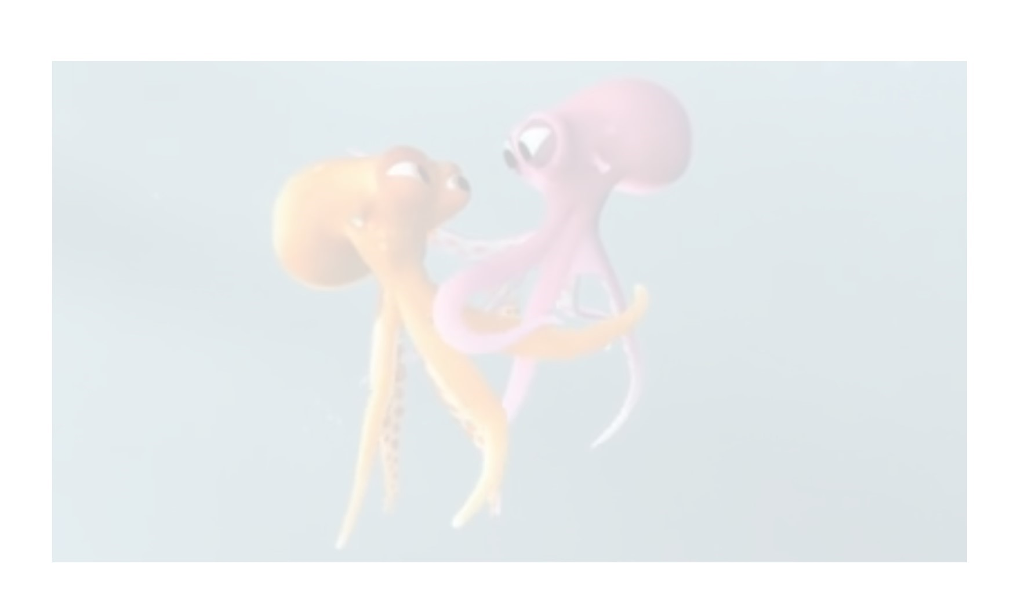
Lesson 5 To write a narrative from one character’s perspective.

Slide 4
Don’t forget to email a photo of your finished piece to me!
Have a great weekend.
Email: hannah.ferris@taw.org.uk

