Slide 1
Year 2 – Home Learning English – Spring 2 – Week 1
Fables

Slide 2
Reminder
Well done Year 2, you are working very hard! Don’t forget to have a go at all of the tasks set on Purple Mash and save them so that I can see what you have been up to!
We also have the blog on Purple Mash so please use this so we can keep in touch!
Try your best to continue to read out loud every day – parents can log reading on the Purple Mash blog.
All paper work should be saved and returned to school when we are open again!
Keep it up ☺

Slide 3
WHOLE SCHOOL WRITING PROJECT
This week, we are running a whole school writing project.
As part of your home learning, you need to take part in this project, and send us evidence of your entry. You can send you evidence in as:
Email to the school email address
A copy to be handed in at the reception
Upload it to Purple Mash
Entries for the writing project must be in by Wednesday 3rd March.

Slide 4
Day 1 – Writing Competition…
Watch the following video;
https://www.literacyshed.com/oktapodi.html
While watching the video, think carefully about what each character might be feeling at different parts of the story. Consider what descriptive sentences you could create to describe the setting and characters.

Slide 5
Day 1 - Planning
Now you must choose one idea for your writing based on the video;
Retell the narrative using rich description and vivid imagery.
Write a dialogue between the two octopi at various points throughout.
Discuss what is going to happen to each of the octopi.
Write alternative endings to the story.
Write stories with flashbacks, perhaps the octopus wakes up in
the truck and a flash back takes place remembering the tank

Slide 6
Day 1 - Planning
Spend this session planning your writing…
Think carefully about the purpose of your writing, what you have decided to do based on the video.
Use a mind map or bullet points to organise your thoughts.
Are you going to use paragraphs?
Will you be writing in first or third person?
What adjectives and similes could you use to describe the setting and characters?

Slide 7
Day 2 – Writing Competition entry
In the previous session, you planned your writing entry for our whole school writing competition.
Before starting to write your entry, I recommend re-watching the video to remind yourself what happened.
https://www.literacyshed.com/oktapodi.html
We will be looking carefully at grammar, punctuation and handwriting.

Slide 8
Once your entry has been received, you will receive feedback from your teacher, which will involve you editing and might require redrafting.
Please make sure that you try just as hard as you would at school so that your teacher can see exactly how well you are doing with your writing.
I can’t wait to read all of your entries and we will give you feedback on your next phone call or visit!
Don’t forget, entries for the writing project must be in by Wednesday 3rd March.

Slide 9
Day 3 – Cold Write
This half term we will be looking at writing our own fables.
Remember that at the beginning of each unit, we complete a cold write. A cold write is an independent piece of writing before we have learnt anything about the topic. This shows what we already know.
Today you will be writing a fable about a tortoise and a leopard, remember that a tortoise can’t move very fast but a leopard can.
Remember that it is ok to find this difficult, you are yet to learn what a fable is. Just have a go and try your best to show what you think a fable might be and the features! ☺

Slide 10
Day 4
Fables are very old stories. They give people a special message or lesson called a ‘moral’. Fables can be quite short stories and they usually have animals in them. At first fables were oral stories, but later people wrote them down and published collections of them in books. One of the most famous collections was put together by a man named Aesop.
Glossary
fable | short stories with animals in them that teach us a lesson
moral | a group of stories put into a book
oral tales | a special message or lesson
collection | stories told aloud to listeners but not written down

Slide 11
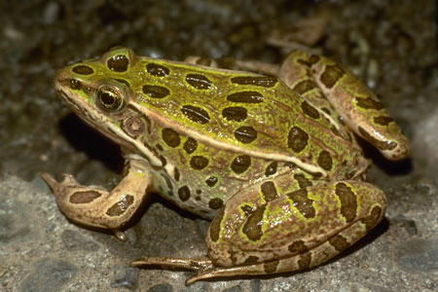
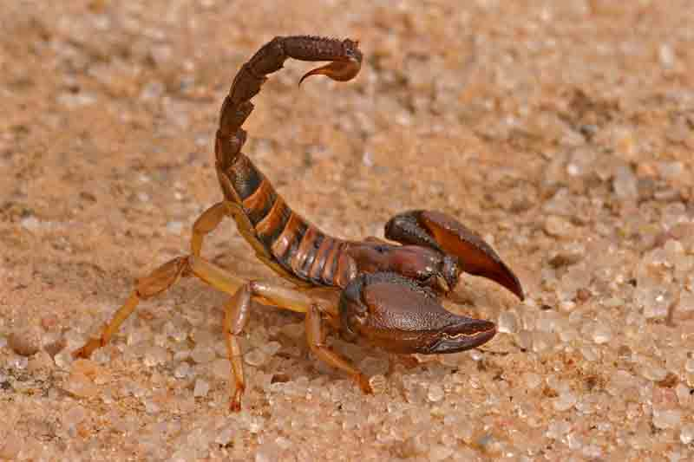
Fables
In the next session we will read a fable about the following two animals;
Leopard Frog
Indian Red Scorpion

Slide 12
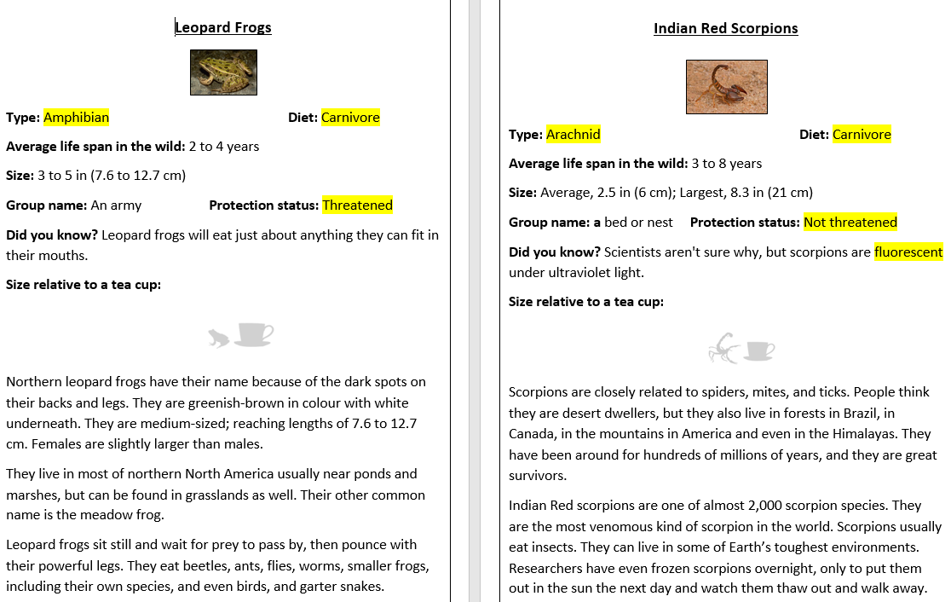
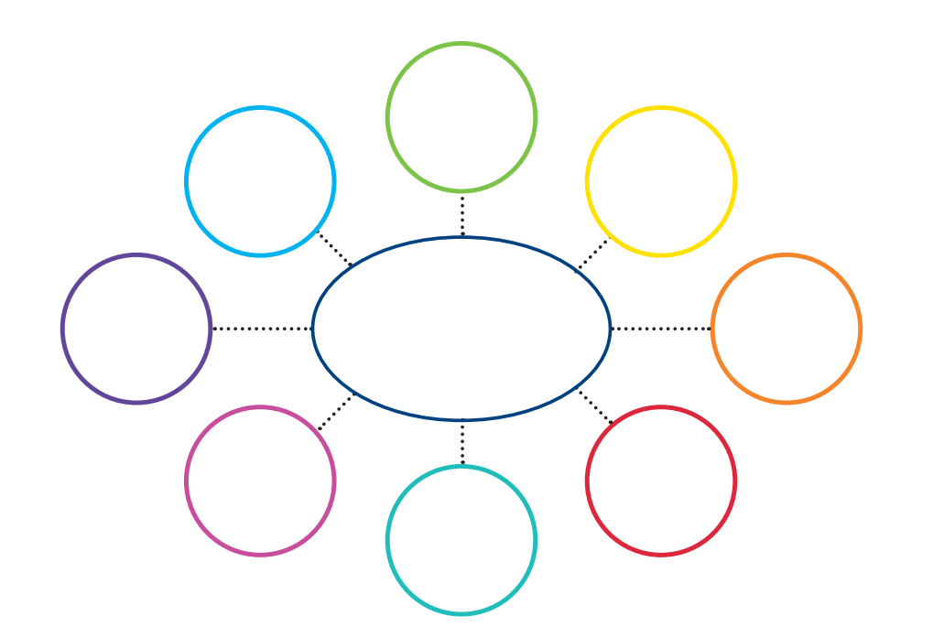
Today we will be finding out more information about the Leopard Frog and Indian Red Scorpion.
You will need to read carefully through the fact files and create a mind-map with the key information that you have learnt (this will help you for the next session.)

Slide 13
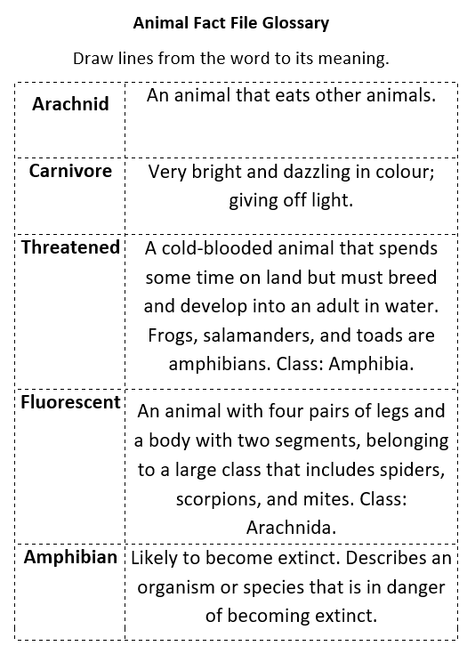
Glossary
Now, use the internet or a dictionary to fix the jumbled glossary.

Slide 14
Extension
Watch the following videos…
Can you find two things that are similar for each animals and two things that are different?
https://video.nationalgeographic.com/video/indian-red-scorpion-predation?source=searchvideo and
https://video.nationalgeographic.com/video/frog_northern_leopard?source=searchvideo

Slide 15
Day 5
Think carefully about the two animals that you read about in the previous session.
Now, listen to the fable of the Frog and the Scorpion. If you don’t have access to YouTube, you can read the outline of the fable.
https://www.youtube.com/watch?v=v2ZWZTlcRcs
While listening to the story;
Can you predict what might happen?
Do you think the frog trusts the scorpion?
What would you do?

Slide 16
“It’s in my nature…”
When the frog asked the scorpion, “Why did you sting me?” the scorpion replied, “It’s in my nature.”
What do you think he meant by this?

Slide 17
“It’s in my nature…”
It’s just the way I am. I cannot help it. It’s how I’m made.
The scorpion explained to the frog that it’s what he was meant to do. It’s just who he is.
Similar to the expression ‘A leopard can’t change his spots.”
In this session we will be writing about ourselves, thinking carefully about our personality and behaviour.

Slide 18
Activities….
1 star – Use the template ‘How I am.’ to organise your sentences. Thinking carefully about what is good about you, what is not so good about you and things that you would like to change.
2 star – Create a short paragraph, discussing your personality and behaviour. Think about what other people like about you and things you think you might need to work on.
3 star – Create descriptive sentences to build a paragraph about your personality and behaviour. Can you compare these features to someone else in your household?

