Slide 1
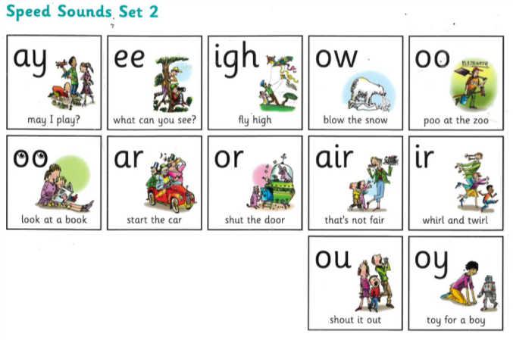
Recap Set 2 sounds
Say each diagraph below that you can remember!

Slide 2
Recap ‘ou’
Read these green words :
out shout ouch
mouth loud

Slide 3
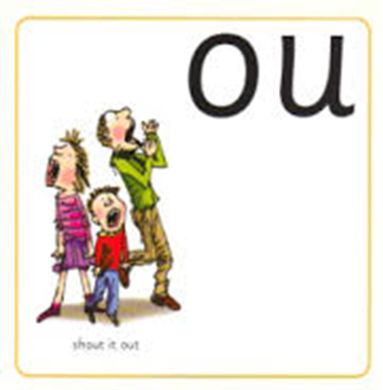
Read and underline the ‘ou’ sounds in these sentences
I am loud.
Shout it out!

Slide 4
Can you write a sentence using the ‘ou’ sound?
_____________________________________________
_____________________________________________

