Slide 1
Year 2 – Home Learning English – Spring 2 – Week 2
Descriptive writing

Slide 2
Reminder
Well done Year 2, you are working very hard! Don’t forget to have a go at all of the tasks set on Purple Mash and save them so that I can see what you have been up to!
We also have the blog on Purple Mash so please use this so we can keep in touch!
Try your best to continue to read out loud every day – parents can log reading on the Purple Mash blog.
All paper work should be saved and returned to school when we are open again!
Keep it up ☺

Slide 3
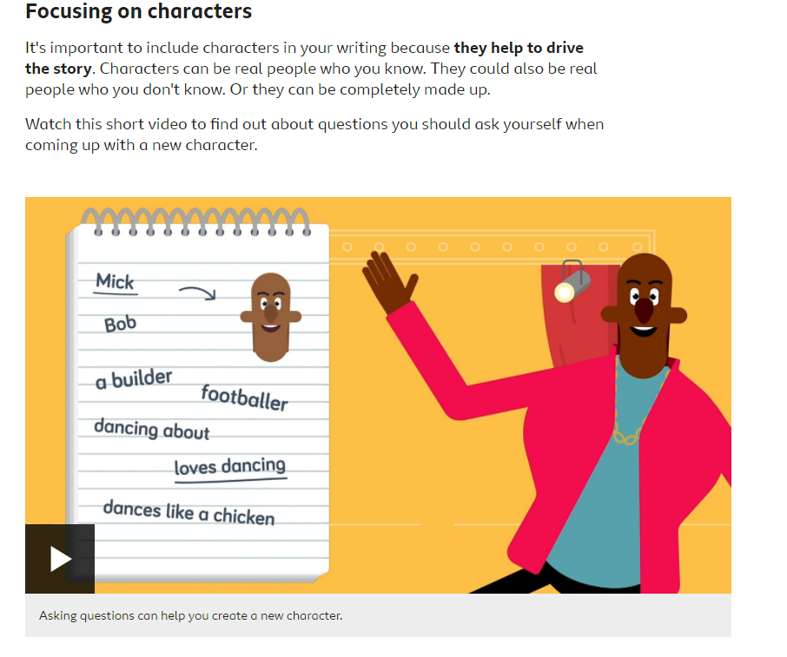
Day 1 – Character descriptions
https://www.bbc.co.uk/bitesize/articles/zg2tqfr

Slide 4
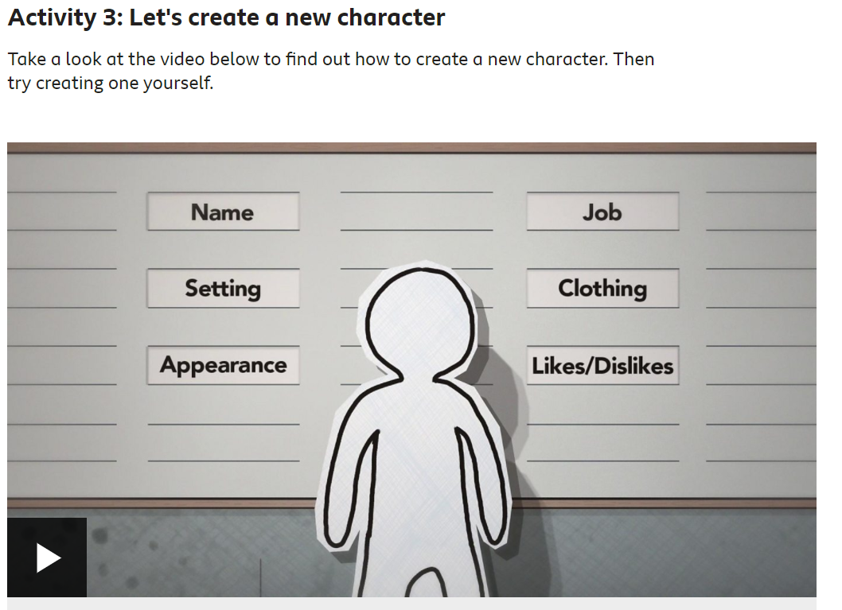
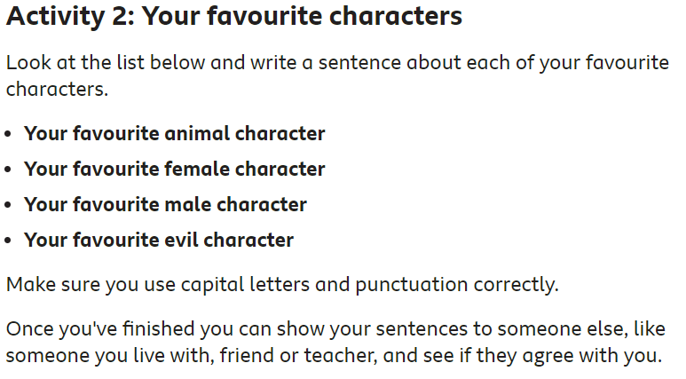
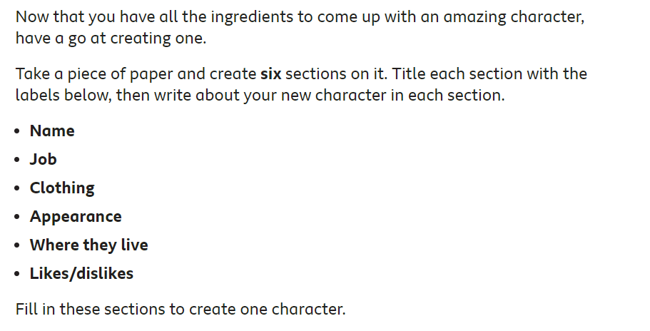
Activities…
Don’t forget to use adjectives and similes to make your character descriptions exciting.
https://www.bbc.co.uk/bitesize/articles/zg2tqfr

Slide 5
Day 2 – Expanded Noun Phrases

Slide 6
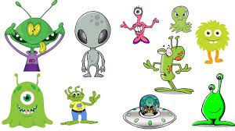
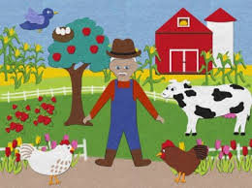
L.O.- To use expanded noun phrases
What will we be learning today?
What words do you recognise in our learning objective?
How might they help us with our learning today?

Slide 7
Expanded noun phrases…
An expanded noun phrase adds more detail to the noun by adding one or more adjectives. An adjective is a word that describes a noun.
For example: a huge tree, some colourful sweets, the large, royal castle

Slide 8
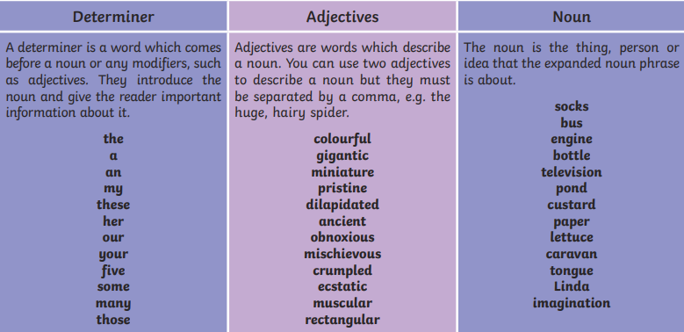

Slide 9
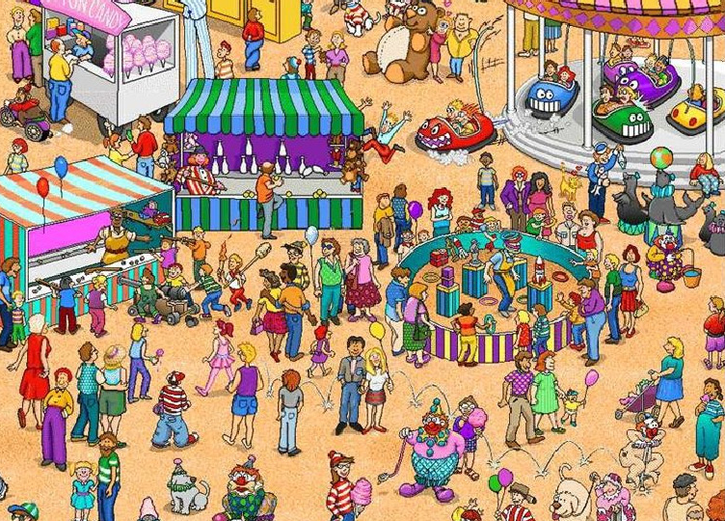
Can you find the lady?
Is that specific enough?

Slide 10
Can you find the tall lady?
Is that specific enough?

Slide 11
Can you find the tall lady with the red dress?
Is that specific enough?

Slide 12
What do you notice happening to the balloon each time I expand my description?

Slide 13
The _________, _________ man with _____ _________ ran away from the bumper truck.

Slide 15
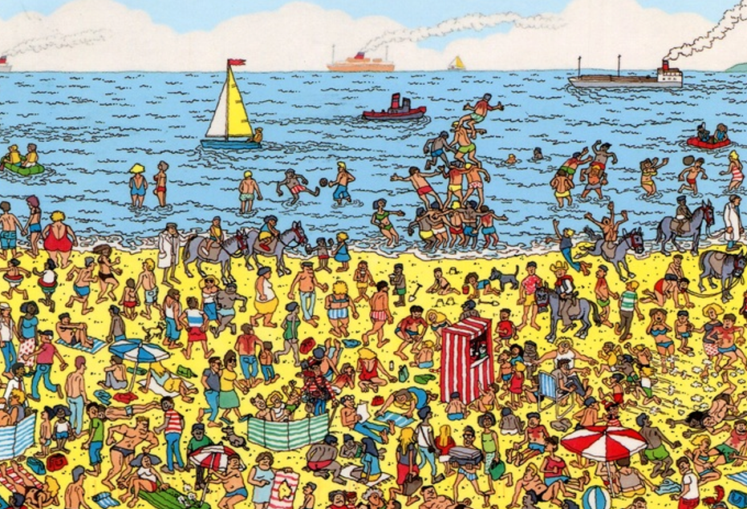
Activities…
Use the Where’s Wally pictures to create expanded noun phrases for some of the characters.
1 star challenge – create a sentence with an expanded noun phrase in it. Can someone in your family guess who you are talking about?
2 star challenge – create sentences with an
expanded noun phrase and simile.
Can someone in your family guess who you
are talking about?

Slide 16
Day 3 – setting descriptions

Slide 17
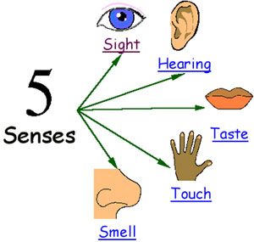
Setting
When you write about a setting, you need to make sure you use lots of description so a reader can picture themselves there.
Effective descriptions appeal to the senses.

Slide 18
One morning there was a different smell in the air, and the ship was moving oddly, with a brisker rocking from side to side instead of the plunging and soaring. Lyra was on deck a minute after she woke up, gazing greedily at the land: such a strange sight, after all that water, for though they had only been at sea a few days, Lyra felt as if they’d been on the ocean for months. Directly ahead of the ship a mountain rose, green-flanked and snow capped, and a little town and harbour lay below it: wooden houses with steep roofs, an oratory spire, cranes in the harbour, and clouds of gulls wheeling and crying. The smell was of fish, but mixed with it came land smells too: pine-resin and earth and something animal and musky, and something else that was cold and blank and wild: it might have been snow. It was the smell of the North.
SIGHT
HEARING
Seals frisked around the ship, showing their clown-faces above the water before sinking back without a splash. The wind that lifted spray off the white-capped waves was monstrously cold, and searched out every gap in Lyra’s wolfskin.
TOUCH
TASTE
SMELL

Slide 19
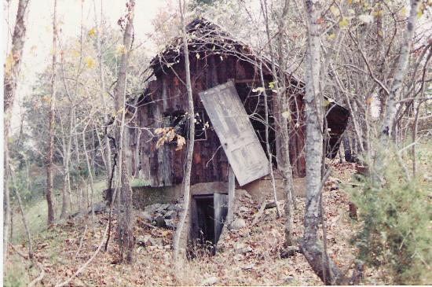
Vocabulary ideas: dilapidated, overgrown, wilderness, lonely, broken.
Describe this setting. You must include a simile (comparing two things using like or as e.g. The house shrivels and rots like a piece of discarded fruit).

Slide 20
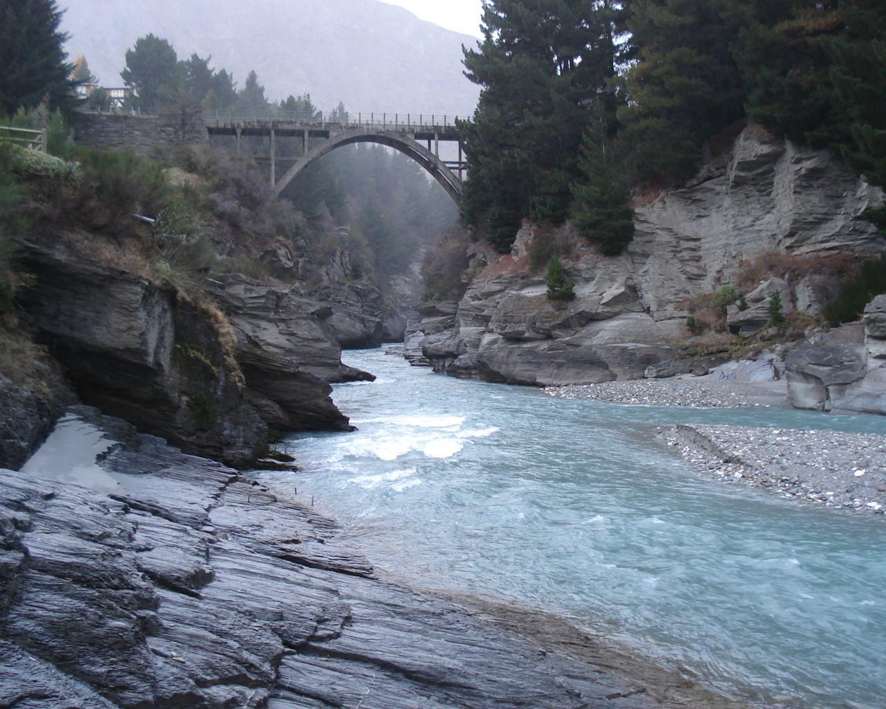
Vocabulary ideas: powerful, relentless, meanders , unforgiving
Describe this setting. You must include a simile (comparing two things using like or as e.g. The rocks jut out like...).

Slide 21
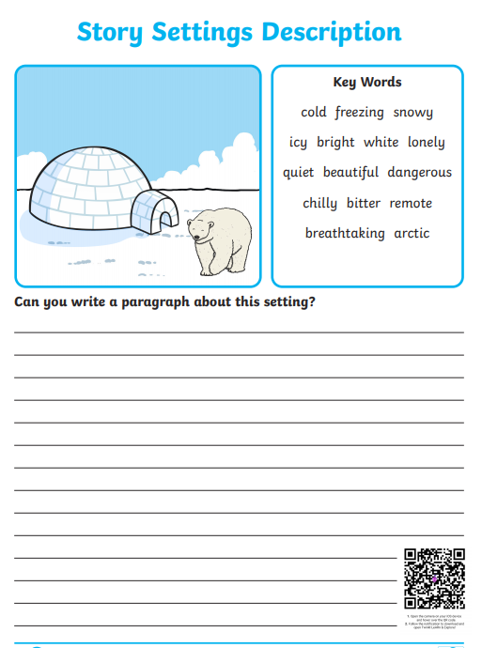
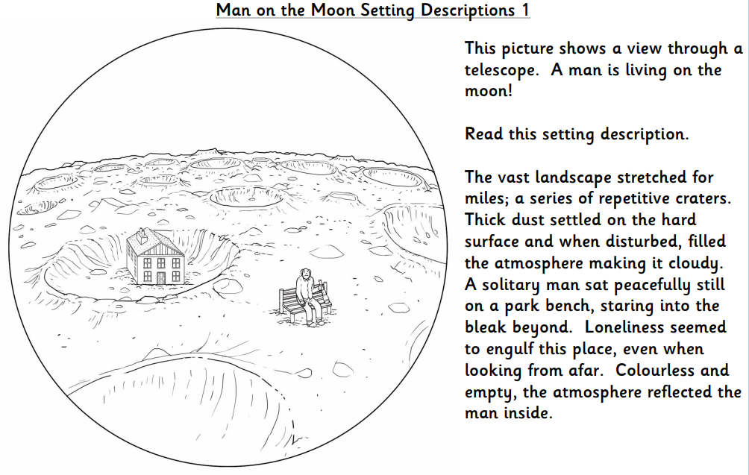
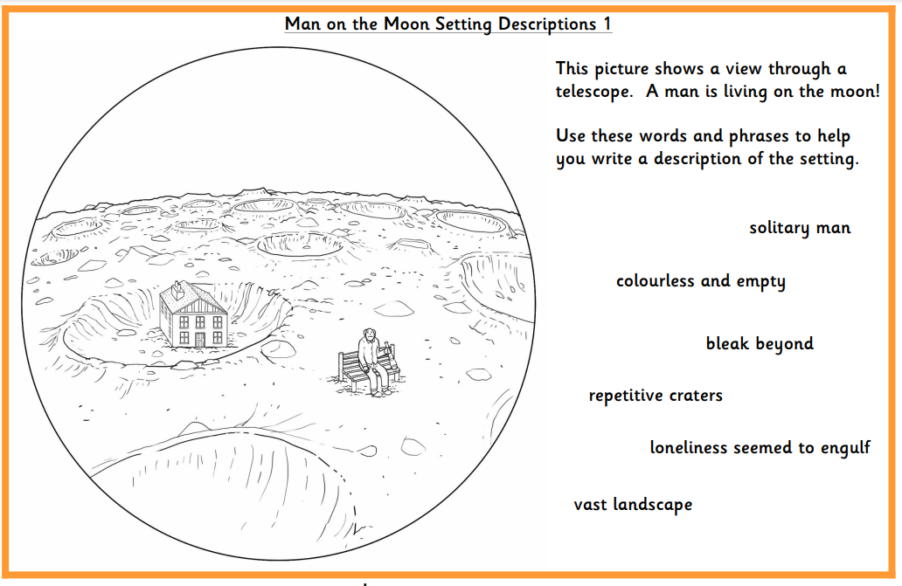
Activities

Slide 22
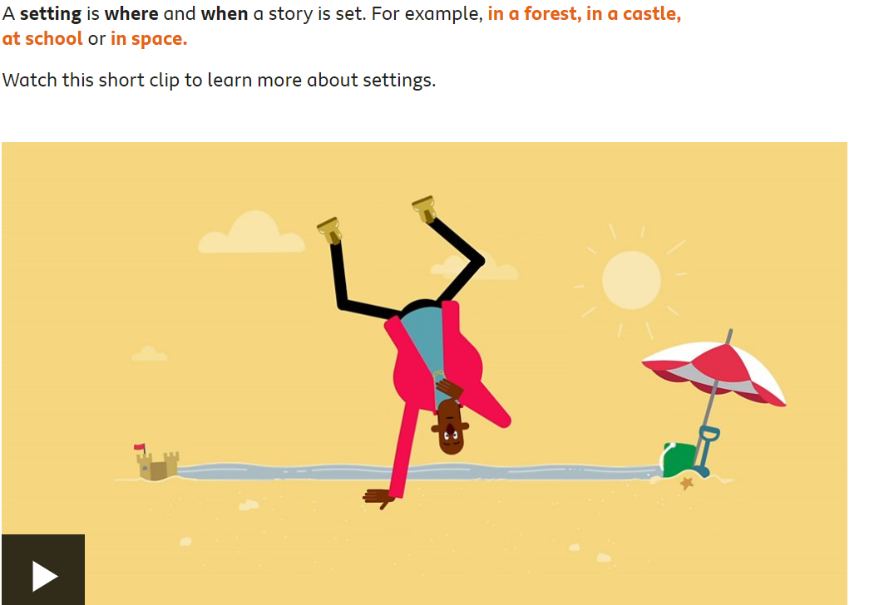
Day 4 – Setting Descriptions…
Read through the BBC article and watch the video…
https://www.bbc.co.uk/bitesize/articles/zcxnm39
Decide which activity is best for you to practice what you have learnt about setting descriptions.

Slide 23
Day 5 – SPAG Assessment
Today, you will independently complete a spelling, punctuation and grammar assessment task.
There are instructions for each part of the assessment, it is important that you complete as much as possible independently so that we can see what you know so far.
You should bring your assessment back into school with you when you return on Monday 8th March.

