Slide 1
Year 2 – Home Learning Reading – Spring 2 – Week 2

Slide 2
Day 1 – Reading for pleasure
Today you will listen to the audio book ‘Hubert Horatio – How to look after your grown ups.’
While you are listening to the audio book, think carefully about what you like about the story, what could be better and how you would end the story if you were the writer.
https://soundcloud.com/harpercollinspublishers/hubert-horatio-how-to-raise

Slide 3
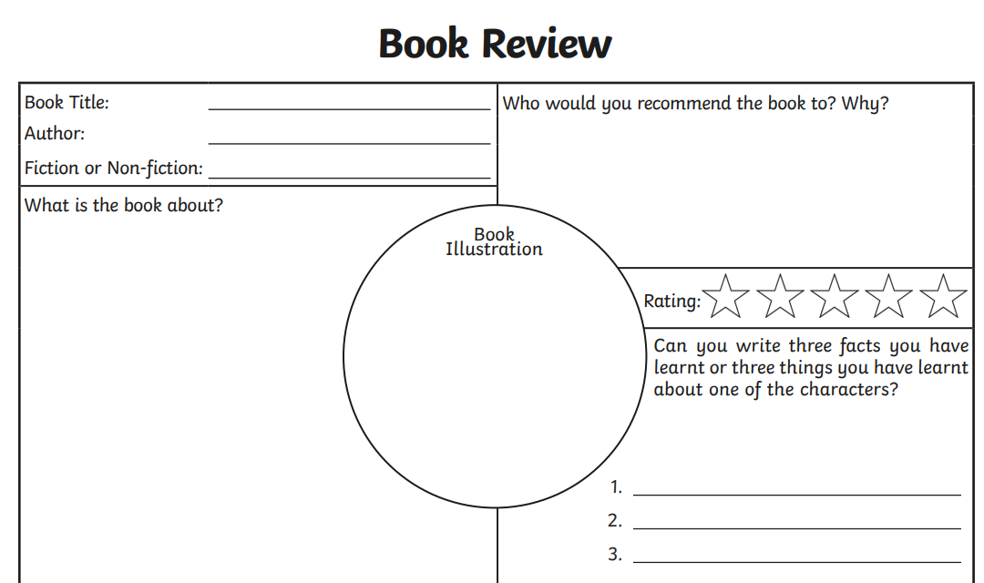
Day 2 – Book Reviews
Today, I would like to hear all about your favourite book. Think carefully about why you like that particular book and who you would recommend it to.
Fill out the book review form and when you get back to school you can try to persuade one of your friends to read it!

Slide 4
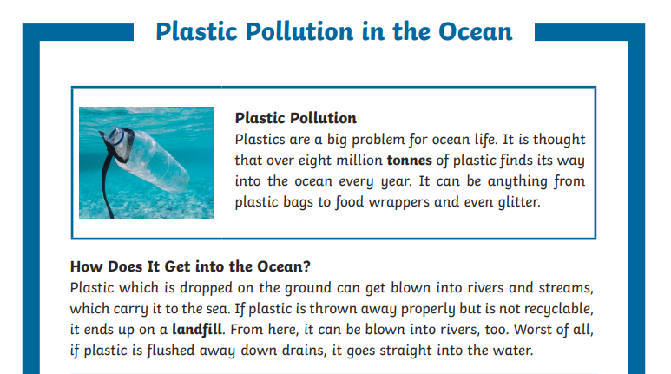
Day 3 - Comprehension
A non-fiction text gives you information about a specific topic or thing. Today you will be given a comprehension text about senses.
Read the text carefully with an adult or older sibling.
Once you have read the text, think carefully about the answers to the questions.

Slide 5
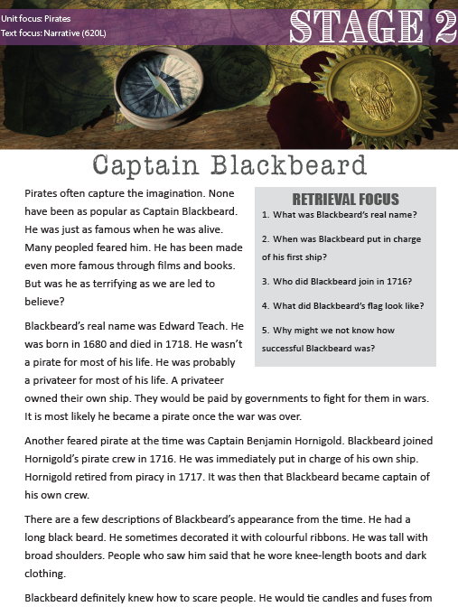
Day 4 - Retrieval
Today’s session will look at locating information from a text to answer questions. If you can, get an adult or an older sister or brother to help you read the text and the questions.
Our focus today is on wonderful women and specifically, NASA star Katherine Johnson.
Read the text carefully and answer the retrieval questions in full sentences.

Slide 6
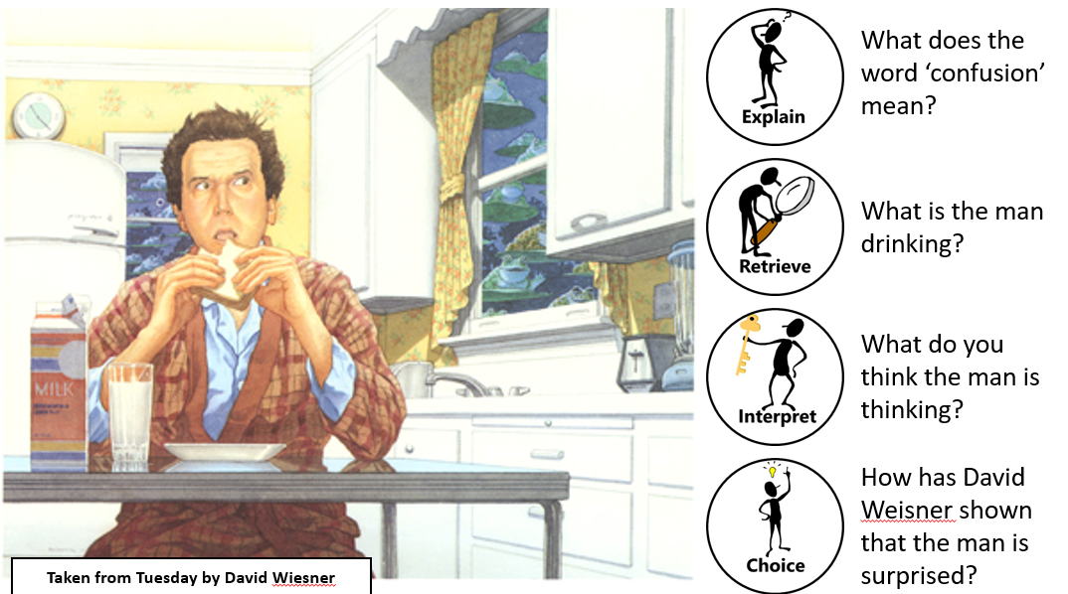
Day 5 - Reading with ERIC - Pictures

