Slide 1
To share a total equally between a set number of groups
Maths
Miss Sidhu

Slide 2
Welcome to today’s lesson!
This is lesson five for the topic of ‘Multiplication and Division’.
You will need:
paper and pencil
objects to share
There are times when you will have to pause the video to have a go at some of the activities yourself.
Let’s get started!

Slide 3
Be prepared….here comes the lesson!
Agenda for the lesson
Here is the outline for this lesson. We are going to look at:
key vocabulary
introducing sharing
sharing equally between groups
an independent task and answers
a final quiz to see what we learnt

Slide 4
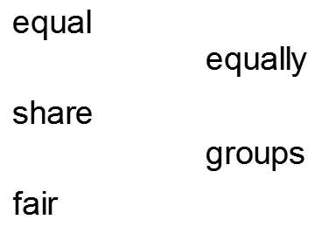
Star Words!

Slide 5
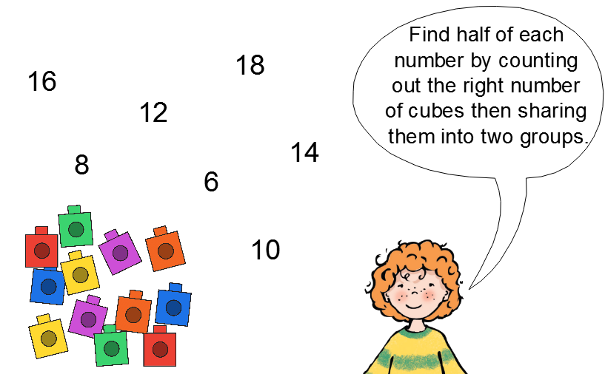
To share a total equally between a set number of groups
Brain teaser!
You may want to use objects.

Slide 6
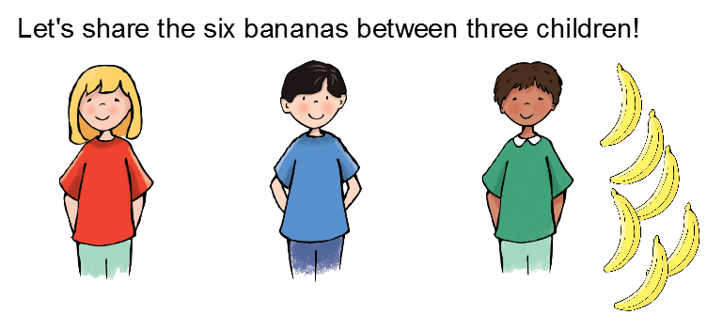
To share a total equally between a set number of groups

Slide 7
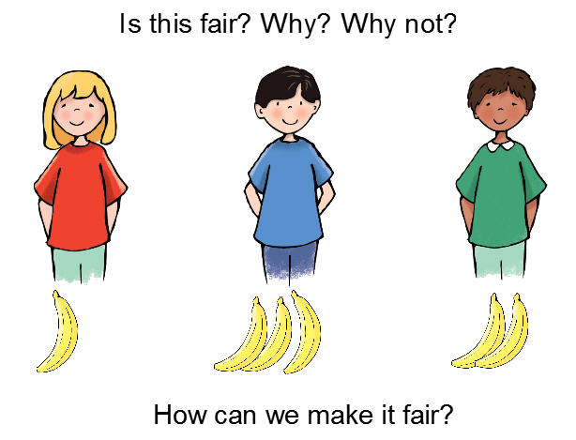
To share a total equally between a set number of groups

Slide 8
To share a total equally between a set number of groups
How can we share the apples fairly between the baskets?

Slide 9
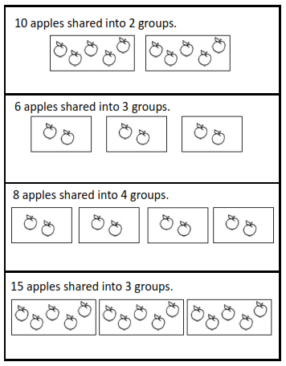
To share a total equally between a set number of groups
How many apples are in each group?
There are 5 apples in each group.
There are 2 apples in each group.
There are 2 apples in each group.
There are 5 apples in each group.

Slide 10
To share a total equally between a set number of groups
Let's divide the 8 strawberries between the 2 plates.

Slide 11
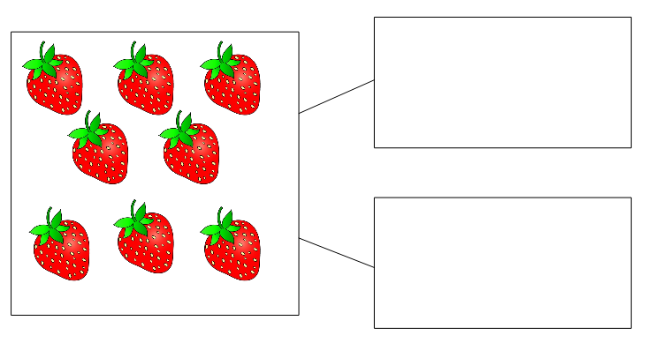
To share a total equally between a set number of groups
Can we show the same idea on the part-whole model?

Slide 12
To share a total equally between a set number of groups
Let's divide the 9 strawberries between the 3 plates.

Slide 13
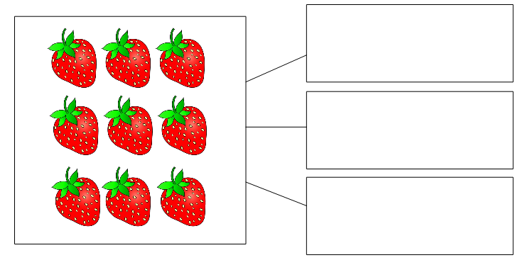
To share a total equally between a set number of groups
Can we show the same idea on the part-whole model?
What do the three parts represent?

Slide 14
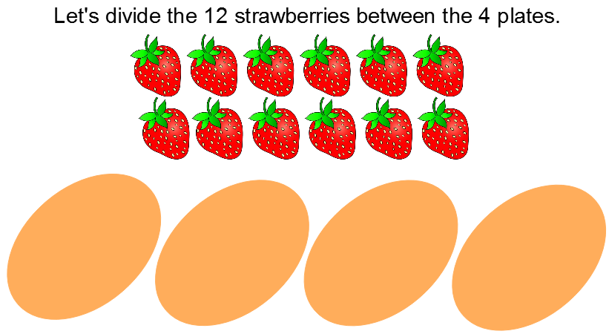
To share a total equally between a set number of groups

Slide 15
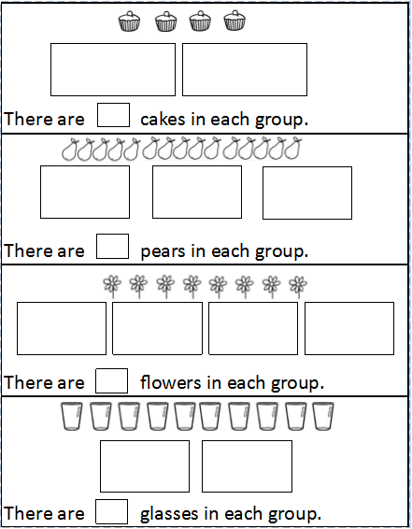
Independent Task 1
How many objects are in each group?
Remember to draw one and cross it out.
You may want to use objects to help you.

Slide 16
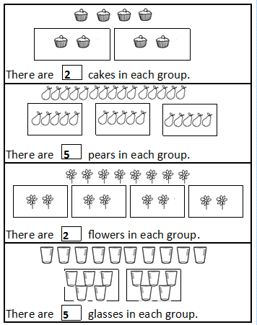
Independent Task 1 Answers
How many objects are in each group?

Slide 17
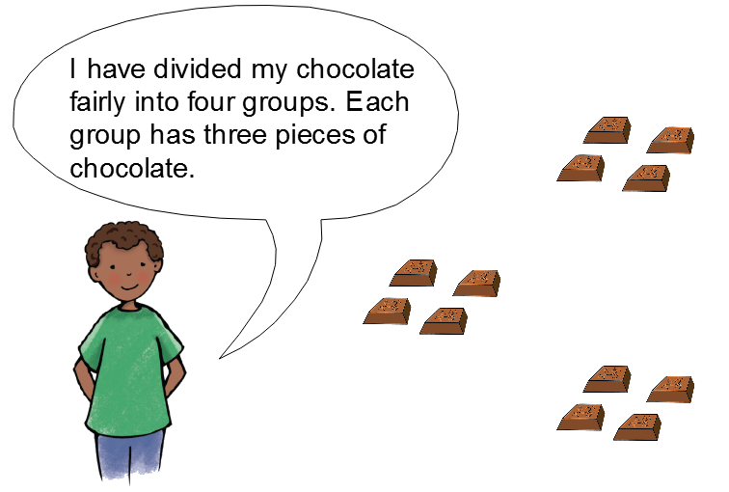
Challenge
True or false? Explain your answer.

Slide 18
Challenge Answers
True or false? Explain your answer.
False because the boy has divided his group into three groups instead of four groups. Each group has four pieces of chocolate instead of three pieces.

Slide 19
Well done for all of your super dividing! Hope you had fun sharing all of the food equally.
Don’t forgot to complete your end of lesson quiz.

