Slide 1
To explore arrays - part two
Maths
Miss Sidhu

Slide 2
Welcome to today’s lesson!
This is lesson nine for the topic of ‘Multiplication and Division’.
You will need:
paper and pencil
There are times when you will have to pause the video to have a go at some of the activities yourself.
Let’s get started!

Slide 3
Be prepared….here comes the lesson!
Agenda for the lesson
Here is the outline for this lesson. We are going to look at:
key vocabulary
exploring arrays
representing equal groups in an array
identifying the groups in an array
an independent task and answers
a final quiz to see what we learnt

Slide 4
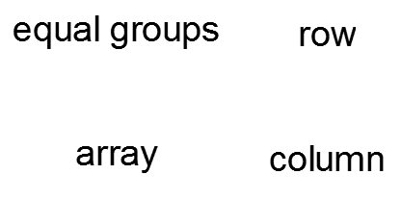
Star Words!

Slide 5
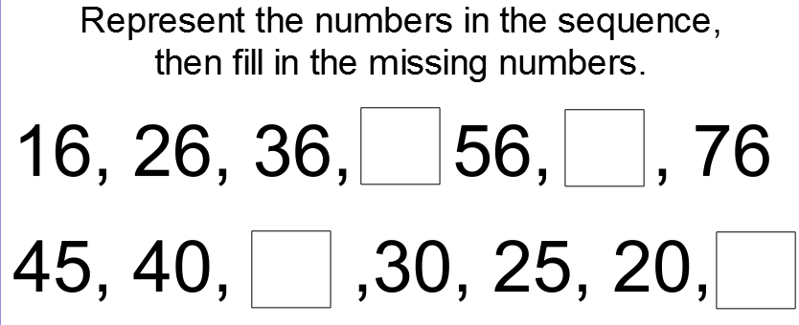
LO: To explore arrays
Brain Teaser

Slide 6
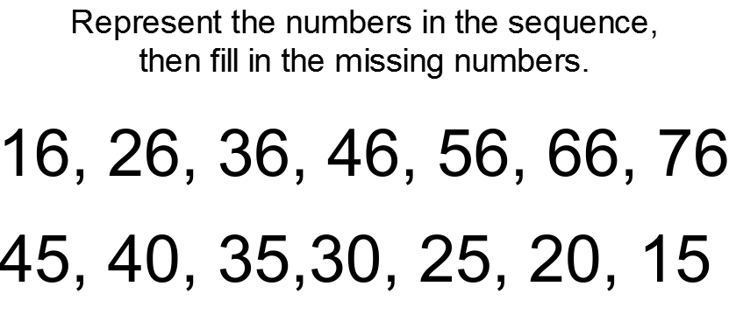
LO: To explore arrays
Brain Teaser

Slide 7
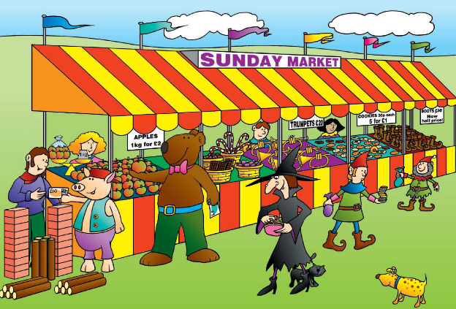
LO: To explore arrays

Slide 8
LO: To explore arrays
Let's put the apples into rows of 6.
How many apples are there altogether?

Slide 9
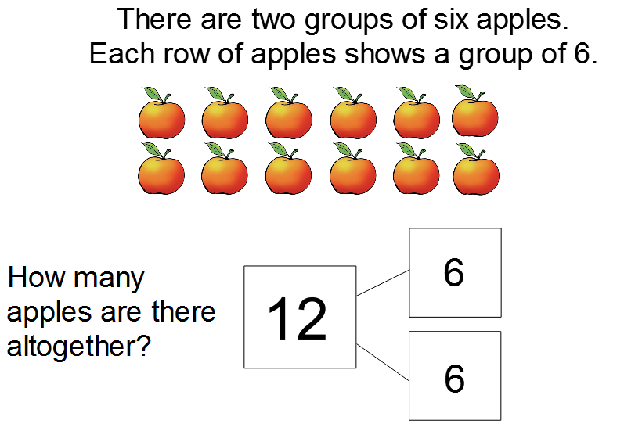
LO: To explore arrays

Slide 10
LO: To explore arrays
Let's arrange the apples in columns of 6.
How many apples are there altogether?

Slide 11
LO: To explore arrays

Slide 12
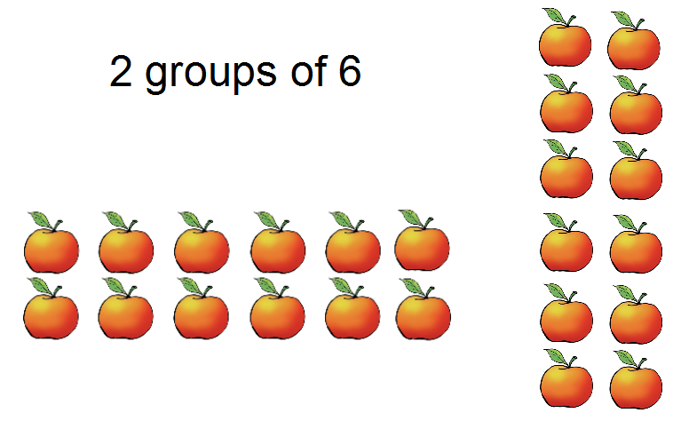
LO: To explore arrays

Slide 13
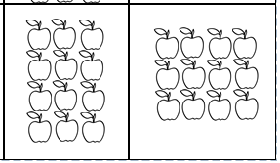
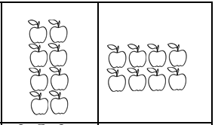
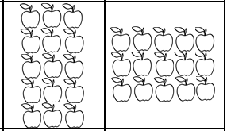
LO: To explore arrays
Match the correct equal groups to the array.

Slide 14
LO: To explore arrays
Match the correct equal groups to the array.

Slide 15
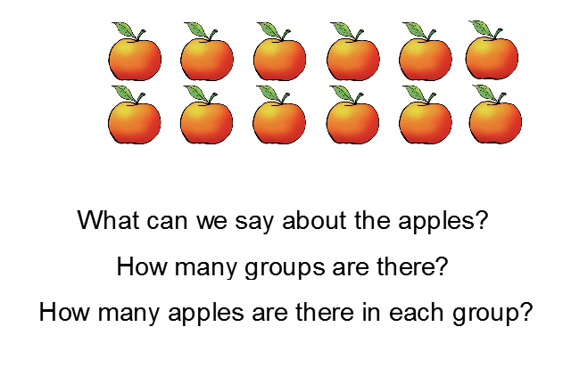
LO: To explore arrays

Slide 16
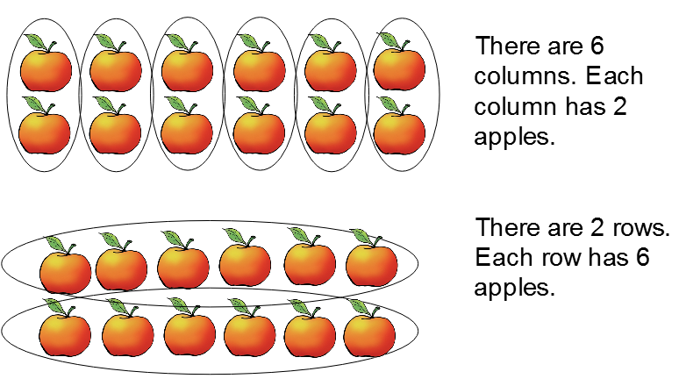
LO: To explore arrays

Slide 17
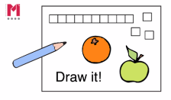
Independent Task - Example
2 groups of 5 | 5 groups of 2

Slide 18
Independent Task
3 groups of 4 | 4 groups of 3

Slide 19
Answers
3 groups of 4 | 4 groups of 3

Slide 20
Hope you’ve had fun drawing the arrays.
Now complete your end of lesson quiz!
See you soon!

