Slide 1
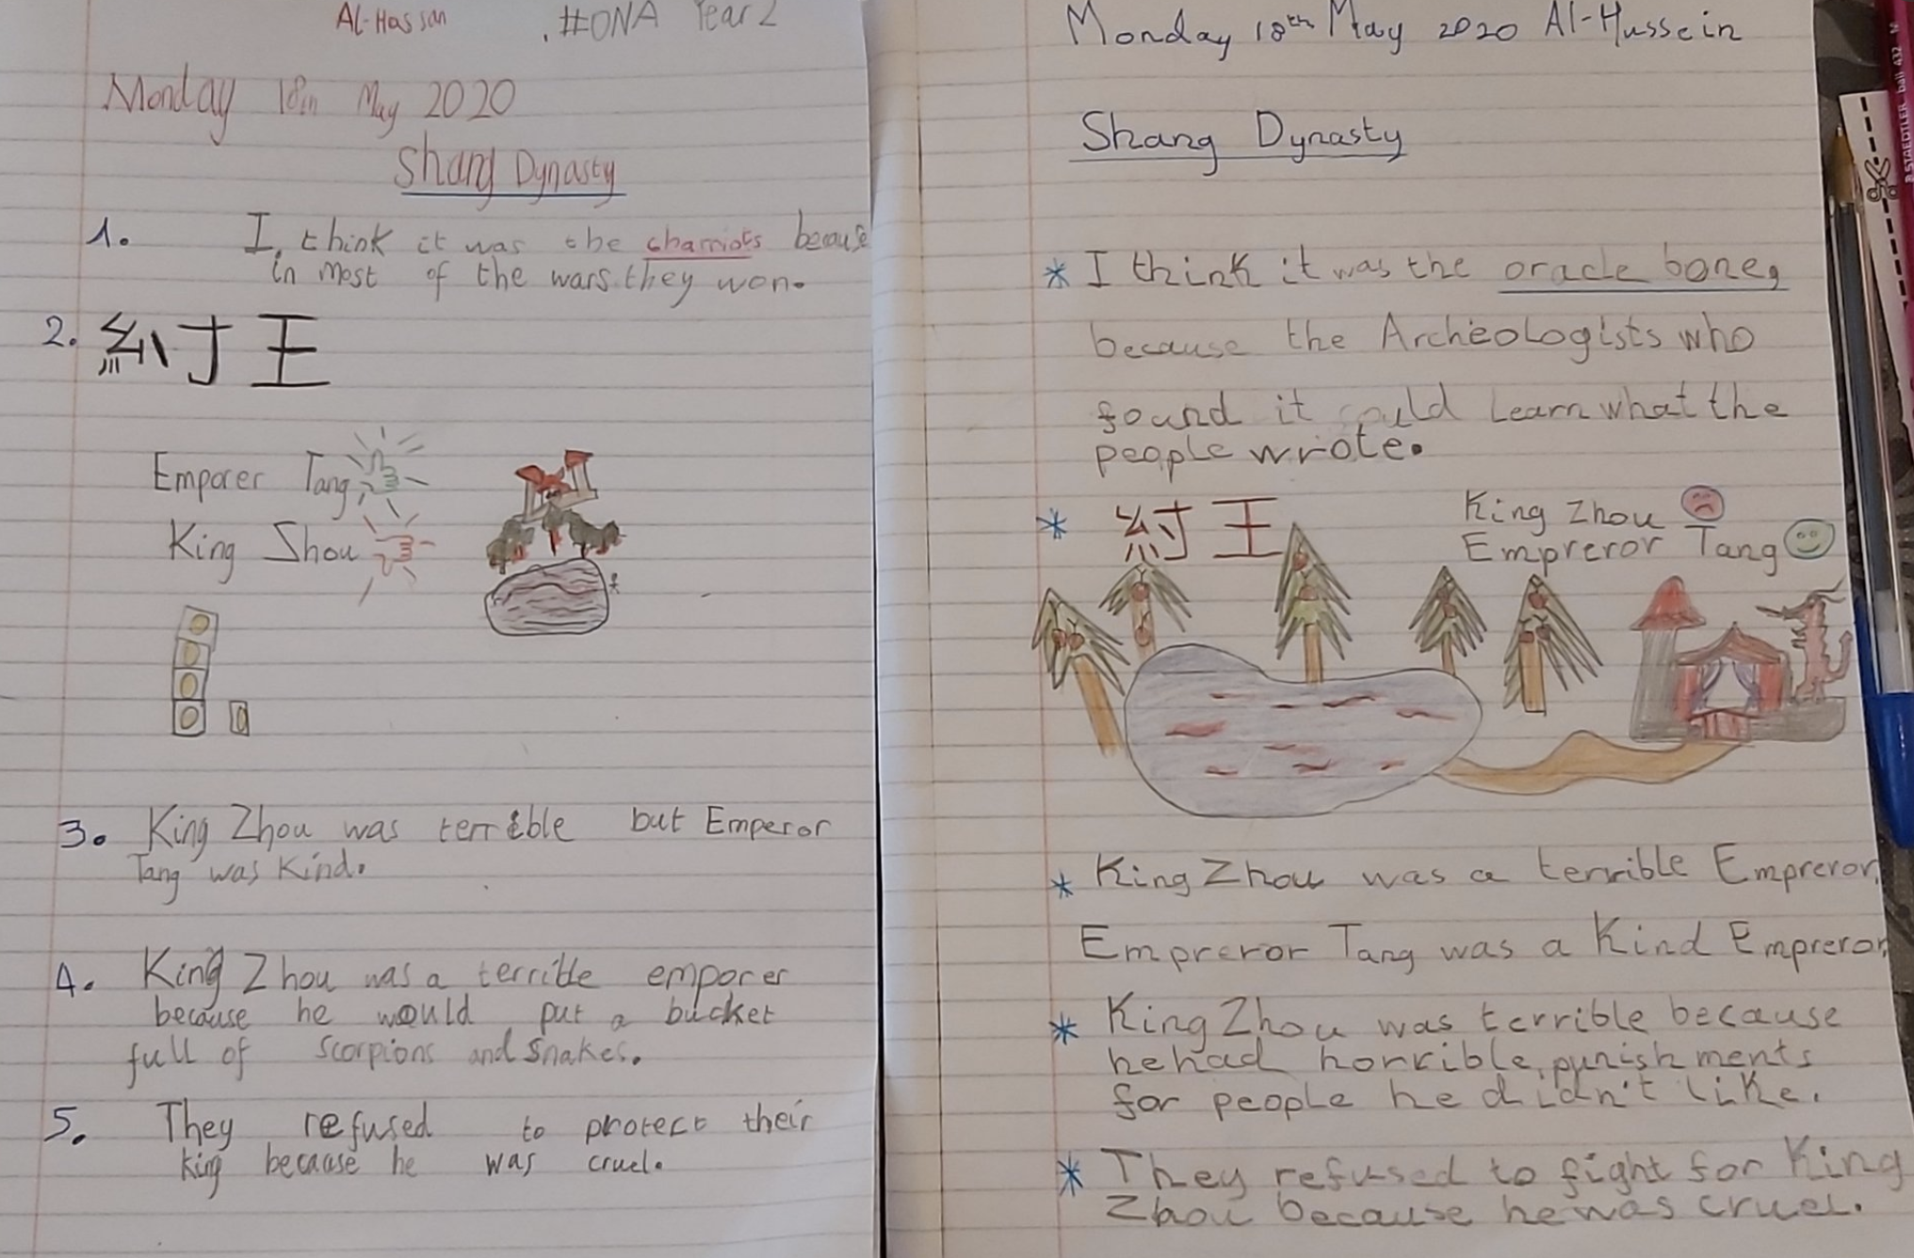
Al-Hassan
Al-Hussein

Slide 2
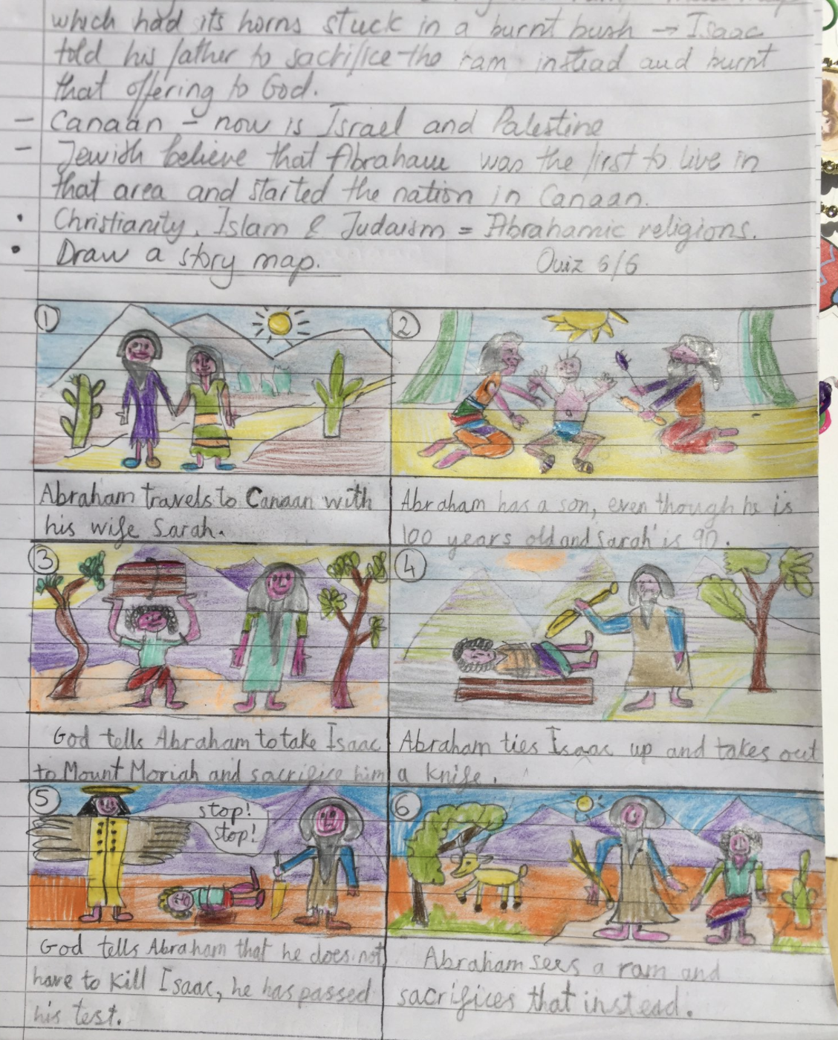
Emily

Slide 3
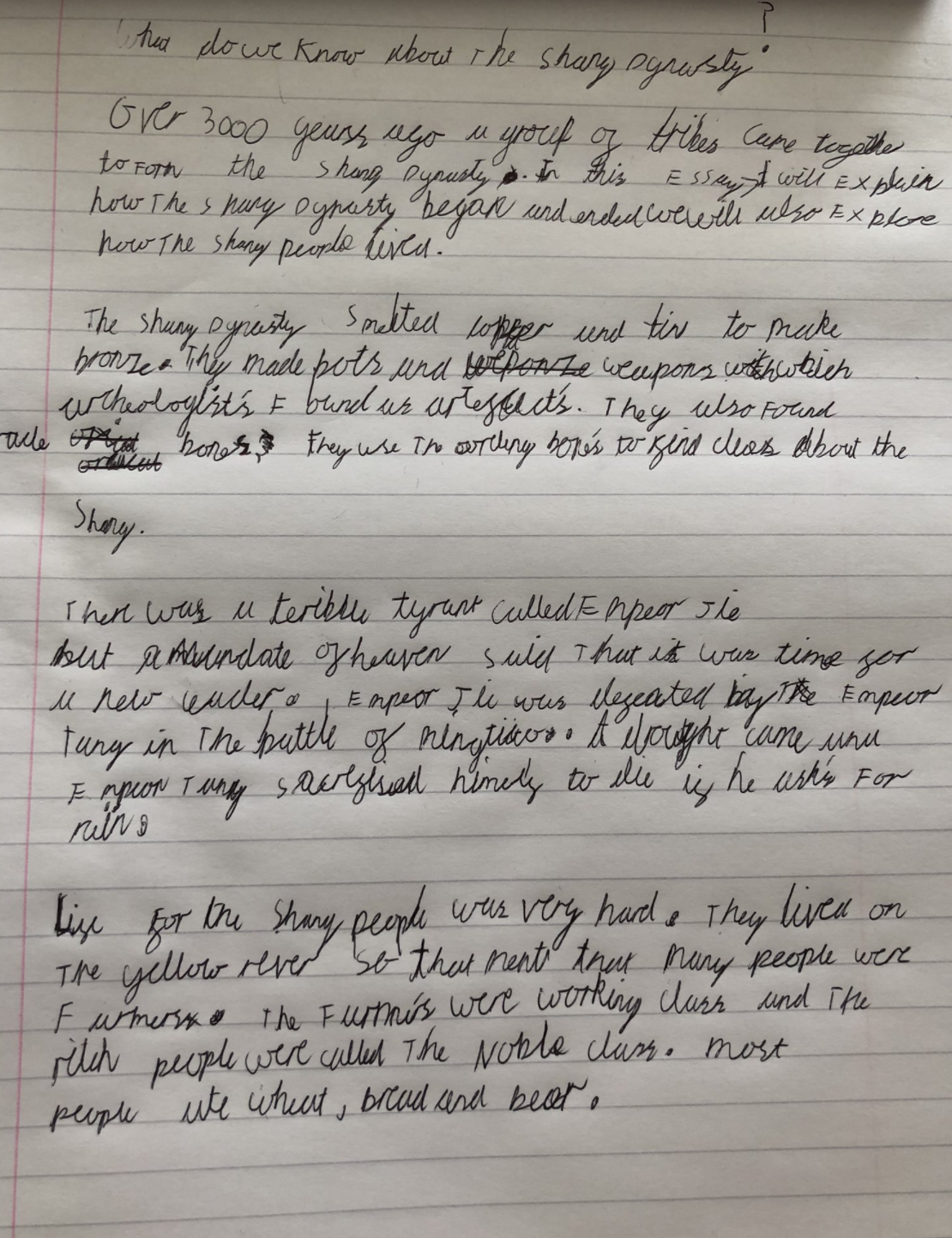
Leo

Slide 4
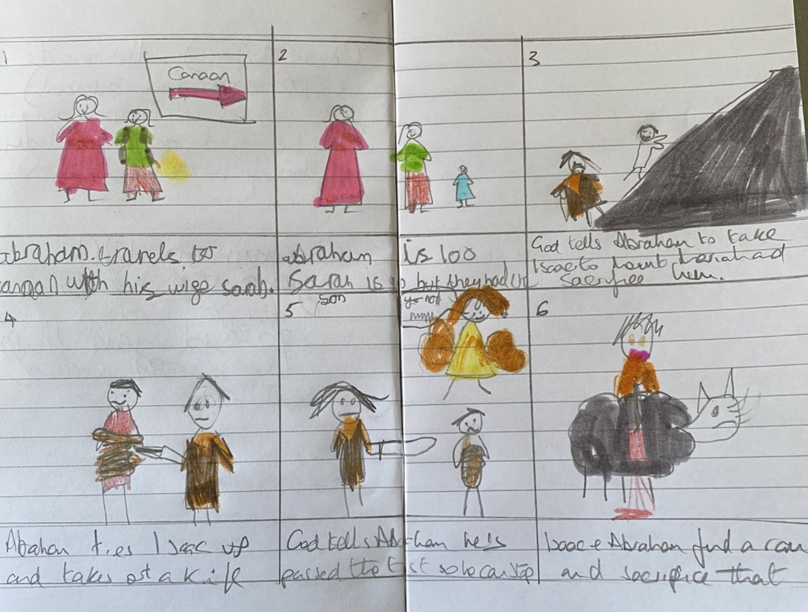
Clara

Slide 5
What is the Torah?
Religious Education: Judaism
Mr Hutchinson

Slide 6
Where did the Torah come from?
What are the five books of the Torah?
What is the Shema prayer?
What are the mitzvot?
End of Lesson Quiz

Slide 7
Where did the Torah come from?

Slide 8
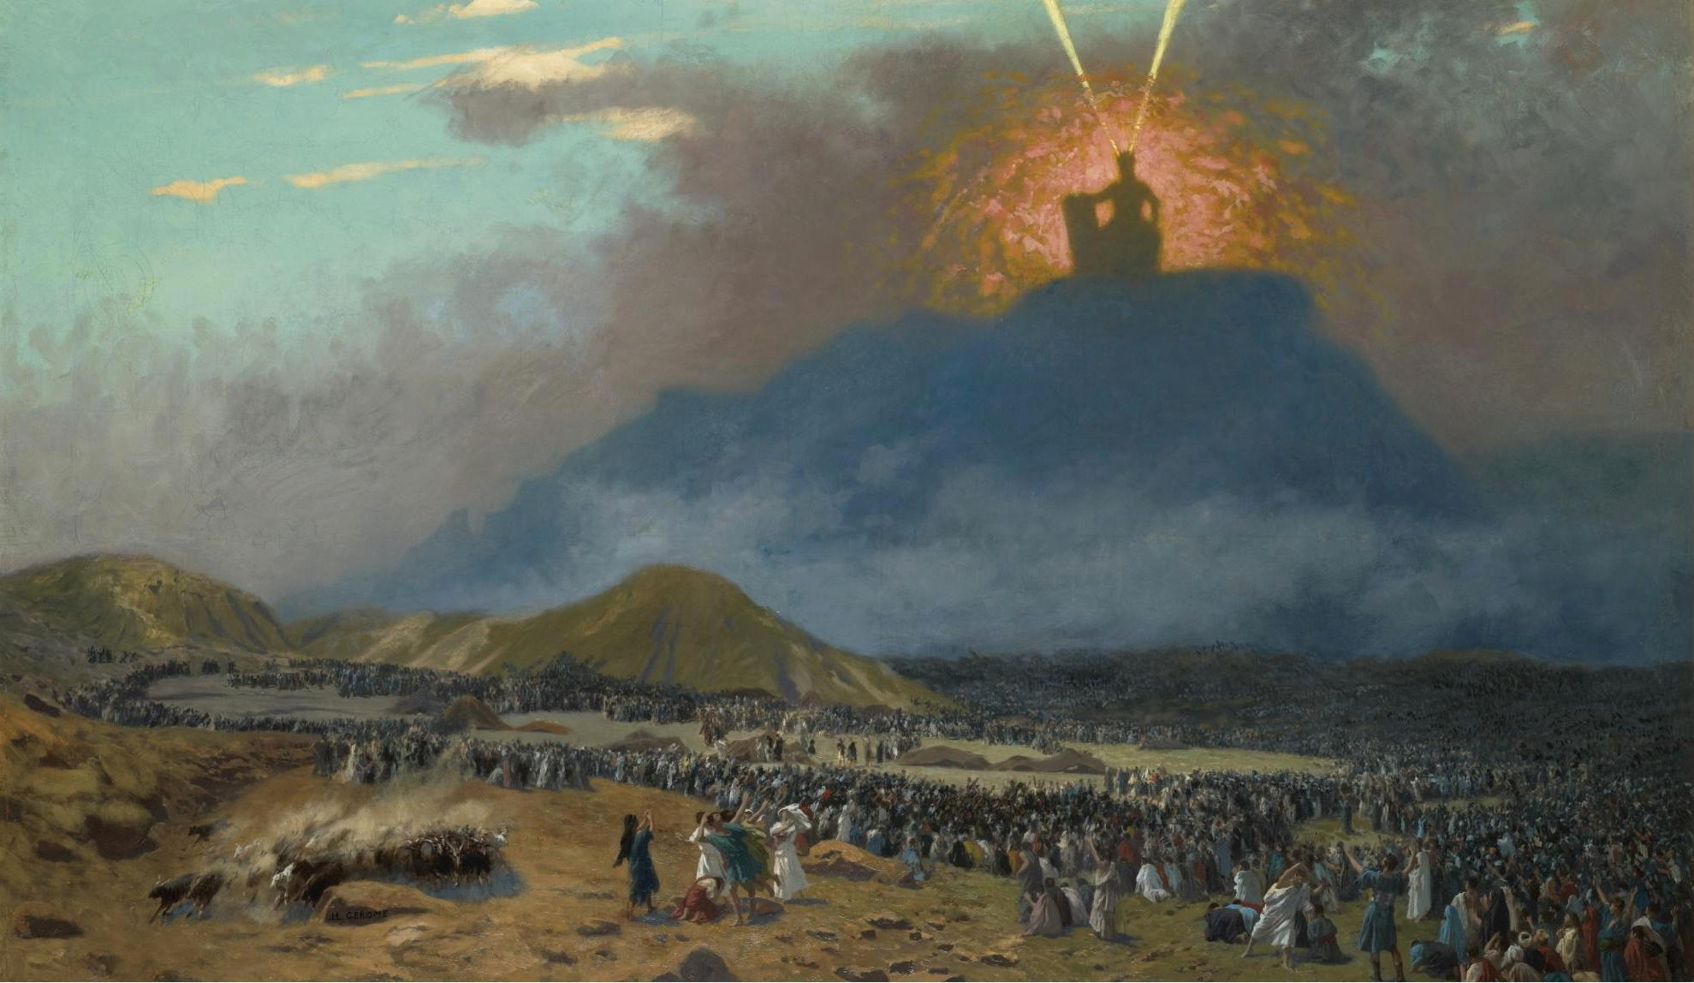
Moses
Mount Sinai
5 Books
Laws or mitzvot

Slide 9
Pause the video to complete your task
Jews believe that...
G-d
Moses
Mount Sinai
laws
Torah
Re-start once you’re done

Slide 10
Pause the video to complete your task
Jews believe that...
Jews believe that G-d spoke to Moses on Mount Sinai, and told him how he wanted his people to live. Moses wrote down these laws. Altogether, there are five books in the Torah.
Re-start once you’re done

Slide 11
What are the five books of the Torah?

Slide 12
There are five books in the Torah. Jews believe that Moses wrote these books. They are:
Genesis
The creation of the world.
Exodus
The Israelites escaping Egypt.
Leviticus
The commandments and law.
Numbers
How many Israelites there were.
Deuteronomy
The teachings of Moses.

Slide 13
Match the names of the books of the Torah to what they are about.
Genesis
How many Israelites there were.
Exodus
The creation of the world.
Leviticus
The teachings of Moses.
Numbers
The Israelites escaping Egypt.
Deuteronomy
The commandments and law.

Slide 14
Did you get them right?
Genesis
The creation of the world.
Exodus
The Israelites escaping Egypt.
Leviticus
The commandments and law.
Numbers
How many Israelites there were.
Deuteronomy
The teachings of Moses.

Slide 15
What is the shema prayer?

Slide 16
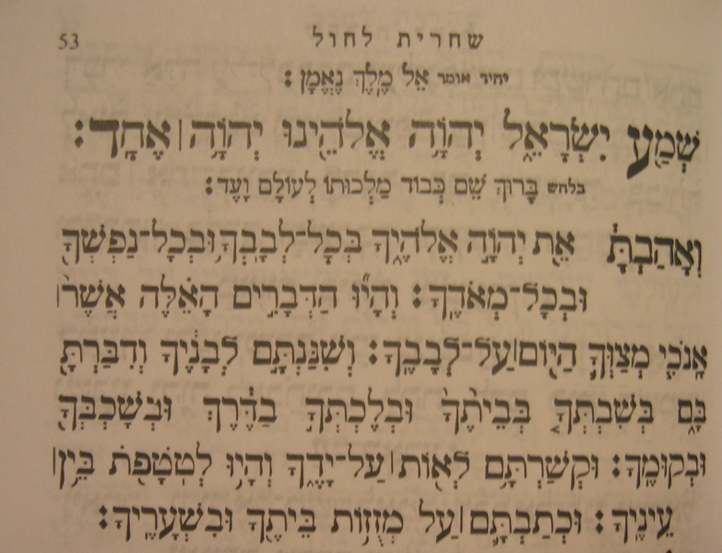
The Shema

Slide 17
Hear, Israel, the Lord is our G-d, the Lord is One.
Blessed be the Name of His glorious kingdom for ever and ever.
And you shall love the Lord your G-d with all your heart and with all your soul and with all your might.
And these words that I command you today shall be in your heart.
And you shall teach them diligently to your children, and you shall speak of them
when you sit at home, and when you walk along the way, and when you lie down and when you rise up.
And you shall bind them as a sign on your hand, and they shall be for frontlets between your eyes.
And you shall write them on the doorposts of your house and on your gates.
The Shema

Slide 18
What are the mitzvot?

Slide 19
Do not lend with interest
Do not eat meat with milk in the same meal
Do not tattoo the skin
Do not break a vow (promise)
Learn and teach the Torah
Love the stranger
Do not harvest your entire field
Leave some of your harvest in the field for the poor
The mitzvot is a list of 613 rules or commandments that tell Jews what they can and cannot do.
Talmud = the oral tradition or teaching of Judaism

Slide 20
Pause the video to complete your task
Why are the mitzvot important to Jews?
Commandments
Covenant
Promise
Torah
Re-start once you’re done

Slide 21
Pause the video to complete your task
Why are the mitzvot important to Jews?
The mitzvot are important to Jews because they teach them how they should live. Although they come from the Talmud, they are based in the Torah. Jews believe that G-d has made a covenant, or promises to them, but only if they follow his commandments.
Re-start once you’re done

Slide 22
End of lesson quiz
Ask your parents to share your work on twitter
@oaknational
#ONAYear2
#learnwithoak

