Slide 1
Who is Katherine Johnson?
Science
Miss Simkin

Slide 2
Lesson Agenda
Star words
Katherine Johnson’s story
Mapping the story
Telling the story
End of lesson quiz
Credit: Widgit Symbols © - Widgit Software 2002-2020

Slide 3
In this lesson, you will need:
Exercise book or paper
Pencil
Brain
Credit: Widgit Symbols © - Widgit Software 2002-2020

Slide 4
Star Words
NASA
calculate
flight path
astronaut
Credit: Widgit Symbols © - Widgit Software 2002-2020

Slide 5
Katherine Johnson’s story

Slide 6
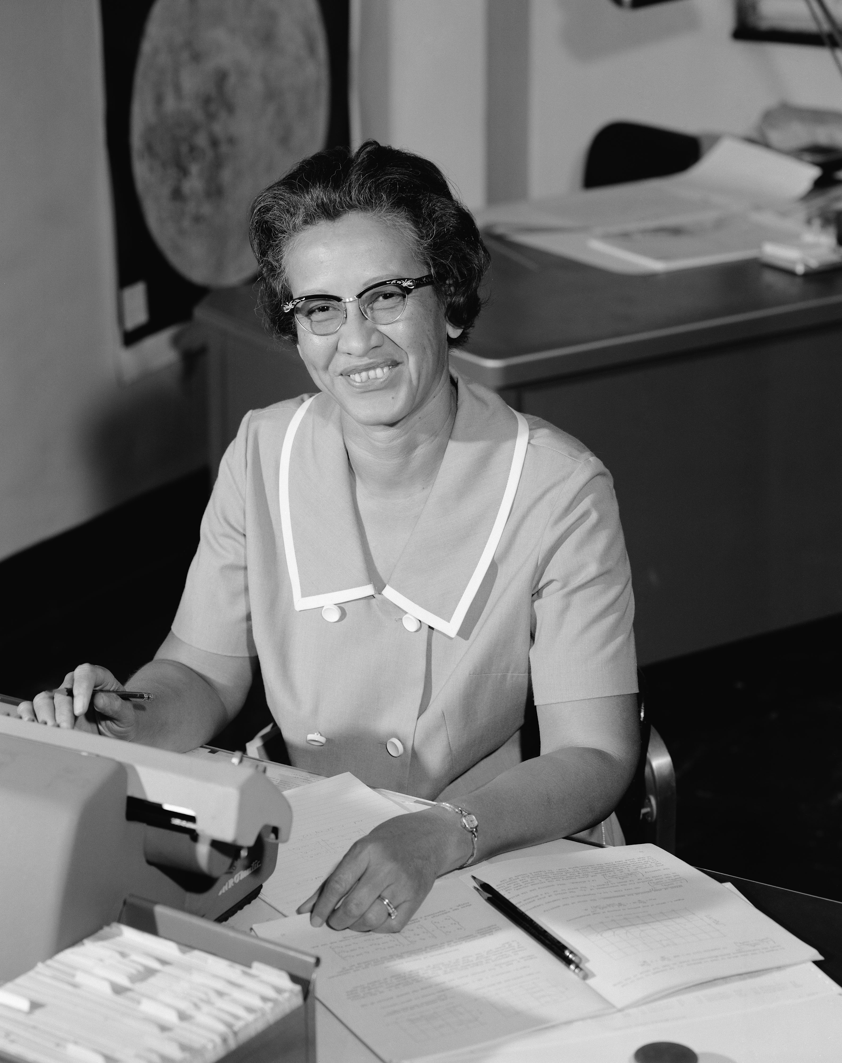
Image: Katherine Johnson at NASA, in 1966, NASA (Wikimedia)

Slide 8
1)
Clever
Skipped 3 years!
Loved maths
Image from Pixabay.

Slide 9
Pause the video to complete your task
What was Katherine’s favourite subject?
Resume once you’re finished
Credit: Widgit Symbols © - Widgit Software 2002-2020

Slide 10
2)
Primary school teacher
‘Computer’ at NASA
Image: NASA Wormball logo,, NASA, Dan Gauthier (Wikimedia)

Slide 11
Pause the video to complete your task
What was Katherine’s job at NASA?
Resume once you’re finished
Credit: Widgit Symbols © - Widgit Software 2002-2020

Slide 12
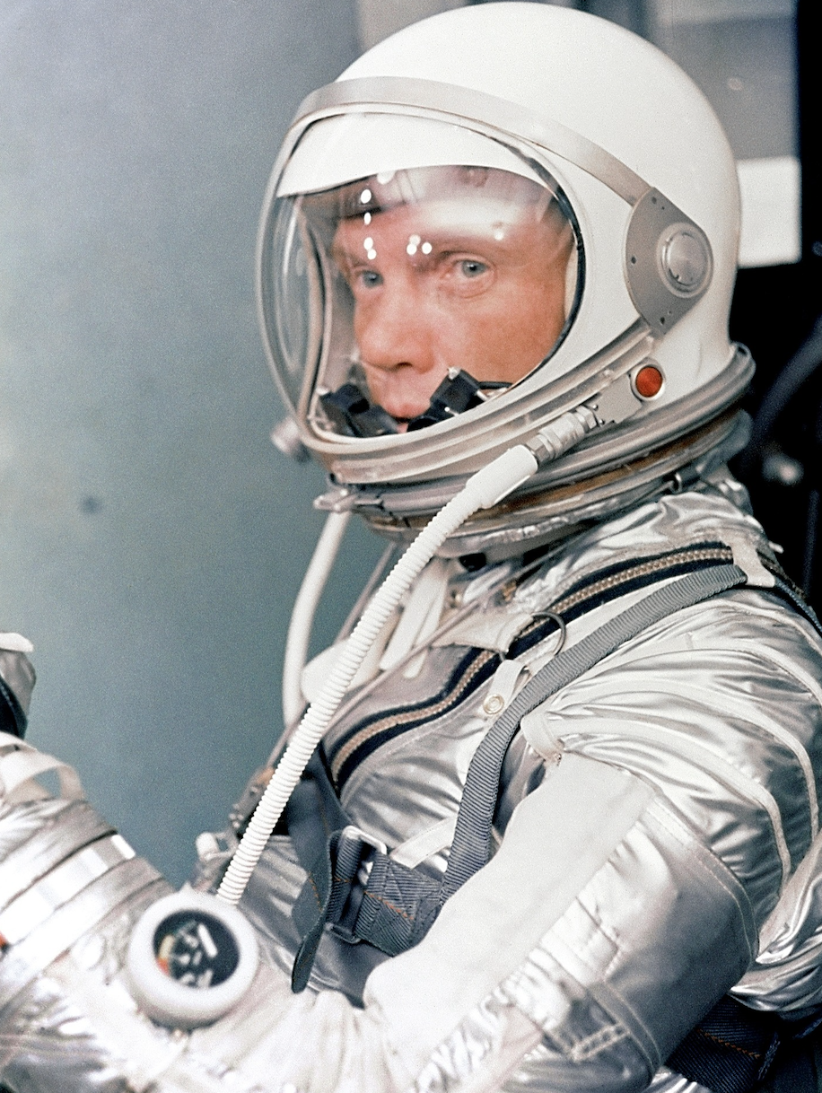
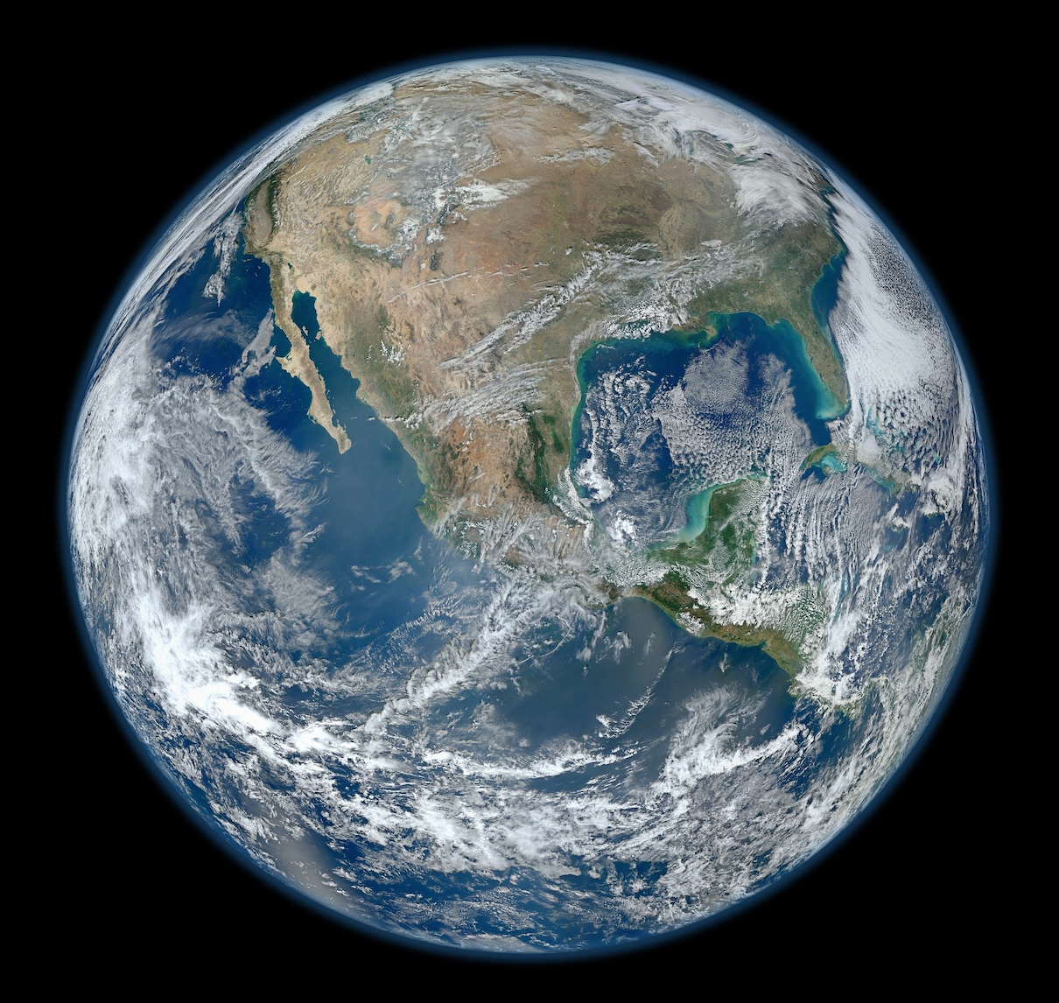
3)
x3
Project Mercury
Calculated flight path
John Glenn
Images from Pixabay.

Slide 13
Pause the video to complete your task
What was project Mercury’s mission?
Resume once you’re finished
Credit: Widgit Symbols © - Widgit Software 2002-2020

Slide 14
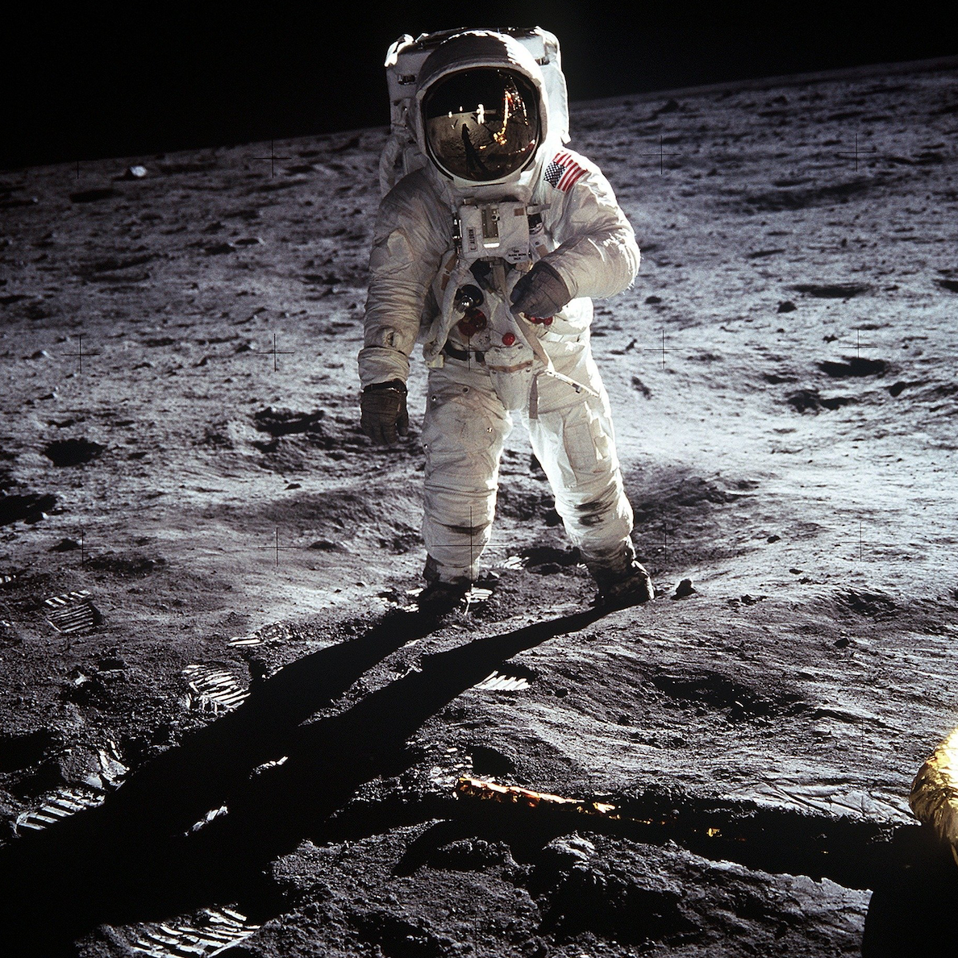
4)
Apollo 11
1969
First people on the moon
Image from Pixabay.

Slide 15
Pause the video to complete your task
When did the first people walk on the moon?
Resume once you’re finished
Credit: Widgit Symbols © - Widgit Software 2002-2020

Slide 16
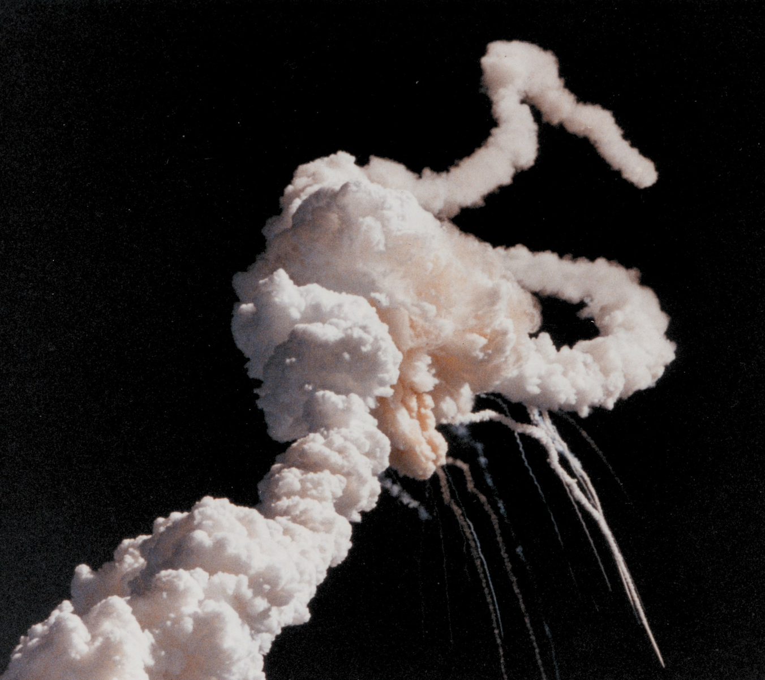
5)
Apollo 13
Explosion!
“Houston, we’ve had a problem.”
Image from Pixabay.

Slide 17
Pause the video to complete your task
What was the problem with the Apollo 13 mission?
Resume once you’re finished
Credit: Widgit Symbols © - Widgit Software 2002-2020

Slide 18
6)
Calculated flight path
Made it home safely!
Image from Pixabay.

Slide 19
Pause the video to complete your task
How did Katherine save the day?
Resume once you’re finished
Credit: Widgit Symbols © - Widgit Software 2002-2020

Slide 20
Mapping the story

Slide 21
Can you draw a picture to help you remember each part of the story?

Slide 22
Telling the story

Slide 23
Can you use your story map to tell the story?

Slide 24
Great job today!

Slide 25
Share your work with Oak National
If you'd like to, please ask your parent or carer to share your work on Instagram, Facebook or Twitter tagging @OakNational and #LearnwithOak
You can also tag @Teach_STEMinism

Slide 26
End of lesson quiz

Slide 27
References
Slide 2, 3, 4, 9, 11, 13, 15, 17, 19, 25 - Widgit Symbols © - Widgit Software 2002-2020

