Slide 1
Who was Guy Fawkes?
Lesson 2 of 3
History
Miss Emms

Slide 2
Star Words
Guy Fawkes
The conspirators
What happened next?
End of Lesson Quiz

Slide 3
In this lesson, you will need:
Paper
Pencil
Brain
📓
✎
🧠

Slide 4
Star Words
⭐
⭐
conspirators
Guy Fawkes
⭐
⭐
religion
Catholics
⭐
⭐
Protestants
⭐
⭐

Slide 5
Recap questions

Slide 6
Pause the video to complete your task
Catholic
Protestant
King James I was a ____________.
Guy Fawkes was a _____________.
The ____________ were in charge.
Resume once you’re finished

Slide 7
Pause the video to complete your task
Why did Guy Fawkes want to blow up the houses of Parliament?
Tell your screen
Resume once you’re finished

Slide 8
Guy Fawkes

Slide 9
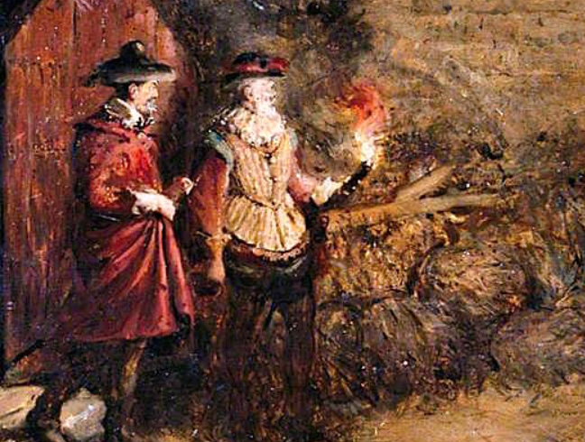
Guy Fawkes
Credit: Guy Fawkes, Charles Gogin, Wikimedia Commons

Slide 10
Guy Fawkes
Guy Fawkes was born on 13th April 1570 in York.
His Catholic religion was very important to him.
A man called Robert Catesby wanted Guy Fawkes’ help in a plot to kill King James I.
He went to war in Europe to fight on behalf of Spain, which was a Catholic country.
Robert Catesby wanted Guy Fawkes to help, because he knew how to use gunpowder.

Slide 11
Pause the video to complete your task
Can you remember the name of the man who asked Guy Fawkes to help him?
Resume once you’re finished

Slide 12
Pause the video to complete your task
Why did Robert Catesby ask Guy Fawkes to help?
Resume once you’re finished

Slide 13
The conspirators

Slide 14
Conspiracy
A secret plan by a group to do something unlawful or harmful.

Slide 15
Pause the video to complete your task
What is a conspiracy?
Resume once you’re finished

Slide 16
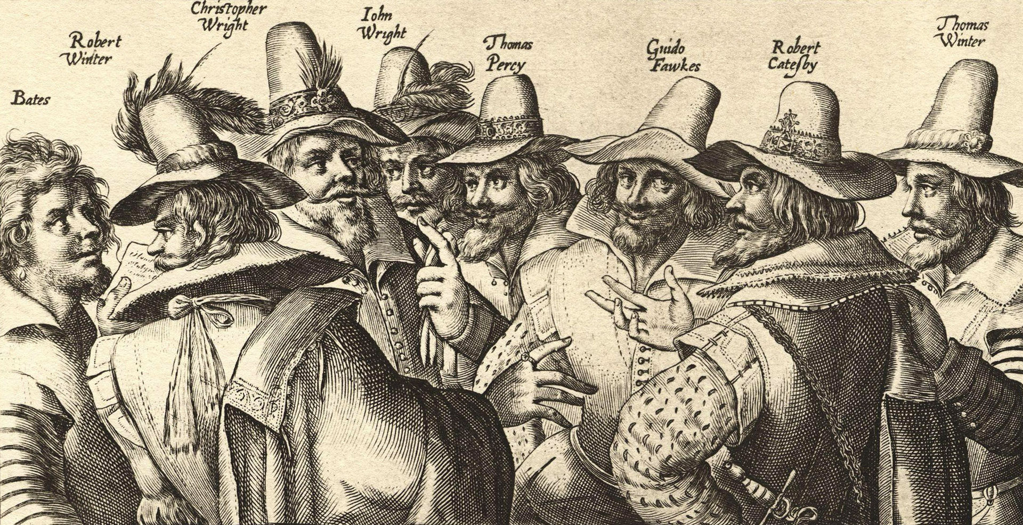
The conspirators
Credit: Gunpowder plot conspirators, Crispijn van de Passe the Elder, Wikimedia Commons

Slide 17
Pause the video to complete your task
What do you think all these people had in common?
In my opinion, ___________________________________________________
__________________________________________________________________
Use the following words in your answer:
Catholics Protestants disliked
Resume once you’re finished

Slide 18
What happened next?

Slide 19
The Conspiracy

Slide 20
Why?
Their plan was revealed to an important political person.
On 5th November 1605, Guy Fawkes was caught with the gunpowder moments before the king was about to open parliament.
Guy Fawkes went to jail on November 5th.

Slide 21
Why was the plan revealed?
Option 1
Option 2
The conspirators were too loud.
The plan was revealed to an important political person.
Option 3
One of the conspirators was nervous and exposed the plan.

Slide 22
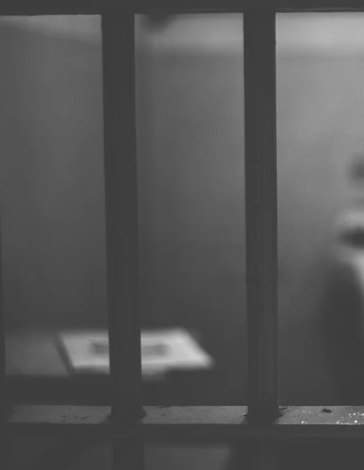
Pause the video to complete your task
What happened to Guy Fawkes?
Guy Fawkes __________________________________________
Credit: Pixabay.
Resume once you’re finished

Slide 23
End of lesson quiz

Slide 24
⭐
⭐
⭐
⭐
Great job today!
⭐
⭐
⭐

