Slide 1
To identify one half of a shape
Maths
Miss Sidhu

Slide 2
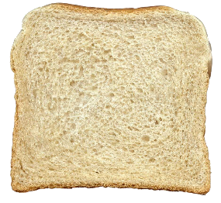
Welcome to today’s lesson!
You will need…
Item 1
Item 2
Item 3
Important:
Please Ask your Parent or Carer to Help you Cut!!!

Slide 3
Lesson agenda
Here is the outline for this lesson. We are going to look at:
Key vocabulary
Exploring what equal and unequal means
Finding half of a shape
An Independent task and answers
A final quiz to see what we learnt

Slide 4
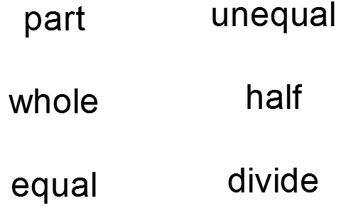
Star Words!

Slide 5
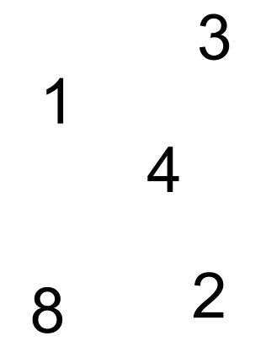
Brain teaser!
Double trouble
Choose a number and double it.

Slide 6
Brain teaser!
6
Double trouble
Choose a number and double it.
2
8
4
16

Slide 7
What is the same? What is different?

Slide 8
How do you know it is half?
The whole has been divided into two equal parts.

Slide 9
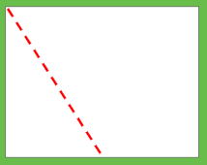

Slide 10
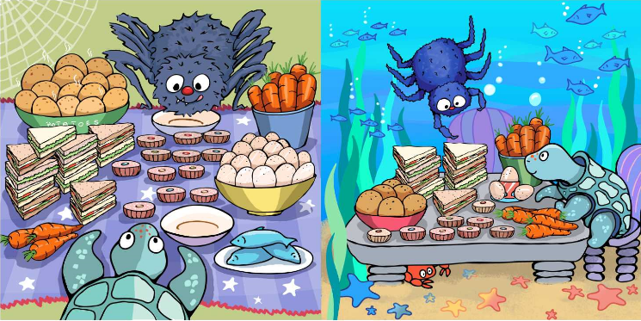
Finding half of a 3-D object

Slide 11
Finding half of a 3-D object
How many parts will we need?
How can we make it fair?
Where would we need to cut it to ensure we cut it in half?
Important:
Please Ask your Parent or Carer to Help you Cut!!!

Slide 12
Pause the video to complete your task
Independent Task
Important:
You Must Ask your Parent or Carer to Help you Cut During this Task!!!
Resume once you’re finished

Slide 13
Independent Task
How many ways
can you cut a slice
of bread in half?
How many ways
can you show the
slice not being cut
in half?
How do you know?
Important:
Please Ask your Parent or Carer to Help you Cut!!!

Slide 14
Pause the video to complete your task
Independent Task
Important:
You Must Ask your Parent or Carer to Help you Cut During this Task!!!
Resume once you’re finished

Slide 15
Answers
Here are some of the ways you can show half.

Slide 16
Share your work with Oak National
If you'd like to, please ask your parent or carer to share your work on Twitter tagging @OakNational and #LearnwithOak

Slide 17
Great exploring of halves today.
Don’t forgot to complete your end of lesson quiz.

