Slide 1
To find one quarter of a quantity.
Maths
Miss Sidhu

Slide 2
Welcome to today’s lesson!
You will need…
Item 1

Slide 3
Lesson agenda
Here is the outline for this lesson. We are going to look at:
Key vocabulary
Finding one quarter of a quantity
Using a part-whole model to find a quarter
An Independent task and answers

Slide 4
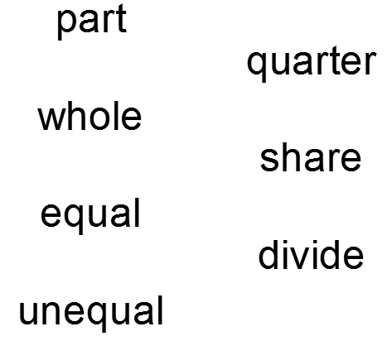
Star Words!

Slide 5
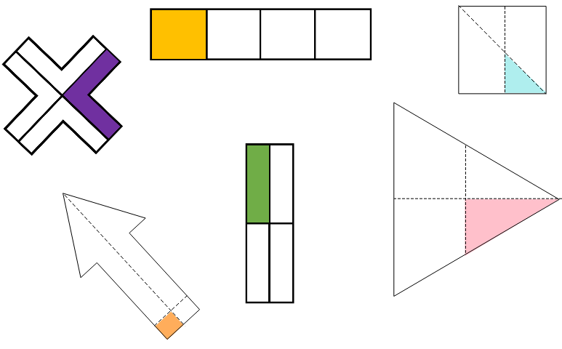
Brain teaser!
Does the shape represent quarters?

Slide 6
Brain teaser!
Yes
No
Yes
Does the shape represent quarters?
Yes
No
No

Slide 7
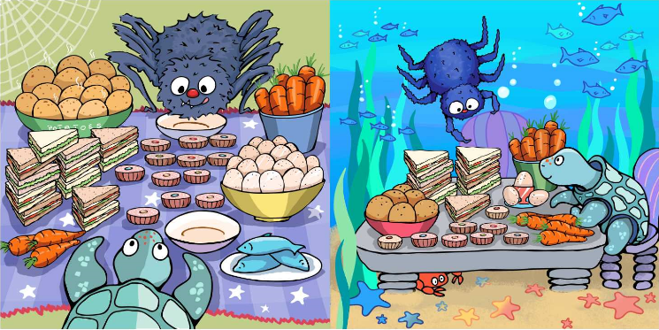

Slide 8
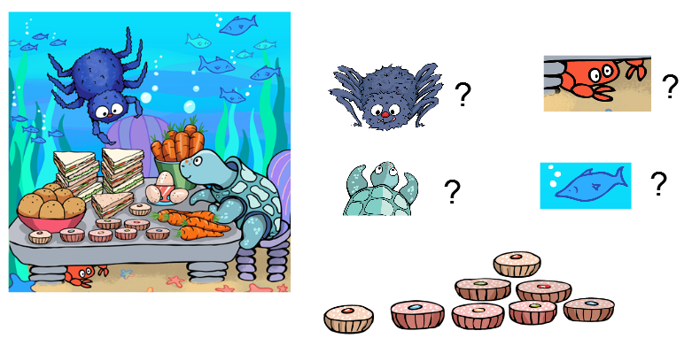
How many cakes will each guest eat?

Slide 9
How many cakes will each guest eat?
One quarter of eight is two.

Slide 10
How many apples will each guest eat?

Slide 11
How many apples will each guest eat?
One quarter of four is one.

Slide 12
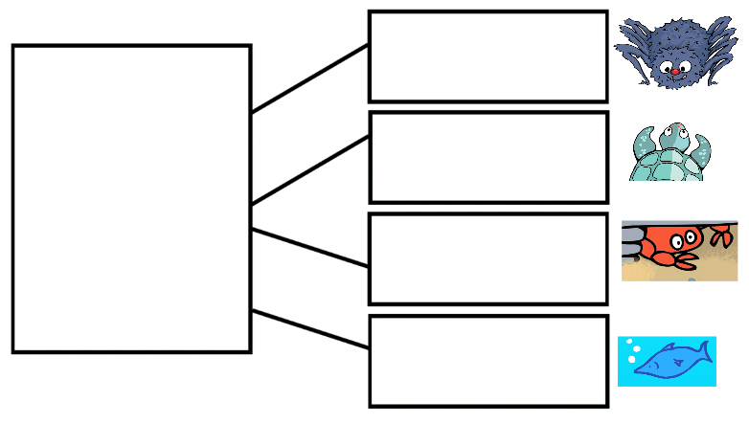
How many cakes will each guest eat?

Slide 13
How many apples will each guest eat?

Slide 14
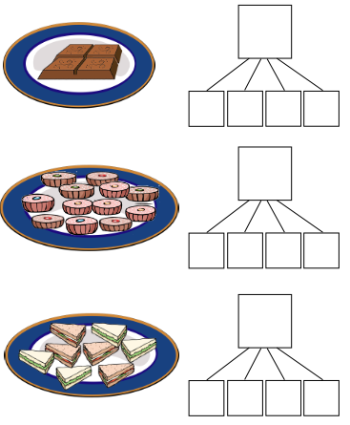
Independent Task
Sharing a feast between four guests.
How many food items will each guest get?

Slide 15
Challenge
What is one quarter of 12?
Who do you agree with?
Why?

Slide 16
Answers
4
Sharing a feast between four guests.
1
1
1
1
12
3
3
3
3
How many food items will each guest get?
8
2
2
2
2

Slide 17
Challenge answers
What is one quarter of 12?
Who do you agree with?
Why?

Slide 18
Share your work with Oak National
If you'd like to, please ask your parent or carer to share your work on Twitter tagging @OakNational and #LearnwithOak

Slide 19
You were incredible today at finding one quarter of a quantity.

