Slide 1
Who is Jane Goodall?
Science
Miss Simkin

Slide 2
Lesson Agenda
Star words
Jane Goodall’s story
Recording behaviour
Conservation
End of lesson quiz

Slide 3
Pencils
In this lesson, you will need:
Paper or exercise book
Pencil
Coloured pencils

Slide 4
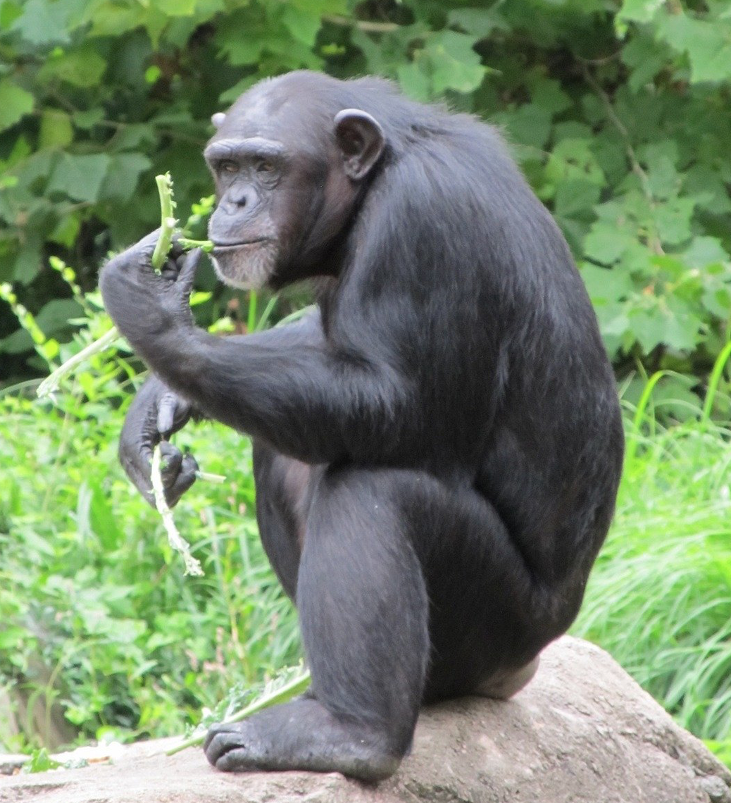
Star Words
⭐
⭐
chimpanzee
conservation
expert
tools
Tanzania
⭐
⭐
⭐

Slide 5
Jane Goodall’s story

Slide 6
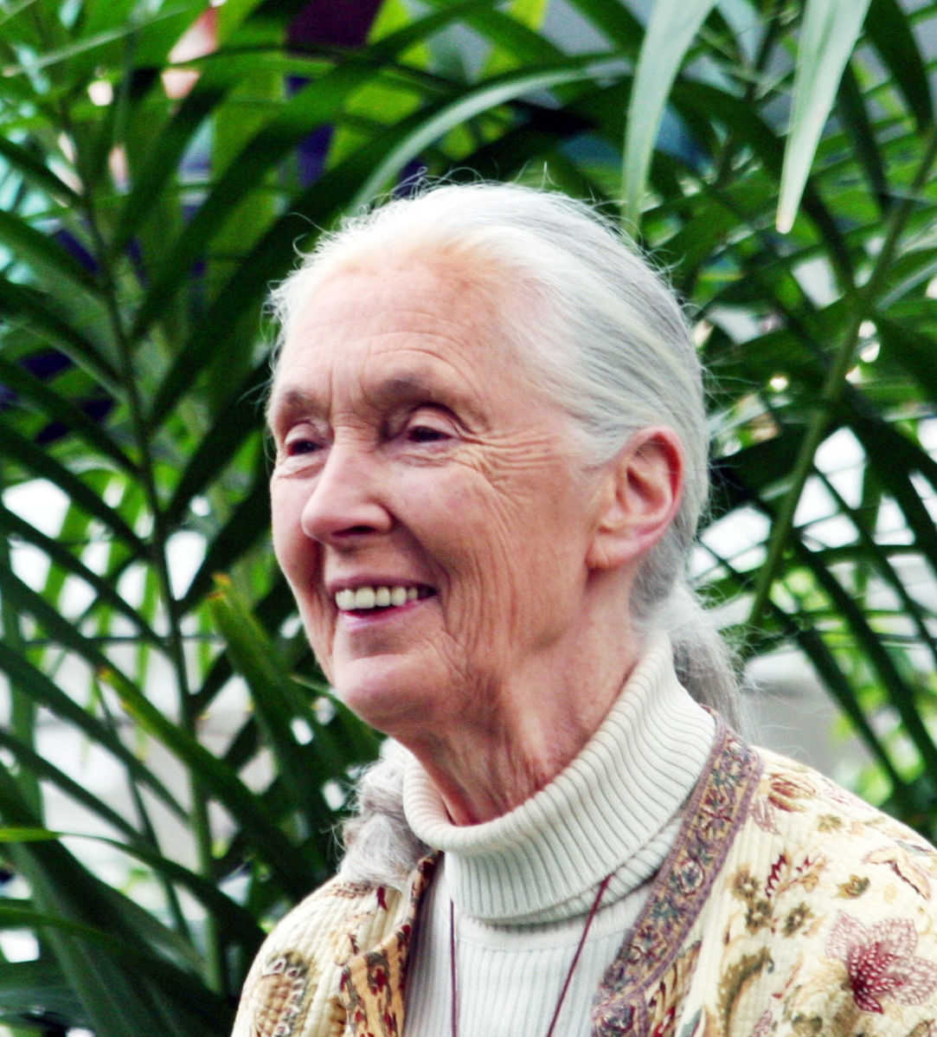
Jane Goodall
Image: Jane Goodall GM, Floatjon, (Wikimedia)

Slide 7
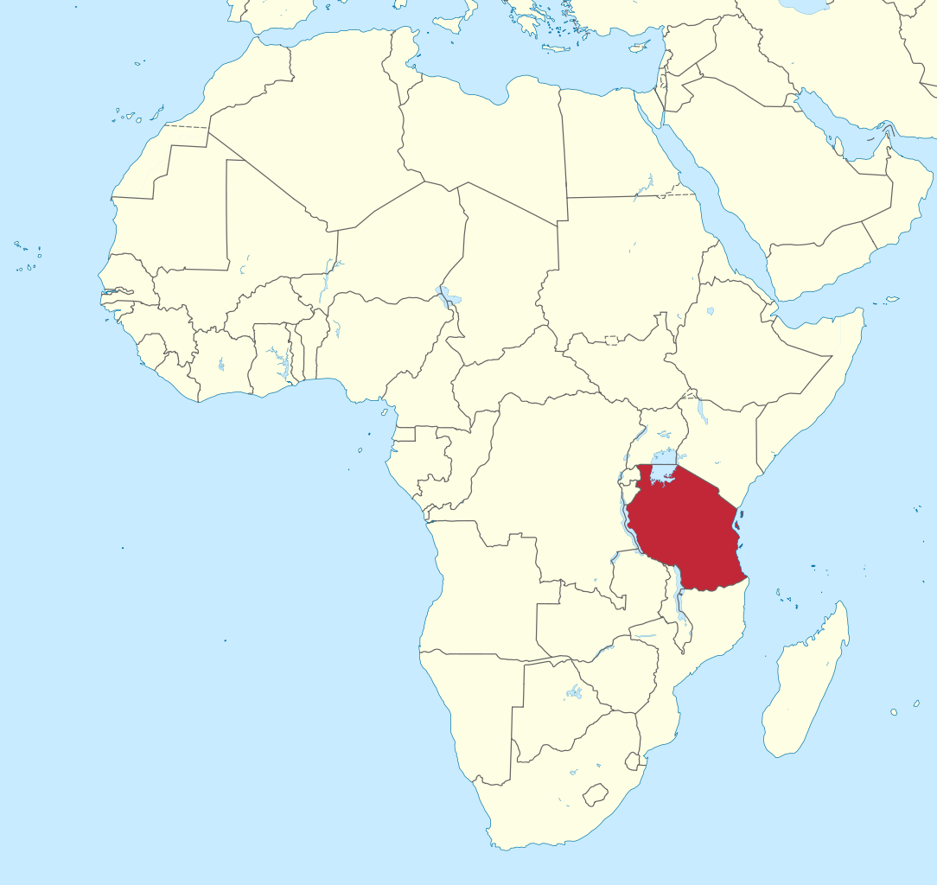
Tanzania
Image: Tanzania in Africa, TUBS, (Wikimedia)

Slide 8
World expert
Gombe Stream
Research Centre
Image from Pixabay

Slide 9
Fill in the gaps
expert Tanzania research centre
chimpanzees tools
Jane Goodall travelled to _____________ to study __________.
She is now the world e__________ and started her own ___________ c________________.
She discovered that Chimpanzees can make their own _____________.

Slide 10
Mark your work
Jane Goodall travelled to Tanzania to study chimpanzees.
She is now the world expert and started her own research centre.
She discovered that Chimpanzees can make their own tools.

Slide 11
Recording behaviour

Slide 12
Ethogram
8:01 - sleeping
8:03 - looking for food
8.15 - drinking water
8.21 - eating fruit
Image from Pixabay.

Slide 13
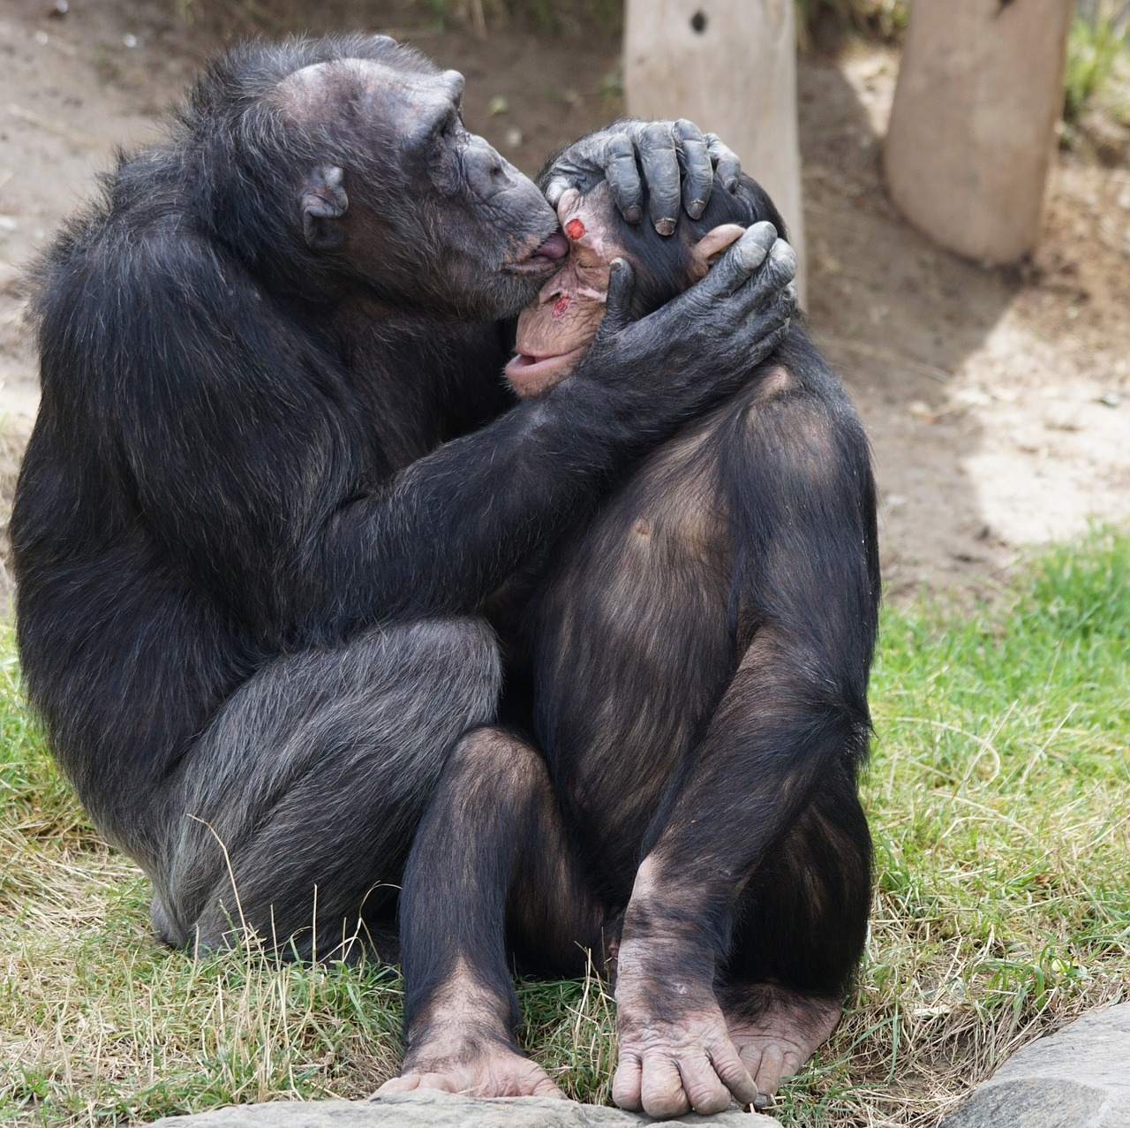
8.05
Example:
8.05 - grooming
8.27 -
8.34 -
8.45 -
8.58 -
Image from Pixabay.

Slide 14
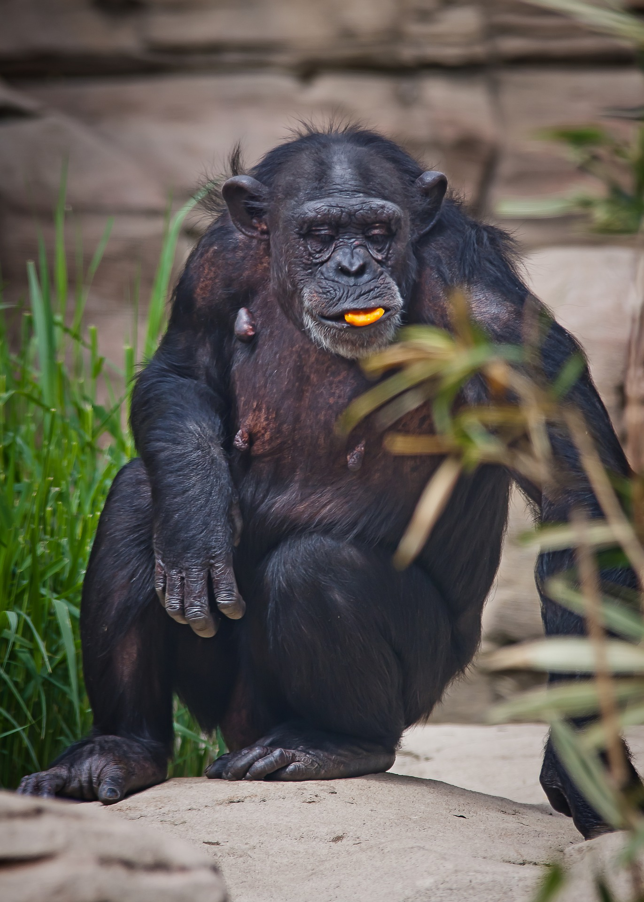
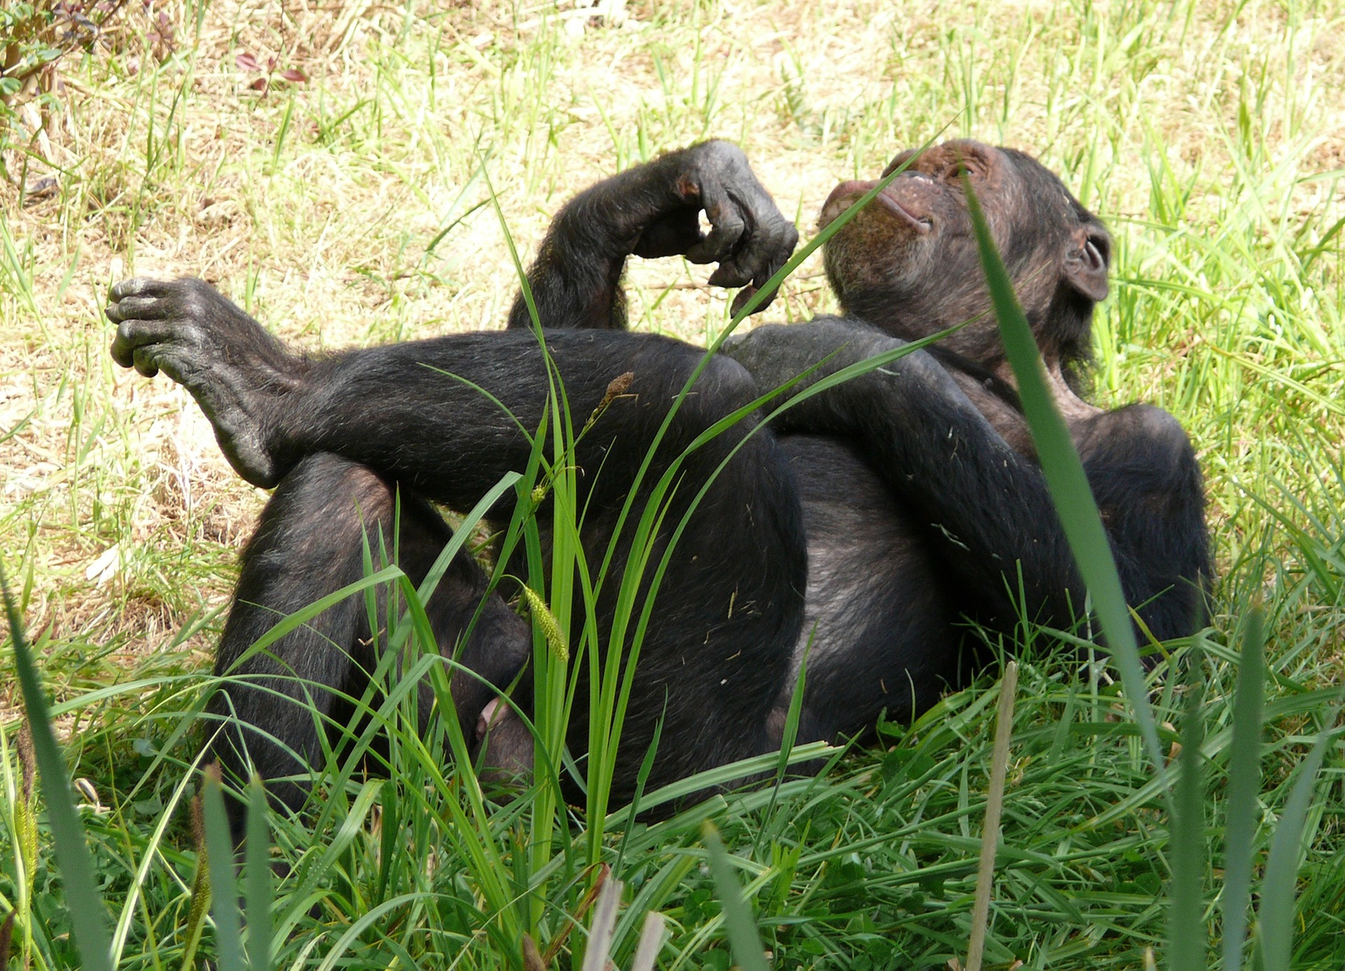
8.27
8.34
Record what the chimpanzees are doing at each time:
Images from Pixabay.

Slide 15
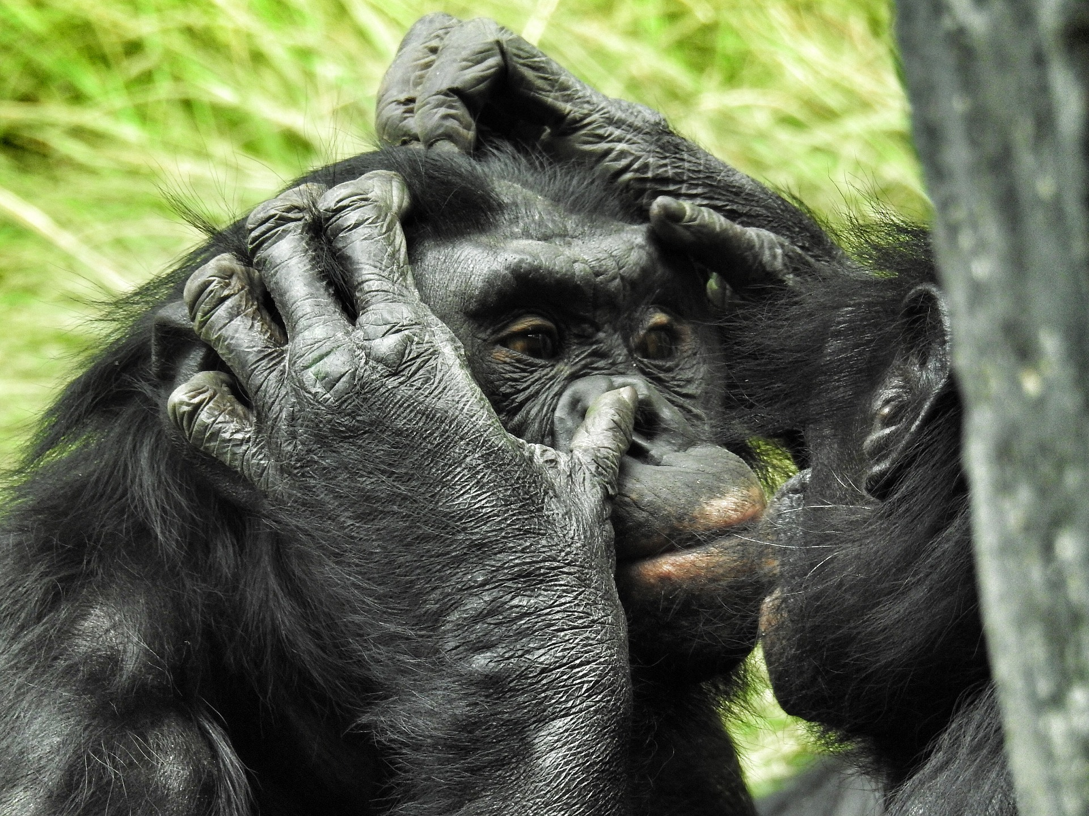
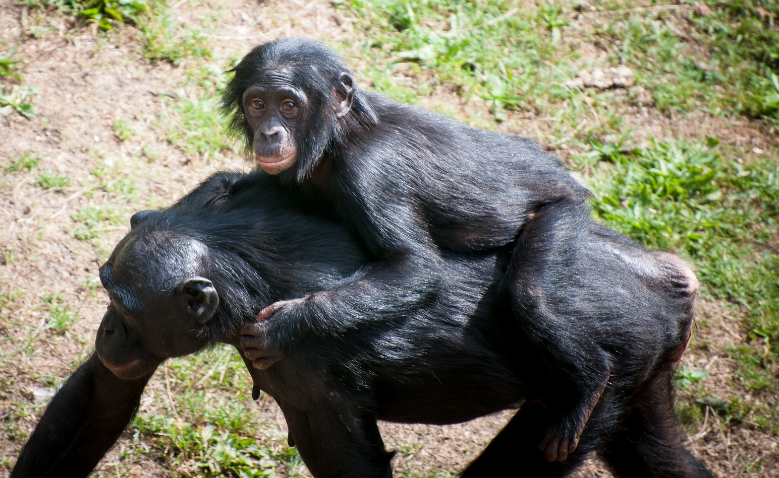
8.45
8.58
Record what the chimpanzees are doing at each time:
Images from Pixabay.

Slide 16
Conservation

Slide 17
Endangered
Hunting for bushmeat
Habitat loss
Image from Pixabay.

Slide 18
Pause the video to complete your task
Draw your own ‘save the chimps’ poster.
Remember to include:
Pictures
Title
Bright colours
Resume once you’re finished

Slide 19
Great job today!

Slide 20
Share your work with Oak National
If you'd like to, please ask your parent or carer to share your work on Instagram, Facebook or Twitter tagging @OakNational and #LearnwithOak
You can also tag @Teach_STEMinism

Slide 21
End of lesson quiz

